Slide 1
Making Scholarly Journals more Reliable Sources of Information for Non-Science Audiences in a Pandemic
By;
Mohammed Aliyu Paiko, PhD
Academic Editor, Hindawi
Paper Presentation @ ACSE Virtual Conference, 21st August 2021

Slide 2
OUTLINE OF DISCUSSION
Introduction
Panic & Drama of COVID-19
Information Sharing;
WHO
National Health Institutions
Social Media Vs. Scholarly Publication
Adjusting Scholarly Publications
Conclusions

Slide 3
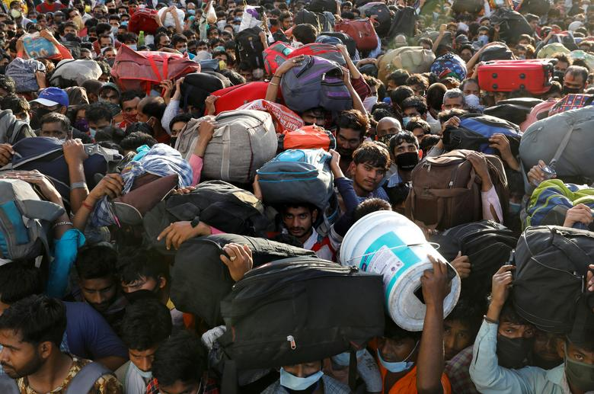
Introduction: Covid-19 PANIC..

Slide 4
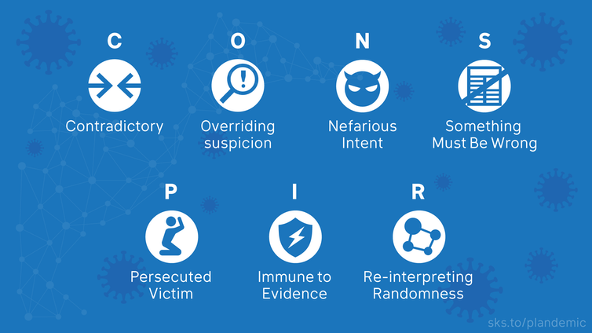
Birthed Conspiratorial Thinking..

Slide 5
To War of MASKS…and how to Wear it.

Slide 6
Then…HUNT for Vaccine(s)?

Slide 7
But Scientific Research went on..

Slide 8
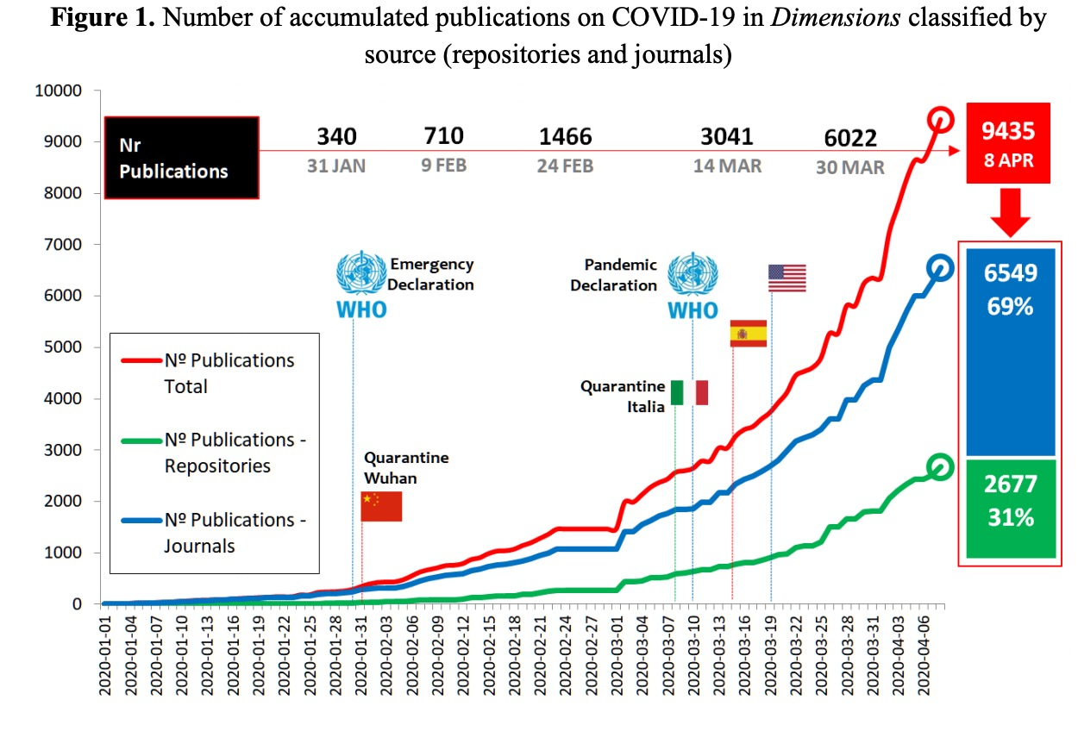
Led to BOOM! of Scientific Research Papers.

Slide 9
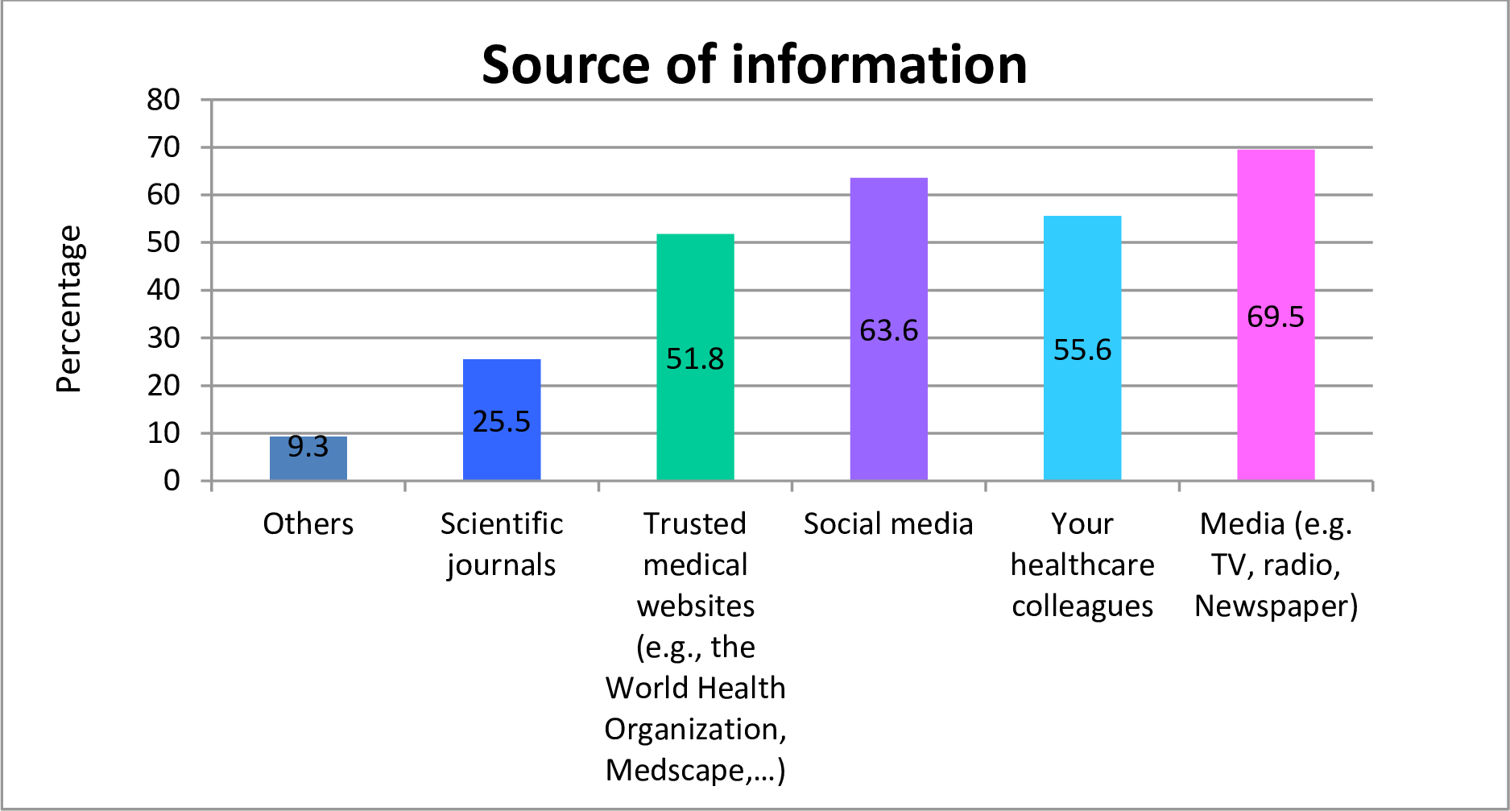
Social media more Reliable by even Medical Personnel

Slide 10
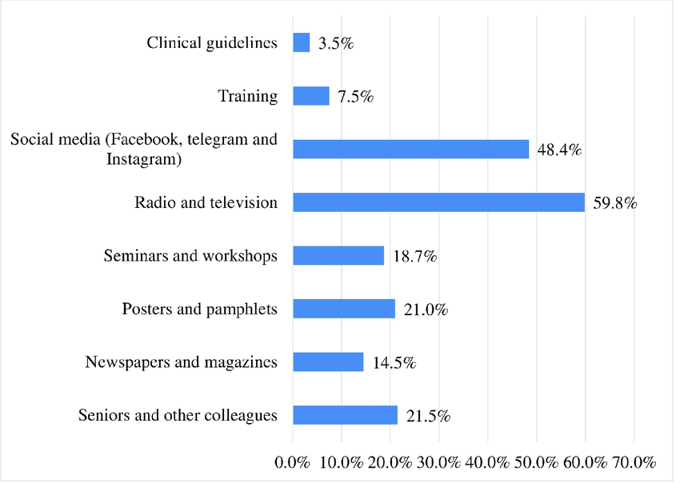
Social media also among the Reliable in Africa

Slide 11
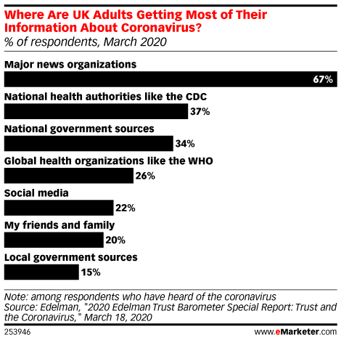
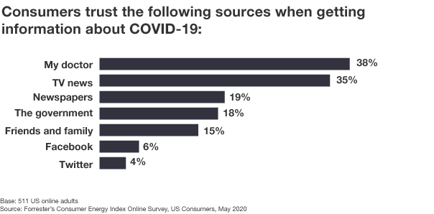
Scholarly Journals NOT among Reliable sources of Info.

Slide 12
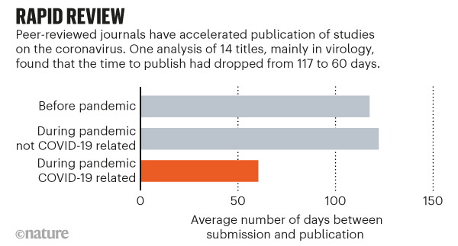
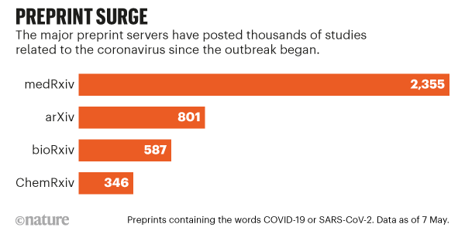
Adoption of PREPRINTS as simple, RAPID strategy …

Slide 13
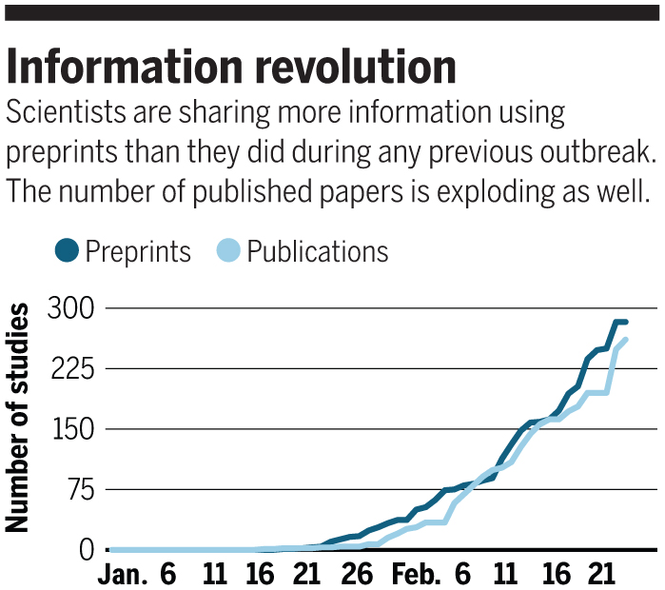
PREPRINTS also increase Publication Rates & become Reliable sources

