Slide 1
Challenges and opportunities for open access publishing in India
Dr. Jani Dilip Batukray
Associate professor
Government engineering college Dahod Gujarat India

Slide 2
Introduction
Open access (OA) publishing is a recent phenomenon in scientific publishing, enabling free access to knowledge worldwide.
In the Indian context, OA to science has been facilitated by government-funded repositories of student and doctoral theses, and many Indian society journals are published with platinum OA.
The proportion of OA publications from India is significant in a global context, and Indian journals are increasingly available on OA repositories such as Pubmed Central, and Directory of Open Access Journals.
OA in India faces numerous challenges, including low-quality or predatory OA journals, and the paucity of funds to afford gold OA publication charges.
There is a need to increase awareness amongst Indian academics regarding publication practices, including OA, and its potential benefits, and utilize this modality of publication whenever feasible, as in publicly-funded research, or when platinum OA is available, while avoiding falling prey to poor quality OA journals.

Slide 3
Role of OA publishing
Journal publication involves submission of manuscripts which are initially checked for suitability, methodological rigour, and integrity by handling editors and forwarded to the external reviewers for commenting.
With the advent and increased reach of the Internet, traditional print journals started providing content online, most switch to online-only model, and numerous start-up e-journals sprung up.
The publishing enterprise requires financial investments which encompass subscription and pay-to-view fees, open access (OA) charges, and supporting organizations' funding for sustainable development.
OA publishing would involve costs, which could be borne by scientists, their funders, or their institutions. Journals proving such OA publishing could exist on their own, or operate on a hybrid model of providing both traditional (with restricted copyrights) and OA publishing (with liberal copyrights).
OA publishing may save financial resources spent on library subscriptions for content of traditionally-published journals.
Content published traditionally may also be permitted to be available in an institutional repository or the author's own website, generally the accepted version of the manuscript (unedited by the typesetter) and with a clear reference to the final published manuscript (green OA).
Green OA content may be subjected to a period of embargo (after final journal publication), following which it may be posted on any online repository such as Research Gate and Academia.edu.
Other types of OA include gold OA, where authors, grant funders, or academic institutions pay the required publication charges, and platinum OA, where journals bear the requisite charges.

Slide 4
Indexing and Archiving Of OA Journals
The Directory of Open Access Journals (DOAJ) and Pub Med Central (PMC) have mechanisms to implement quality control and increase visibility of trustworthy OA content.
Both PMC and DOAJ check editorial policies and technical specifications of applying journals to ensure the users are supplied with quality contents.
Some journals on DOAJ are awarded the DOAJ seal, which is an affirmation from the DOAJ that these journals meet the best technical standards of publishing.
Searches on PMC and DOAJ led us to infer that regionally relevant information published in most Indian society journals is freely available, and the trend is not to charge article processing fees.
Another important finding is that a significantly lesser number of journals published from India were listed in DOAJ when compared to a few years back, which may point to tightened indexing policies of the DOAJ over the last few years.
A limitation of analysis is that some of the journals from other regions are published in India.

Slide 5
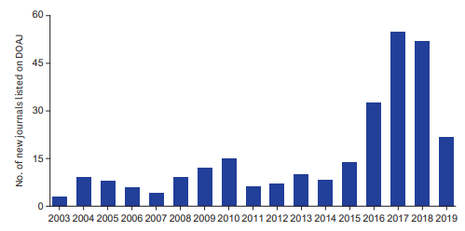
Indexing and Archiving Of OA Journals
Year
. Figure 1. Year of entry into the DOAJ of journals published from India and currently listed on DOAJ

Slide 6
Challenges for academic publication promotion
The University Grants Commission of India (UGC), which is an Indian federal body regulating higher education (not just medical education), has prescribed a list of journals, which is revised annually, from which publications may be considered for use in applications for academic recruitment or promotion. This list includes mostly journals indexed in Scopus, Web of Science, and the Indian Citation Index, which is a collection of more than a thousand journals published in India.
The faculty responsibilities in an Indian medical academic institution involve the daily care of an increasing patient load (in understaffed practice settings without help from healthcare workers), and teaching of students in other educational institutes. Research is sparingly funded. This is why even the best-intentioned researchers may struggle to attain the publication goals set by the UGC.
Future revisions of the promotion guidelines should not increase the publication requirements, for fear of pushing individuals into a race to publish or perish, with little emphasis on the quality. The prevailing situation in certain neighbouring regions, where publications are linked to the income of an academician, should be avoided in an Indian context. Another concern is that inordinate attention is paid to the journal impact factors, rather than the quality of the publication.
Also, the faculty may publish in poor-quality local journals (a majority of which claim to be OA) owing to their unawareness of what constitute quality OA. What is required is an effort to educate undergraduate students the principles of research and ethical science, particularly in the changing world of publishing.

Slide 7
Challenges for academic publication promotion
There has been an increasing awareness of the dangers of publishing in substandard OA journals in Indian academic circles. However, much work remains to be done. A major step in this regard is the aforementioned UGC list of legitimate journals. In addition, there should be a greater awareness of which indexing services are reliable.
A majority professed a lack of willingness to consider journals with publication charges for their papers. A major impediment toward publishing in OA journals was a perceived lack of prestige of such journals which charged fees from authors. In the personal experience of the authors, such negative sentiments regarding OA fees are not uncommon amongst Indian scientists.
Speaking from a regional standpoint, the present-day India is still a developing country. In such a scenario, where government funding for research and research publication is suboptimal, understandably so, due to greater priorities elsewhere, including healthcare and agriculture, it may be stretching too far to ask the government to cover OA publication charges for all such published work.
Indian scientists who choose an academic career often do so at the cost of lucrative jobs in the private sector, where the pay is much higher. In the real life, Indian scientists have to struggle for access to research services which may be considered routine in other parts of the globe, such as plagiarism checks and access to Scopus, Web of Science, and subscription-based aggregators of information.
Therefore, it is highly unlikely that Indian scientists or their institutions will be able to afford OA publication fees in the majority of instances. These considerations strengthen the viewpoint that there is a little relevance in the current Indian scenario.

Slide 8
Challenges for academic publication promotion
Authors have limited familiarity with the concept of OA publishing and surrounding issues and OA policies have little impact on author’s decision for submitting papers. There is a misconception that it will be difficult to assess the impact of research if it isn’t published in conventional journals. Some unawareness also lies in the fact that the attitude of the journals is changing and renowned journals also permit the authors to archive both preprints and post prints.
Intellectual property issues continue to dominate the OA landscape. As a result many archives are either in the development stage or on the intranets pending clarification of IPR issues.
There are copyright violations concerns. Fears to be stolen of the preliminary research ideas might prevent author submissions and there exists the perception that research in smaller institutions may plagiarize the work of the premier institutions.
Barriers to the widespread implementation of IR at universities include a lack of leadership and poor infrastructure. Many universities and research institutions in India lack both computers and high bandwidth Internet connectivity.
At present there is not much support for adopting a national approach to e-prints archives in India and distributed repositories are being favored.
Lack of expertise and training issues in organizations for the promotion, installation and maintenance of repositories.

Slide 9
Opportunities for academic publication promotion
Traditional Indian journals, which recently switched to online publishing, have digitized their old issues, occasionally by manually scanning print papers.
The Indian scientific community has made significant efforts toward OA not only through journals, but also through institutional repositories at major scientific hubs such as the Indian Institute of Science.
Also, OA repositories for theses, such as the Shodhganga initiative, are admirable government-funded efforts to promote the worldwide accessibility of Indian research.
Despite the efforts to develop such repositories, literature suggests that their utilisation remains sub-optimal.
A survey of researchers from India revealed that the major reason for the underutilization of such institutional repositories were concerns regarding plagiarism and copyright of articles submitted to such repositories.
This suggests that there is still an unmet need to sensitize stakeholders about unethical scientific practices.

Slide 10
Opportunities for academic publication promotion
There exist myriad opportunities to provide OA to research in India, at an affordable cost. Opening institutional repositories should be encouraged, and their uptake promoted to the faculty. This would enable at least full and free access to research from the locality.
Since a previous paper identified the fear of inappropriate copyright and plagiarism issues as a major impediment for authors to submit their work to institutional repositories, this reiterates the need to further inculcate the principles of scientific writing and ethical publishing in students right from an early age.
Formally evaluated courses in these subjects may be made compulsory for all under- and postgraduate students. Further efforts should be made to teach students and faculty regarding publishing models.
These would serve the dual purpose of making them aware about the dangers of predatory journals, as well as to dispel their myths about genuine OA publishing.
Journal editors should follow updated editorial strategies to eliminate content of dubious scientific merit from their journals. Their overall efforts to improve scientific and technical standards may raise awareness of authors about proper scientific writing.

Slide 11
Opportunities for academic publication promotion
All scholarly contributors should be encouraged to utilize Open Researcher and Contributor IDs to raise transparency and integrity of OA publications.
Overall, the principles espoused in two recent notable documents on the integrity of scholarly publishing (the OA Scholarly Publishers Association principles and the declaration should be followed rigorously by the editors of all OA journals.
Specifically, there should be transparency from journals as to their editorial practices, their publication processes, copyright, article processing charges, addresses of editorial offices, policies for dealing with potential misconduct, sources of journal revenue, and advertisement policies. Information regarding such issues should be clearly visible on the websites of such OA journals.
It may also be considered good practice to endorse such declarations publicly on the journal websites, after implementing them. Revision of promotion criteria to incorporate an actual quality assessment of the published work by the assessor, rather than relying on bibliometric indicators, such as the impact factor, will also improve the overall standards of publishing.
In future, there should be unlimited research funding and institutional support for funding OA publication charges for all Indian authors. However, the reality in India is quite distant from this, and efforts should instead focus on increasing the awareness of scientists about quality OA, with utilization of this model in an ethical manner whenever feasible.

Slide 12
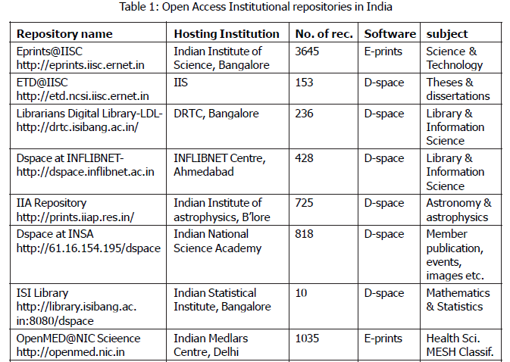
Opportunities for academic publication promotion

Slide 13
Conclusion
We should not only focus just on the technological changes which are necessary to allow academic publishing to flourish into the future, but on the social, intellectual, technological innovation and institutional changes that are necessary to pave the way for such flourishing. In order for new modes of communication to become broadly accepted within the industry, academy, scholars and their institutions must take a new look at the mission of the university, the goals of scholarly publishing and the processes through which scholars conduct their work. Collectively consideration about new technologies have to offer not us, not just in terms of the cost of publishing or access to publications, but in the ways we research, the ways we write and the ways we review. Open access to scientific journals is beneficial to scholars and has wide support as a concept but it needs viable revenue models and great commitment among its promoters. Therefore the emphasis should be primarily on setting up open archives rather than on persuading journal publishers to make their journals open access. While we realize the importance and value of expanding OA to scholarly research, it is equally important to address the many questions that are being raised about the prospects of OA. Its principal strength will continue to derive from technology that enables accessing and sharing distributed resources by the community of researchers. Though the OA concept is still debated and there is no consensus within the scientific community or a proven model, indeed, the benefits of open access to results of research cannot be denied.

Slide 14
References
Nazim M, Zia S. Acceptance and adoption of open access publishing by researchers in India. Glob Knowl Mem Commun 2019;68(1-2):148-58.
Gasparyan AY, Nurmashev B, Voronov AA, Gerasimov AN, Koroleva AM, Kitas GD. The pressure to publish more and the scope of predatory publishing activities. J Korean Med Sci 2016;31(12):1874-8.
Ghosh K, Ghosh K. Medical research in medical college in India: current scenario and ways to improve it. J Assoc Physicians India 2019;67:71-3.
Satyanarayana K. Open access publication in biomedical research: implications for developing countries. Indian J Med Res 2004;120(2):67-9.
Seethapathy GS, Santhosh Kumar JU, Hareesha AS. India's scientific publication in predatory journals: need for regulating quality of Indian science and education. Curr Sci 2016;111(11):1759-64.
Ghosh SB, Kumar Das A. Open access and institutional repositories — a developing country perspective: a case study of India. IFLA J 2007;33(3):229-50.
Shukla P, Khan AM. Implications of institutional repositories on contributors' professional and publishing practices: a survey. Int Inf Libr Rev 2014;46(3-4):125-36.
Singh HP. Knowledge and attitude of health researchers from India towards paying to publish and open access journals. Indian Pediatr 2015;52(3):252-3.
Gasparyan AY, Yessirkepov M, Voronov AA, Koroleva AM, Kitas GD. Updated editorial guidance for quality and reliability of research output. J Korean Med Sci 2018;33(35):e247.
Habibzadeh F. Open access journals in the Middle East and Iran. J Korean Med Sci 2019;34(16):e123.
Smith R. Peer review: a flawed process at the heart of science and journals. J R Soc Med 2006;99(4):178-82.

Slide 15
Thank you

