Slide 1
Scholarly Publishing in the Pandemic Era and the Emergence of Artificial Intelligence-Assisted Tools
Habeeb Ibrahim Abdul Razack
1 Faculty of Medicine & Health Sciences, Universiti Putra Malaysia, Serdang, Selangor, Malaysia
2 Department of Cardiac Sciences, College of Medicine, King Saud University, Riyadh, Saudi Arabia

Slide 2
Increasing Trend in Research Outputs
6,331,484
5,731,845
5,316,588
4,967,869
4,561,794
4,345,407
Source: https://app.dimensions.ai/discover/publication

Slide 3
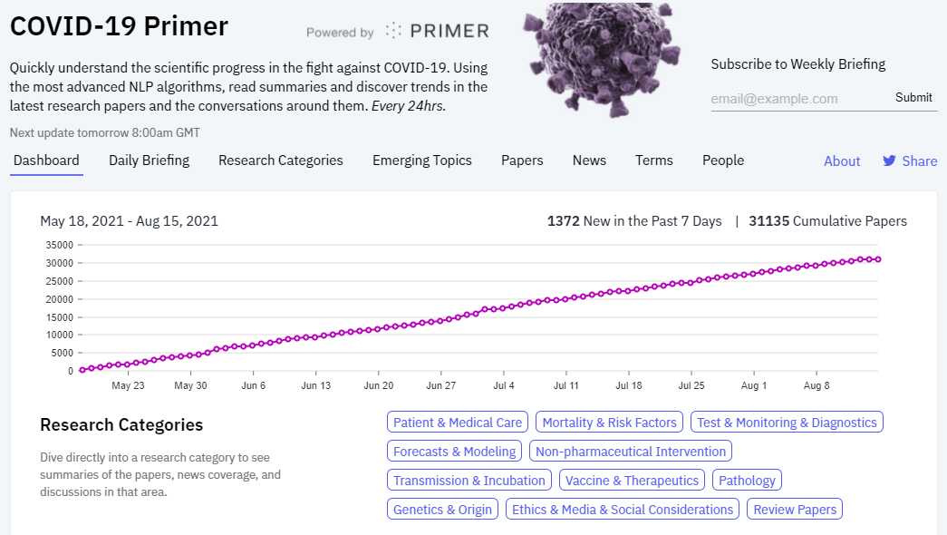
Surge in Pandemic-related Publications
Source: https://covid19primer.com/dashboard

Slide 4
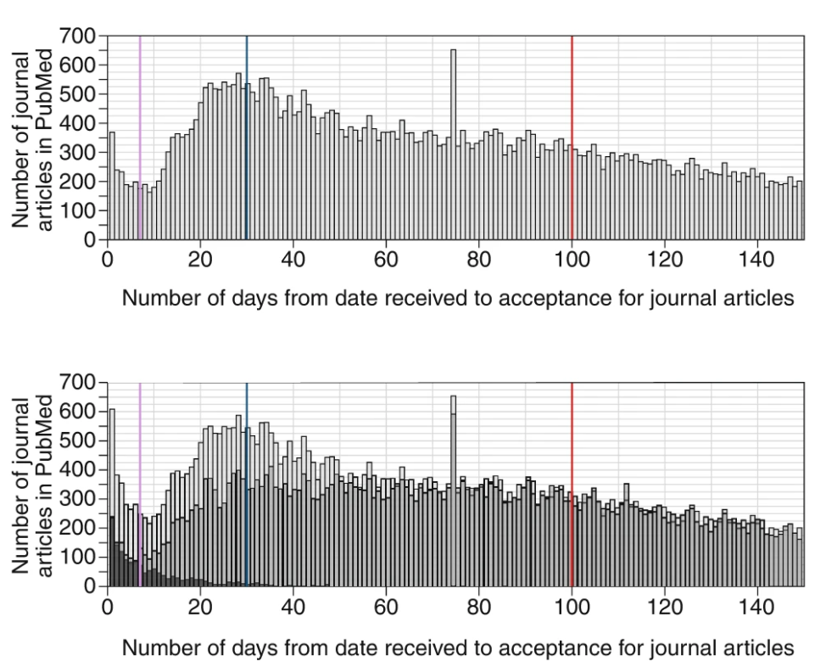
Accelerated Peer Review Process
Palayew A, Norgaard O, Safreed-Harmon K, Anderson TH, Rasmussen LN, Lazarus JV. Pandemic publishing poses a new COVID-19 challenge. Nat Hum Behav; 2020;4:666–669. DOI: https://doi.org/10.1038/s41562-020-0911-0

Slide 5
Role of Artificial Intelligence (AI) in Scholarly Publishing
AI is becoming a noticeable sensation also in scholarly and academic publishing.
AI-based algorithms may help redefine the role of science communication experts in the years to come.
There are various AI-based product choices for scholarly publishing.
State of AI 2020 Report: COVID-19 pandemic has not prevented high-performing organizations from investing in AI.

Slide 6
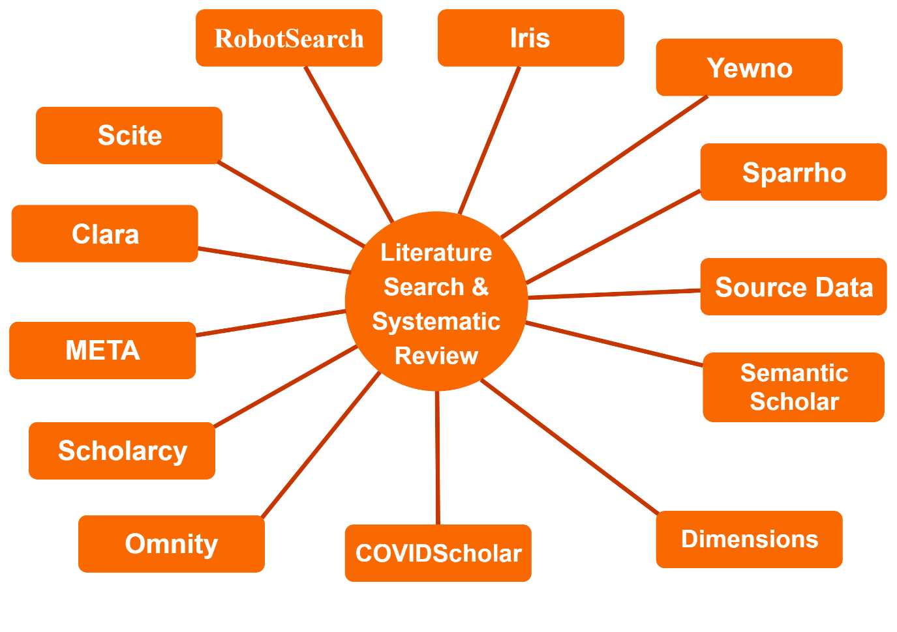
Literature Review

Slide 7
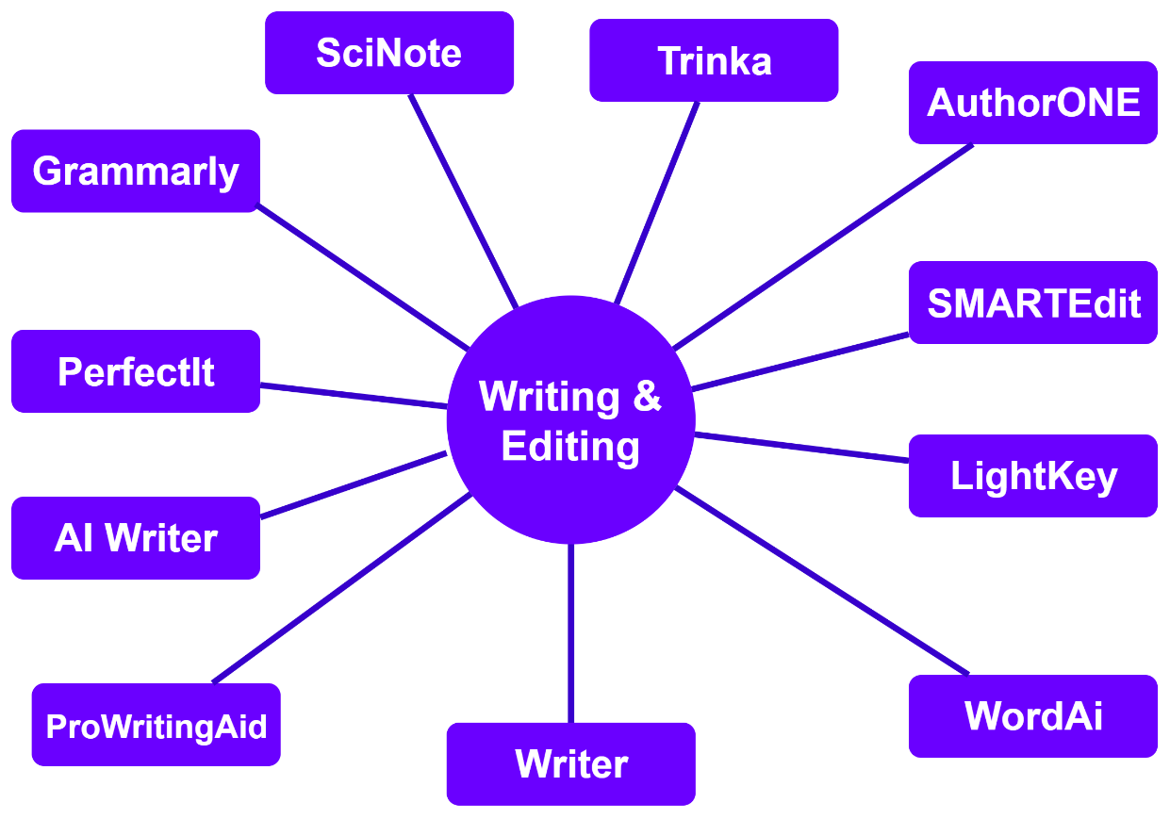
Manuscript Preparation

Slide 8
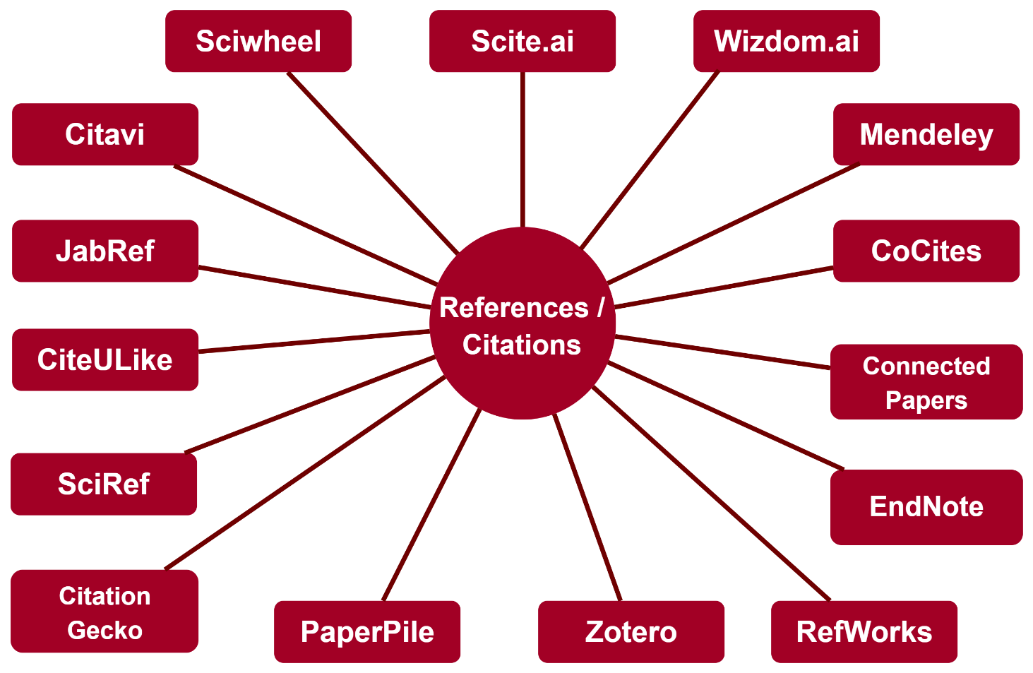
Reference Management

Slide 9
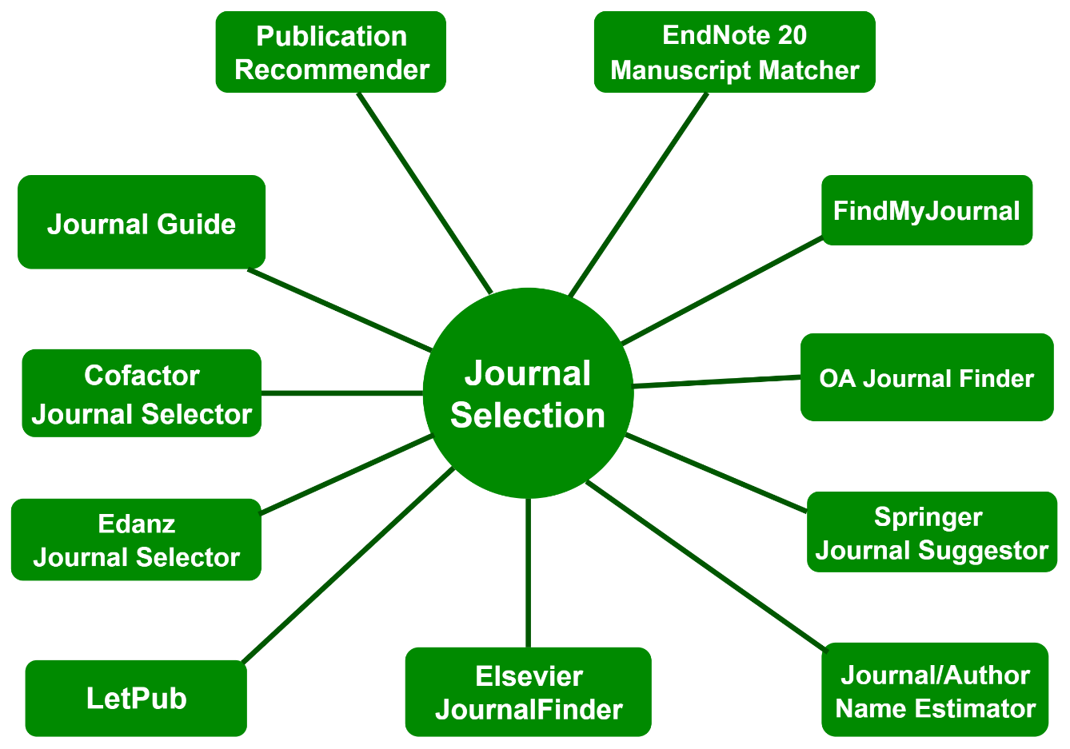
Target Journal Selection

Slide 10
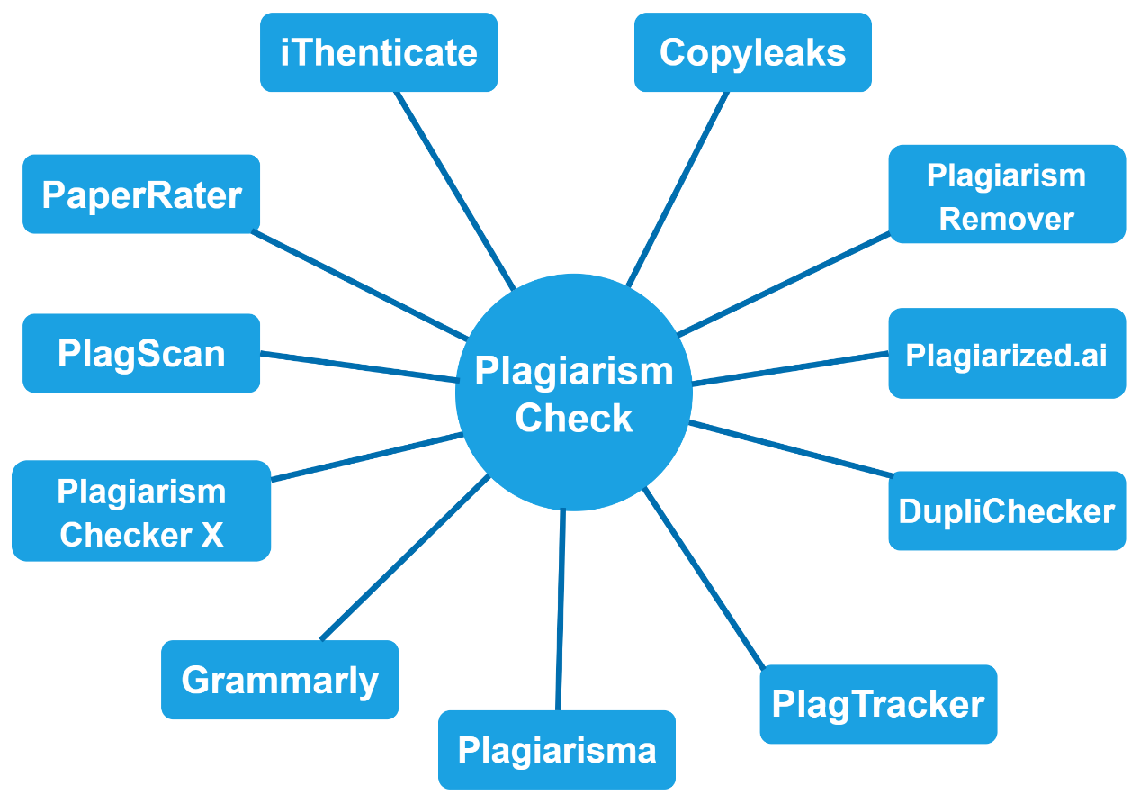
Plagiarism Detection

Slide 11
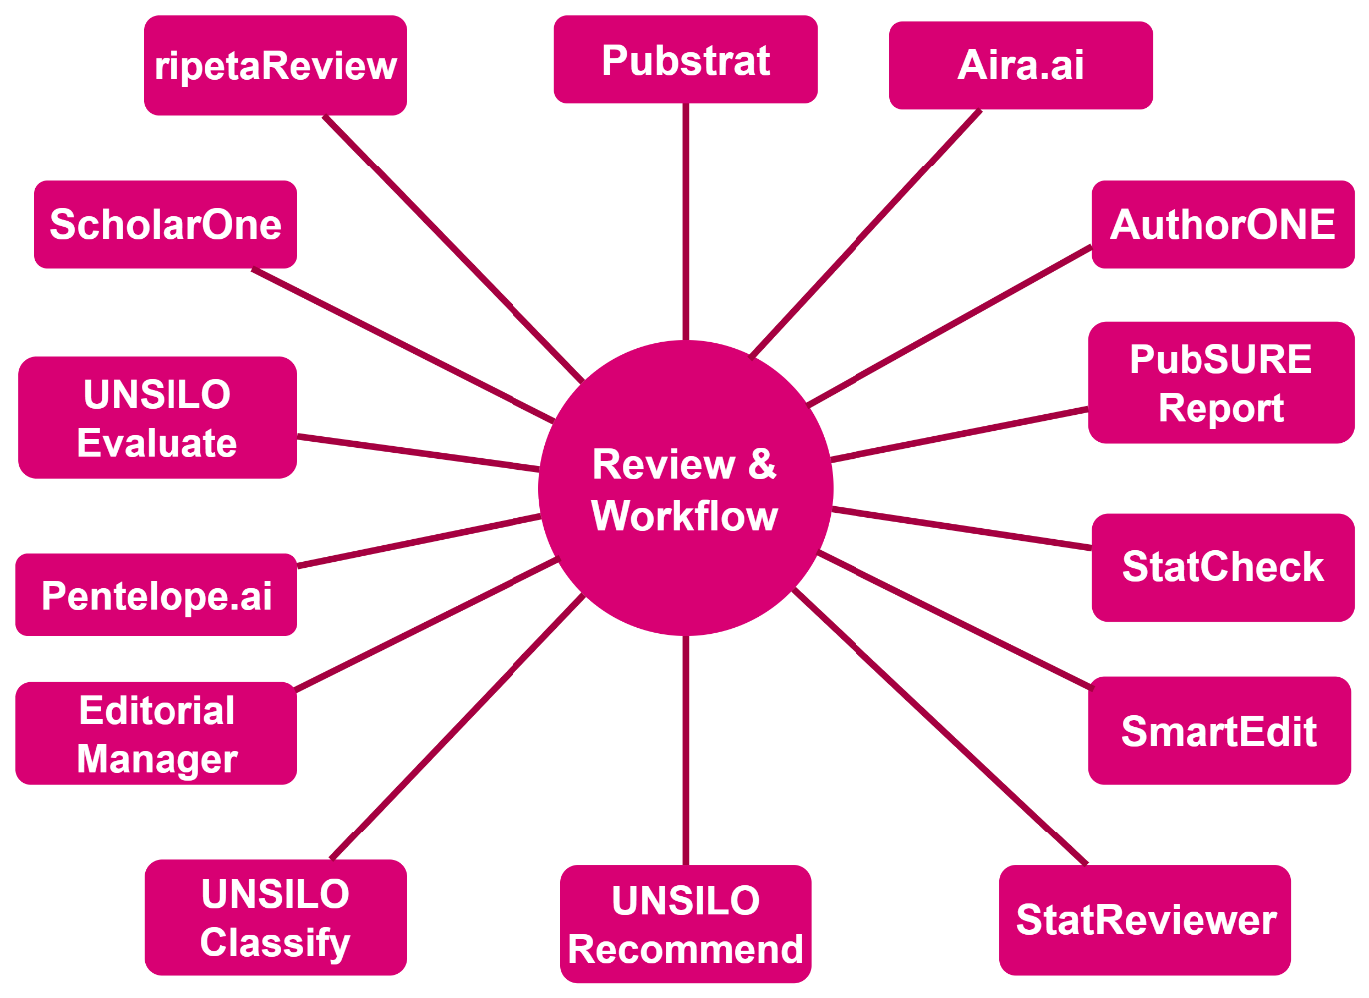
Peer Review

Slide 12
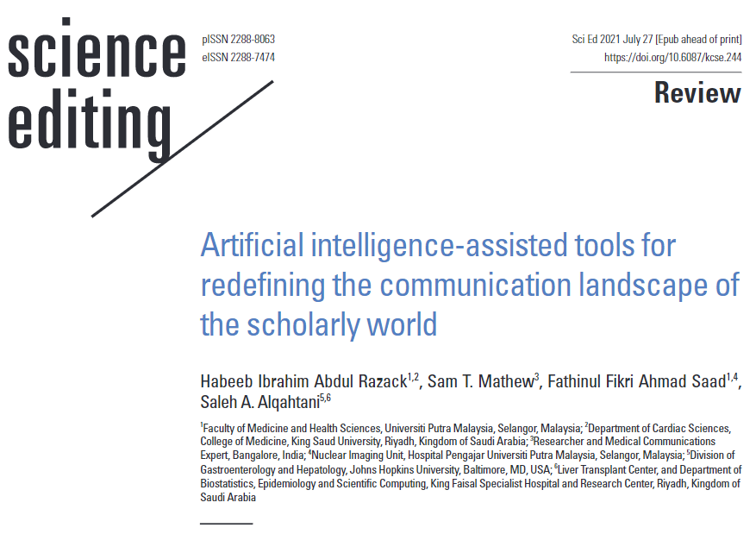
For more insights…
https://doi.org/10.6087/kcse.244

