Slide 1
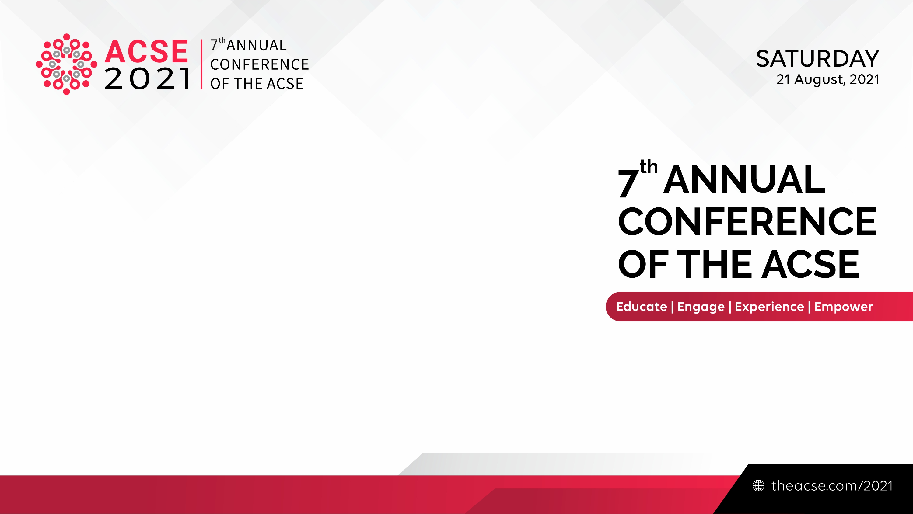

Sustainable Academic Goals: Reducing Dependencies to Commercial Publishing
Dasapta Erwin Irawan
Faculty of Earth Sciences and Technology,
Institut Teknologi Bandung, Indonesia

Slide 2
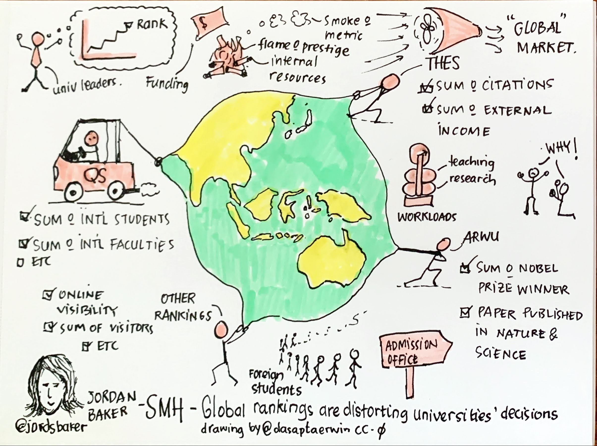
Global Rankings are Distorting Universities’ Decisions
We’re moving away from the substantial components to administrative components.
Promoting journal’s brand aside to focusing on to share the contents.
Link to original article
Link to image (CC0)

Slide 3
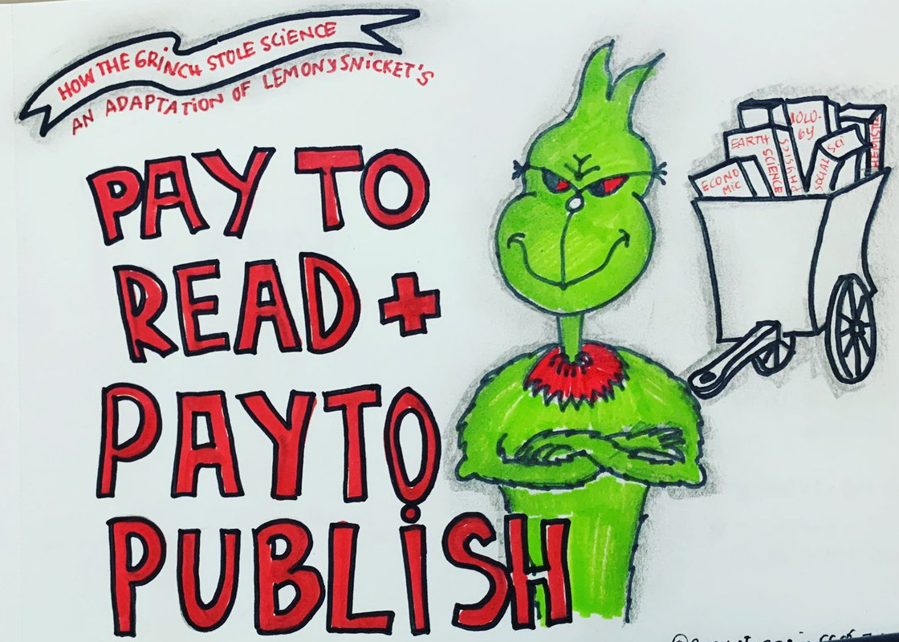
This has been used by the markets to put OA as a commodity:
Shift the payment from readers to authors
DR. SEUSS’
They limit our options to publish non OA or OA with very expensive price.
Link to image (CC0)

Slide 4
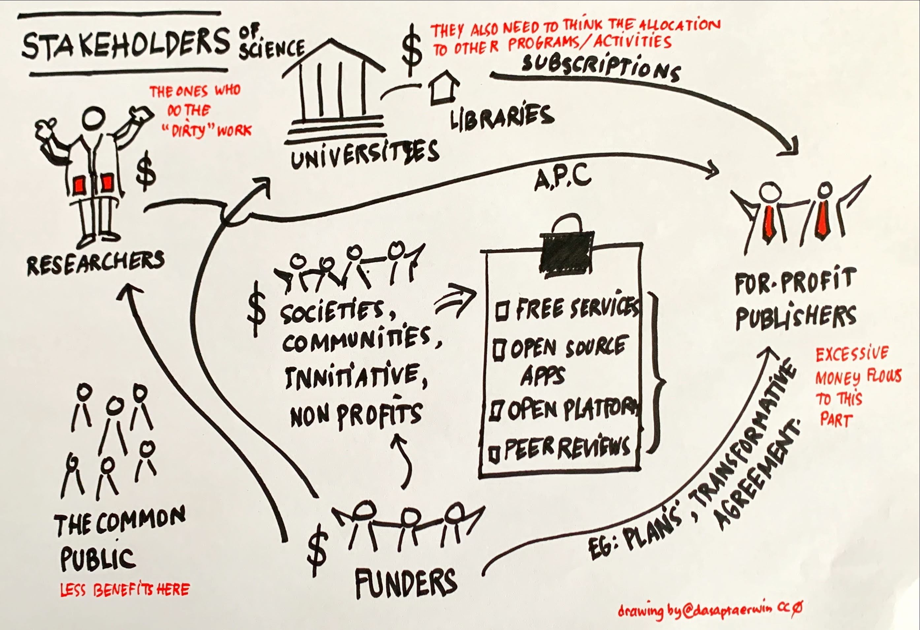
More money flows out from the real stakeholders to the commercial publishers.
Less benefits received by the real stakeholders.
Link to image (CC0)

Slide 5
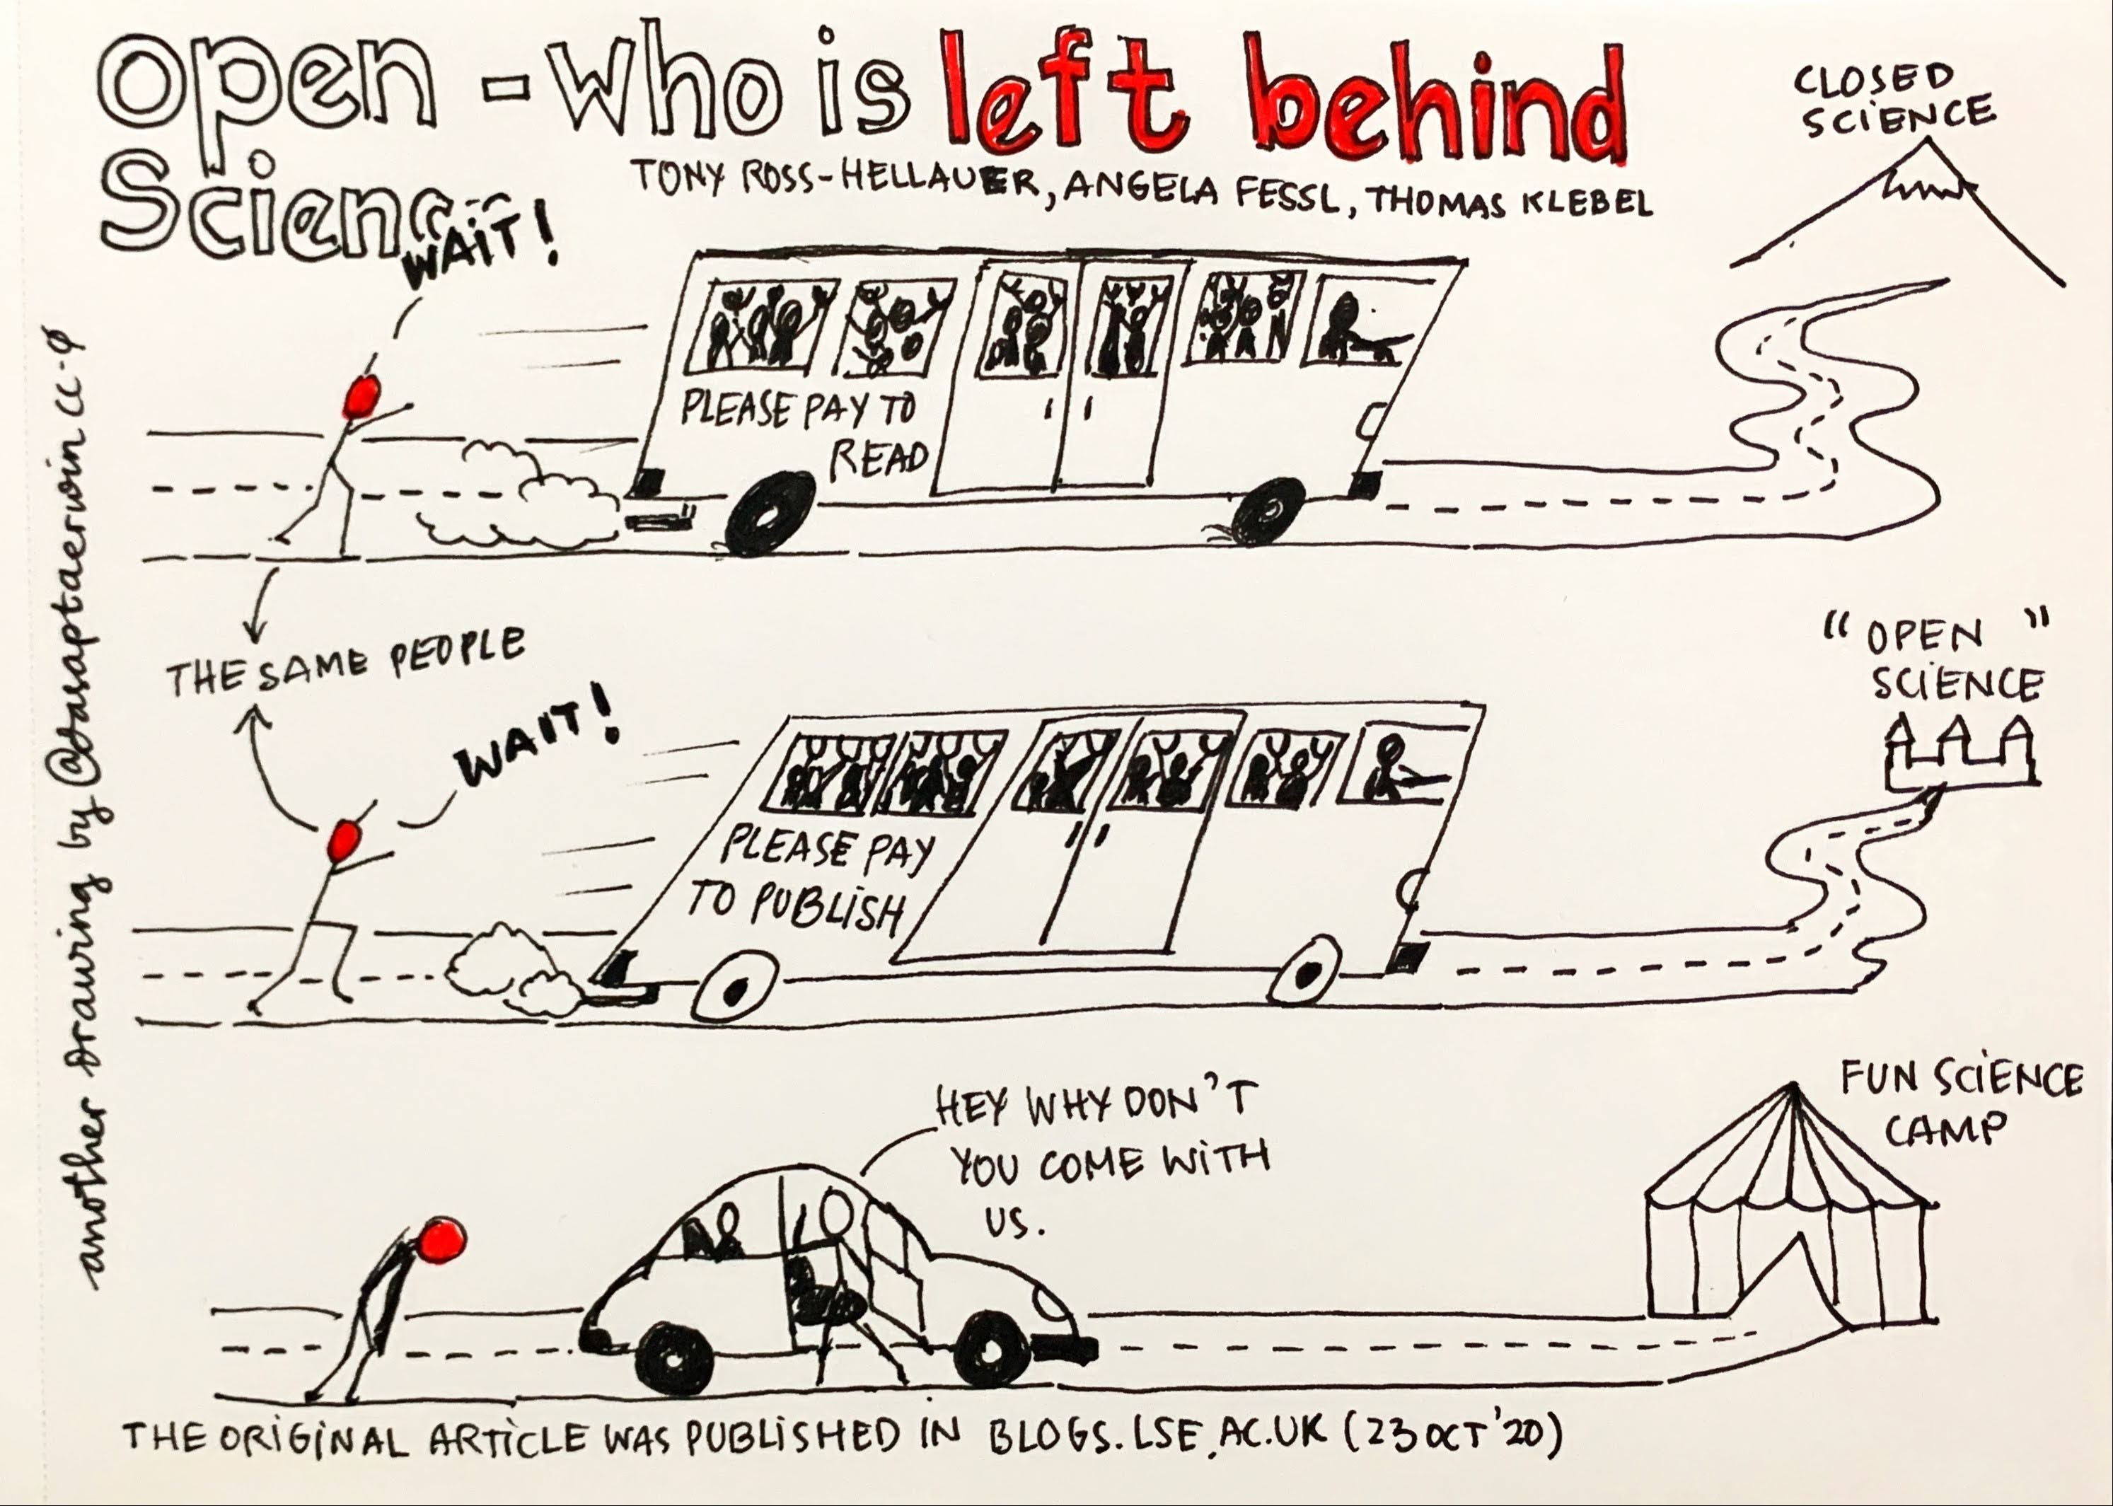
Open Science – Who is Left Behind
Link to original article
Link to image (CC0)

Slide 6
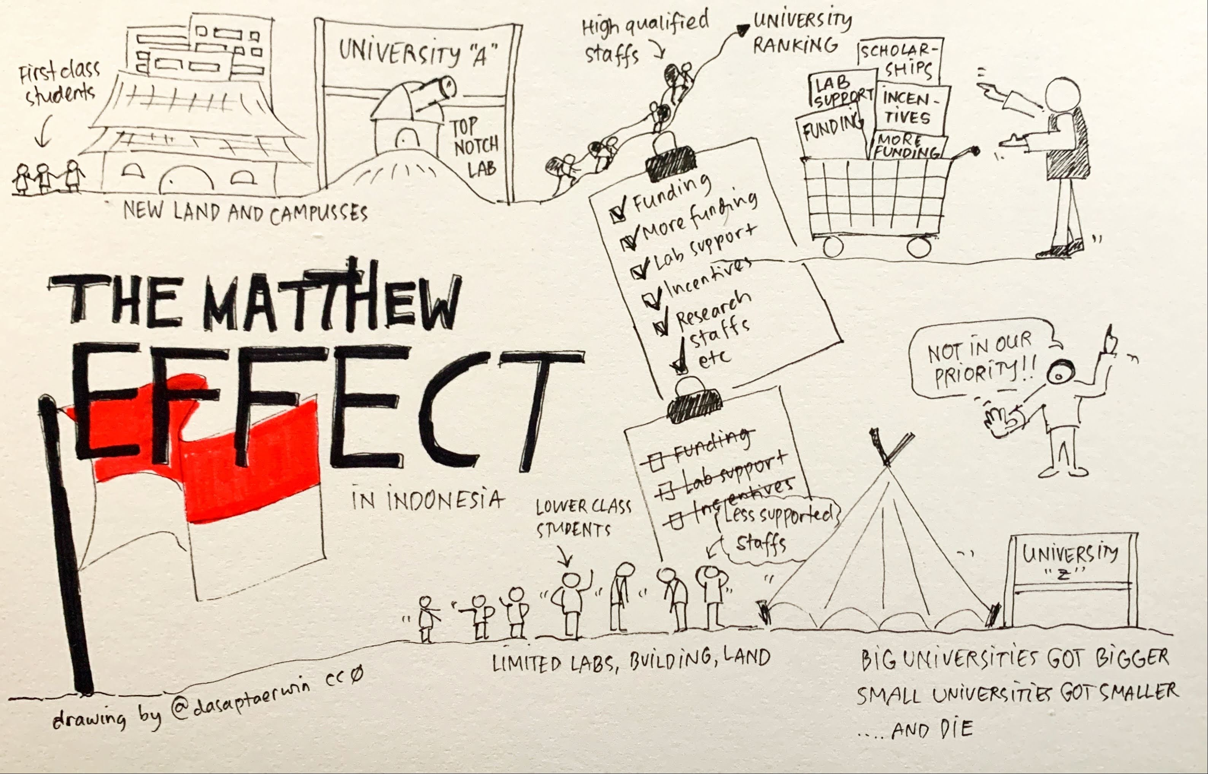
The Matthew Effects in Science
Big universities/institutions would only get bigger and small ones would only get smaller and eventually die
Link to image (CC0)

Slide 7
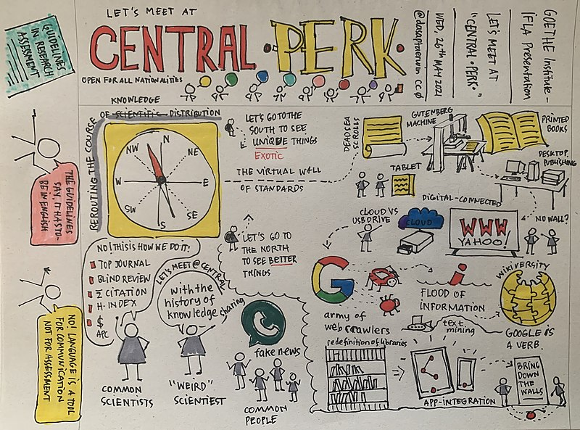
Proposed solution: In this Digitally Connected World, Let’s Meet at the Central
Language barrier should not always mean to use English, but also for researchers to learn national language.
Translation software have been extensively developed.
Avoid to rely to journal’s brand.
Link to image (CC0)

Slide 8



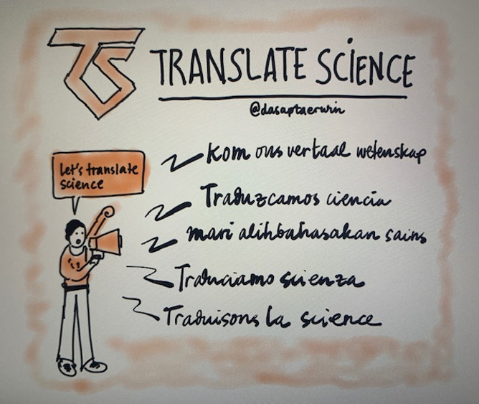
Proposed solution: Work with community led innitiatives
Community of peer reviewers,
Societies,
Consider non-commercial publishers,
Provide translations (to EN vice versa),
Science communication
Work with preprint servers
Link to image (CC0)

