Slide 1
Pandemic Preparedness: Scholarly Communications and Countermeasures
Zabta Khan Shinwari Prof. Emeritus, Quaid-i-Azam University, Islamabad

Slide 2
Pandemic preparedness and importance of science literacy
With a surge in the number of daily cases, the health system is under immense pressure. Oxygen consumption has reached 90% of its production, and people are desperately looking for alternatives.
Viral videos: how to “increase blood oxygen levels” by directly taking steam through a pipe connected to one of the outlets of a pressure cooker. While steam might help alleviate chest congestion in Covid-19 patients, other risk-free alternatives are available. Another such viral video presents the use of a nebuliser to improve oxygen levels.
Social media has been a source of information during the pandemic. However, the dearth of science-based guidance has created a void where misleading information proliferates. Acceptance of disinformation by the public can result in a cascade of adverse events such as people drinking alcohol as a cure for Covid, that claimed hundreds of lives.
Walk-through disinfecting gates and fumigation of streets lack scientific basis.
US president had suggested injecting disinfectants or irradiating UV light as treatment. Many leaders believed that it is just a flu! His ignorance of science-based recommendations resulted in the spread of Covid-19, killing millions of people.
We need to prepare for the next pandemic of misinformation by promoting science literacy from early childhood. Scientific literacy can help people believe in pressing global challenges such as drug resistance, climate change, pandemics. Also, national policies supporting science literacy throughout the life span are required. Besides teaching basic science concepts, scientific thinking, and the scientific method, the philosophy of science must also be introduced. So that the public could differentiate science from pseudoscience, bad science, and misinformation.
May 10, 2021 https://tribune.com.pk/story/2299129/covid-19-highlights-the-importance-of-science-literacy

Slide 3
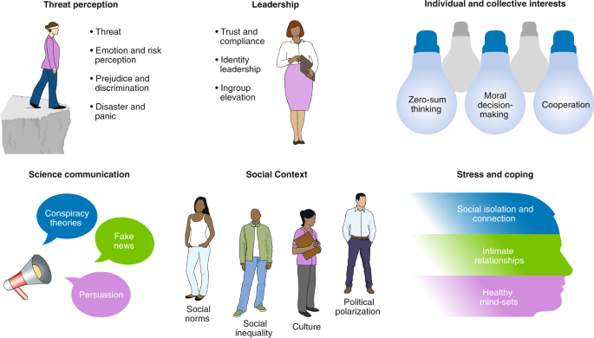
Biology will play ‘a key role in the response to future crises
Translating science into policy has been challenging in the COVID-19 era. It is now critical to "expand biology expertise in government from the silos it is currently in to much more prominent policymaking roles
Government capacity to respond to biological threats, pandemics, or otherwise, is that the community of biology experts who have access to the policy process is small compared to the scope of the issues they deal with.
— much of which is dual-use and can be used to help people as much as to hurt them — is a festival of potentially mis-usable items. As a result, they miss the untapped potential for biological research to produce defensive, rather than offensive, uses.
We've long paid lip service to the importance of biology in the security community.

Slide 4
Pseudoscience and COVID-19 — we’ve had enough already
Cow urine, bleach and cocaine have all been recommended as COVID-19 cures — all guff. The pandemic has been cast as a leaked bioweapon, a byproduct of 5G wireless technology and a political hoax — all poppycock. And countless wellness gurus and alternative-medicine practitioners have pushed unproven potions, pills and practices as ways to ‘boost’ the immune system.
WHO has called it, the “infodemic” — Regulators have taken aggressive steps to hold marketers of unproven therapies to account. All scientists — not just a few of us — must stand up for quality information.
Here are two places to start.
First, we must stop tolerating and legitimizing health pseudoscience, especially at universities and health-care institutions. Many bogus COVID-19 therapies have been embraced by integrative health centres at leading universities and hospitals.
Second, more researchers should become active participants in the public fight against misinformation. We need physicists, microbiologists, immunologists, gastroenterologists and all scientists from relevant disciplines to provide simple and shareable content explaining why this hijacking of real research is inaccurate and scientifically dishonest. Good science and public trust are perhaps the most valuable tools in the fight against misinformation.
27 APRIL 2020
https://www.nature.com/articles/d41586-020-01266-z

Slide 5
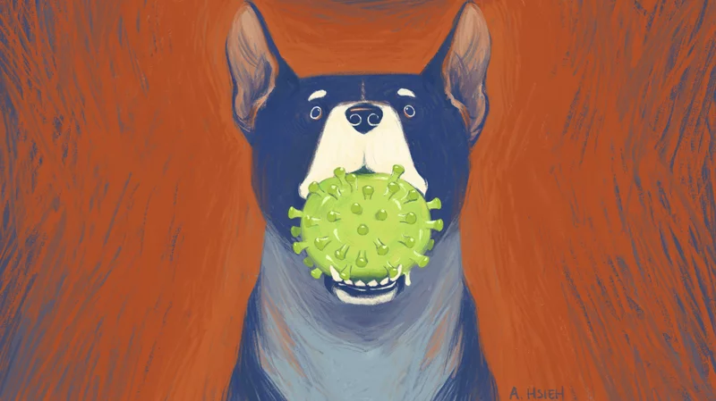
New Coronavirus Detected In Patients At Malaysian Hospital; The Source May Be Dogs
In 2002, SARS-CoV jumped from civets into people. Ten years later, MERS emerged from camels. Then in 2019, SARS-CoV-2 began to spread around the world. Maybe from a bat coronavirus (88 percent sequence homology) and through genetic exchange with another coronavirus in a co-infected intermediate host such as a pangolin (an ant-eating mammal), to human.
Evidence of an entirely new coronavirus associated with pneumonia in hospitalized patients — mostly in kids. This virus may be the eighth coronavirus known to cause disease in people, the team reports Thursday in the journal Clinical Infectious Diseases. The patients' upper respiratory tracts were infected with a new canine coronavirus, i.e., a dog virus. "Canine coronaviruses were not thought to be transmitted to people. It's never been reported before.“
"There's no evidence yet of transmission from human to human," But it's not known how these patients became infected with the virus or whether they had direct contact with infected animals.
https://www.npr.org/sections/goatsandsoda/2021/05/20/996515792/a-newly-identified-coronavirus-is-making-people-sick-and-it-s-coming-from-dogs?utm_source=Nature+Briefing&utm_campaign=b68a41bc5f-briefing-dy-20210520&utm_medium=email&utm_term=0_c9dfd39373-b68a41bc5f-45895602 May 20, 2021

Slide 6
Ethical responsibilities of science as it deals with this grave global threat.
5 June 2020 Statement Int Sci Council
Health and social policies should be guided by the best possible scientific evidence.
Misinformation can have dire consequences, from promoting panic or denialism to the use of unproven and possibly dangerous therapies. The scientific community has the responsibility to be vigilant in the face of such anti-scientific acts, to make publicly known their lack of validity, and to advocate strongly for scientific values and the scientific method.
The rapid development of new technologies and procedures, integrated with big data, is changing the way in which we conduct science. The serious threat posed by the pandemic should not be used as an excuse to ignore these basic ethical principles.
COVID-19 highlights the fact that the vulnerable in society are generally the worst affected in a public health crisis. Scientists should recognize that there are always asymmetries between more and less vulnerable groups as they select patients for study, suggest therapies and policies, and much more.
Good science is absolutely essential to an effective response to the COVID-19 pandemic and other global threats. For it to be truly effective, scientists must have the right to scientific freedom but also pursue their research in an ethical and socially responsible manner.

Slide 7
A dialogue space for “The role of science and science funders in the time of the COVID-19 crisis”
Identifying critical COVID-related knowledge gaps and fostering potential collaboration and synergies;
Understanding the impacts of the COVID-19 pandemic on science funders;
Discussing potential longer-term implications of the pandemic for global science systems; and
Exploring ways of enabling science to respond more effectively to future similar threats.

Slide 8
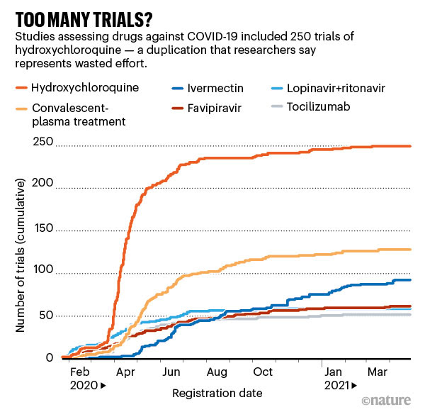
May 14,2021
None of 4 Antiviral drugs (remdesivir, interferon, the malaria drug hydroxychloroquine, and a combination of HIV drugs called lopinavir and ritonavir) used with COVID-19 in 30 countries saved lives or shortened hospital stays.
As viral infections progress, the body’s own immune responses can cause harm, damaging healthy tissue in the quest to kill infected cells. In June 2020, a large UK-based study called RECOVERY found that the immune-suppressing steroid dexamethasone reduced deaths among those on ventilators or receiving supplemental oxygen owing to coronavirus infection.

Slide 9
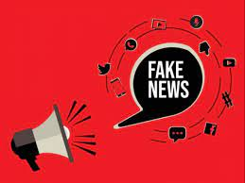
Disinformation and Epidemics: Biowarfare in 2020
Anti-vaccination Movement:
The resurgence and normalization of anti-vaccination debates has been mirrored in the resurgence of measles cases, which jumped globally by 30% since 2016, causing WHO to declare the anti-vaccination movement as a top-10 threat to global health in 2018.
Similar disinformation campaigns are beginning to be identified and reported in the context of the current COVID-19 pandemic.
IN Pakistan we are experiencing similar threat about polio vaccination
Effect of Social Media Misinformation and Disinformation
The perpetuation and persistence of transmission
Mistrust in government responses, preventing people from seeking treatment
Stigmatization of those infected, leading to violence or people not seeking treatment
Exacerbation of existing political sentiment, including antigovernment or antiforeigner sentiment
The Delegitimization of Science
In a context of delegitimization of expertise by social media accounts and a sustained assault on science by populist politicians, disinformation campaigns are likely already disrupting global efforts to fight the epidemic by eroding confidence in the public health response. Media framing is often impacted by ideological leaning and bias of previous coverage, which can misconstrue or deconstruct scientific evidence.
Health Security 19(1) : 2020 DOI: 10.1089/hs.2020.0038

Slide 10
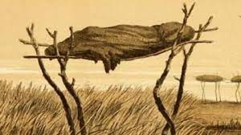
Global problems need social science
We cannot improve global health if we take only a narrow medical view. Epidemics are social as well as biological phenomena. West African Ebola epidemic with proposals to substitute risky burial rituals with safer ones, rather than trying to eliminate such rituals altogether.
Treatments for mental health have made insufficient progress. Advances will depend, in part, on a better understanding of how social context influences whether treatment succeeds. Similar arguments apply to the problem of food habits/obesity; antimicrobial resistance and antibiotic overuse.
Environmental issues are not just technical challenges that can be solved with a new invention. To tackle climate change we will need insight from psychology and sociology. Scientific and technological innovations are necessary, but enabling them to make an impact requires an understanding of how people adapt and change their behavior. That will probably require new narratives — the purview of rhetoric, literature, philosophy and even theology.
Poverty and inequality call even more obviously for expertise beyond science and maths.
‘Vaccine hesitancy’ is more a social phenomenon than a technical one
Between Faith and Fear
15 JANUARY 2020 Nature.com

Slide 11
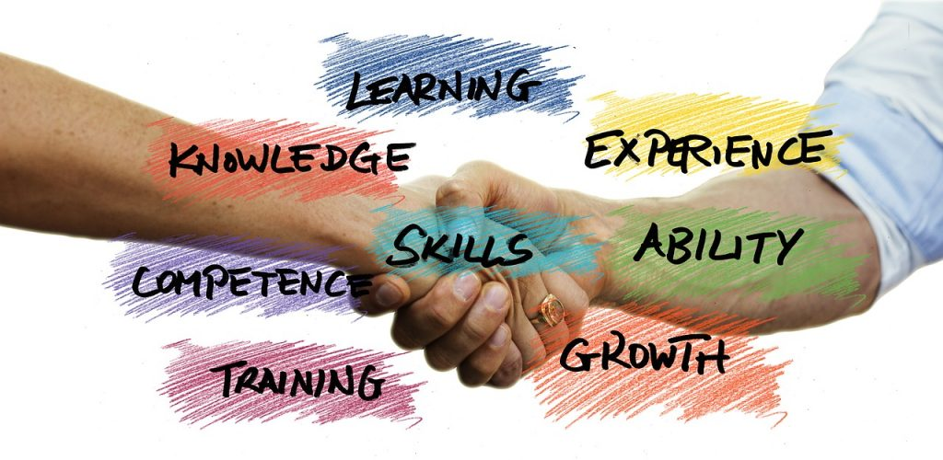
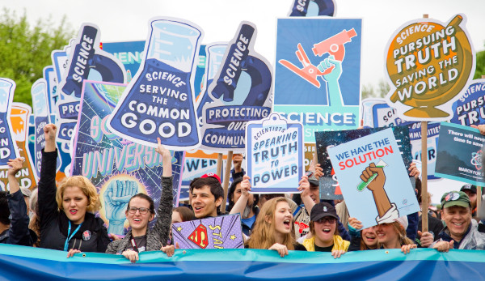
Science with and for Society: Inclusive Society and Sustainable Development
Policy suggestions to the government
Objectives:
engage society more broadly in its research and innovation activities,
increase access to scientific results,
ensure gender equality, in both the research process and research content,
take into account the ethical dimension, and
promote formal and informal science education.
https://ec.europa.eu/programmes/horizon2020/en/h2020-section/science-and-society

Slide 12
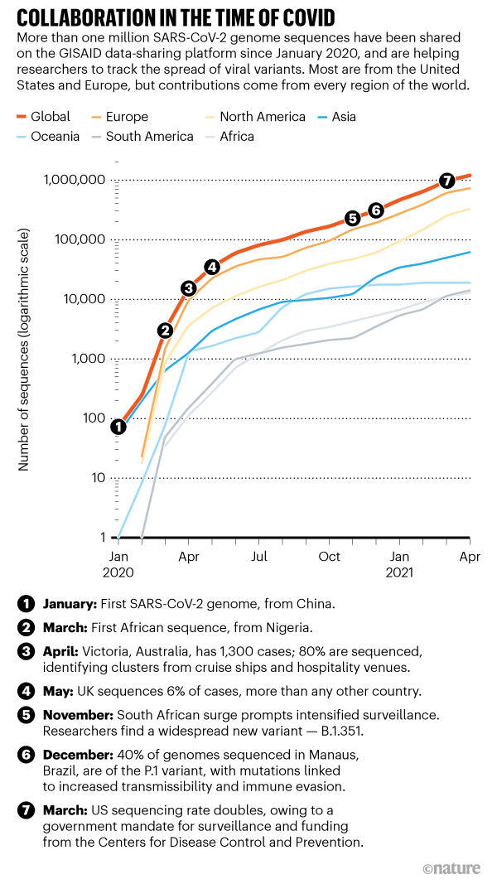
Nature23 APRIL 2021

Slide 13
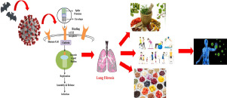
The effect of an herbal syrup formulation in patients with COVID-19: Results of a randomized triple-blinded placebo-controlled clinical trial
Trachyspermum copticum (Ajwain) has been administered in the management of different ailments including epidemic febrile conditions, cough, respiratory distress, fatigue and loss of appetite in traditional medicine.
Zizyphus jujube (Jujube) are used for fever, cough and asthma. This trial aimed to evaluate the safety and efficacy of Tiban syrup (combination of Ajwain and Jujube) in patients with confirmed COVID-19.
All patients were enrolled and randomly assigned to receive either placebo or Tiban syrup 5 cc, three times a day for 14 days, in addition to standard medications of COVID-19. A total of 50 patients completed the study.
There is a significant reduction in dyspnea and severity of fatigue score after taking medication (p=0.001). Patient’s appetite significantly increased in Tiban group (p=0.001).
According to the findings, oral consumption of Tiban syrup could be a promising opportunity to reduce dyspnea and fatigue severity and also increased appetite in COVID-19 patients.
Complementary Therapies in Clinical Practice 2020

Slide 14
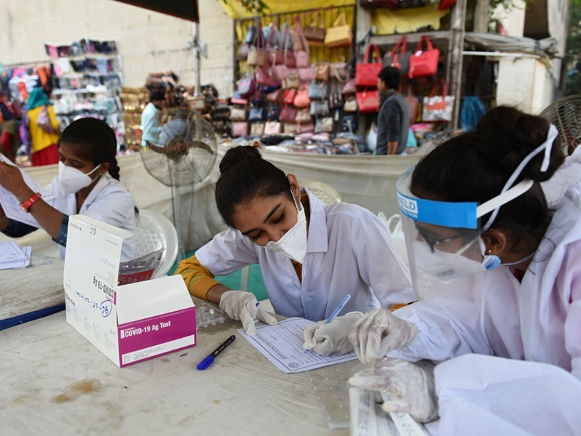
Scientists criticize use of unproven COVID drugs in India
Researchers say it is unclear on what basis the drugs were approved for ‘emergency use’.
The Drugs Controller General of India (DCGI) has approved several repurposed drugs for ‘restricted emergency use’ for treating the disease, the first time it has used such powers. Yet scientists say it’s unclear on what basis the drugs were approved, and critics argue that the manufacturers’ data on their effectiveness is unconvincing so far.
One of the drugs approved for COVID-19 in India is itolizumab, which is used to treat the autoimmune condition psoriasis. In India, at least 15 pharmaceutical companies are selling the drug, and sales have reached 2.8 billion rupees (US$37.6 million) since June
The influenza drug favipiravir was approved for treating mild to moderate cases in June; remdesivir, a broad-spectrum anti-viral drug, was also authorized in June; and itolizumab was approved for treating moderate to severe acute respiratory distress in people with COVID-19 in July 2020.
The US Food and Drug Administration (FDA) has granted emergency-use authorizations (EUAs) for three putative COVID-19 drugs: infusions of antibody-rich plasma from people who have recovered from the disease; the malaria drug hydroxychloroquine; and remdesivir, which has since been granted full approval for use in adults. “It leads to a kind of an emotional blackmail on the family,”
some researchers criticized the lack of information on the hydroxychloroquine authorization. The FDA later revoked the hydroxychloroquine authorization, after clinical trials showed the drug did not work for COVID-19 and had serious side effects.
Unconvincing data
Emergency approvals are typically granted on the basis of preliminary evidence that a drug works. But scientists say there is little evidence so far that favipiravir and itolizumab can treat COVID-19 successfully.
NATURE: 09 NOVEMBER 2020

Slide 15
Fiction, Quarantine and the Pandemics
COVID-19: Psychological burdens, Pandemic to Infodemic
People must rely on authentic data, the news spread through social media platforms often masks the original news/statistics. Team of social media experts linked to the official sources can be helpful in diffusing correct information across the social media platforms
Countering counterfeit medical products
Counterfeit medical products deny patients proper medical treatment and are harmful to their health. The COVID-19 pandemic has dramatically exacerbated this phenomenon.
Misuse of information from azithromycin, oseltamivir; hydroxychloroquine; Remdesivir; Dexamethasone, Vitamin D (BAME Com.) led to black marketing, and counterfeit drugs
For herbal drug from Artemisia annua (Madagascar); Licoryce (China); Cassia angustifolia-Sanna Makki (Pakistan); ashwagandha, guduchi, mulethi; Basil (tulsi) leaves, cinnamon bark, sunthi (Zingiber officinale) and krishna marich (Piper nigrum) (India)”

Slide 16
Good practice in science, think global but act local
International codes of conduct are important, but grass-roots efforts are the key to embedding research integrity.
When it comes to research integrity, scientists use the language of aspiration, whereas policymakers talk about hard rules and enforcement.
Integrity is not confined to preventing data fabrication, falsification and plagiarism, it encompasses quality and relevance, as well as recognition of diversity and inclusion.
The World Science Forum, 2019 declaration, “harmonisation and enforcement of standards of conduct of scientific research across borders and across public and private research”. The declaration also supported processes by which scientists “can report suspected research misconduct and other irresponsible research practices, without fear of reprisal”
Other examples: Singapore Statement on Research Integrity; the All European Academies Code of Conduct for Research Integrity, the 1964 Declaration of Helsinki, of human participants in medical research.
Networks for integrity in the global south e.g. the African Research Integrity Network, (2017), and the Asia Pacific Research Integrity Network (2015).
Nature EDITORIAL 576, 181: 11 DECEMBER 2019

Slide 17
Five principles for scientists on social media
First, see and be seen: communication is two-way, so listen, too.
Second, select and specialize: focus on those things that suit you; there’s only so much you can do.
Third, serve: think about where you can add most value.
Fourth, socialize: don’t forget about relationships just because they’re digital.
Fifth, strategize: make social media part of your overall communication strategy, even if it’s just emerging.
Nature 593, 37 (2021) 14 APRIL 2021

Slide 18
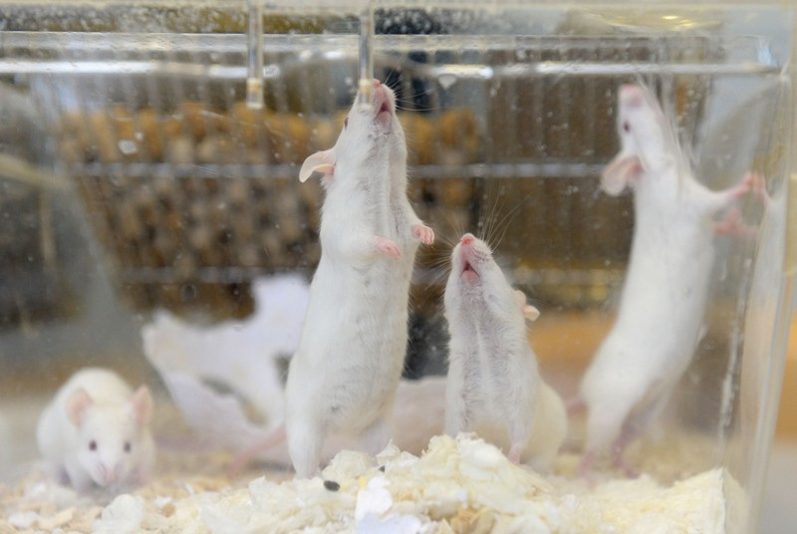
‘Pregnant’ male rat study kindles bioethical debate in China
Researchers question the value of the experiment — which involved sewing together male and female rats and led to the birth of live young.
it offers few insights into the possibility of pregnancy in people assigned male at birth.
pregnancy in people of any sex who wish to bear children.
reckless biological experimentation could blemish the China’s reputation.
2018, a Chinese researcher announced the creation of the first genome-edited babies, which was widely criticized as highly unethical.
Pregnancy in males is extremely rare in nature, and is observed only in a group of fish that includes seahorses and pipefishes. To study the possibility of achieving it in mammals, the Chinese researchers sewed the elbows, knees and skins of pairs of rats together, each consisting of a castrated male and a female, to join their blood supply. This conjoined model, known as a parabiont, allows the animals to share blood. from an elderly mouse to a youthful one to study the process of ageing.
Six weeks after the castration and surgery, testosterone levels in the male rats had significantly declined — but their levels of oestrogen and progesterone mirrored those in the female rats.
Eight weeks after surgery, the researchers transplanted a uterus into each male rat, followed by embryos into both the male and female after another eight weeks. Three weeks into the embryos’ development, and near the end of a normal rat pregnancy, the researchers delivered the pups by caesarean section.
Some groups are already considering the possibility of uterine transplants in transgender women,
09 July 2021 Nature

Slide 19
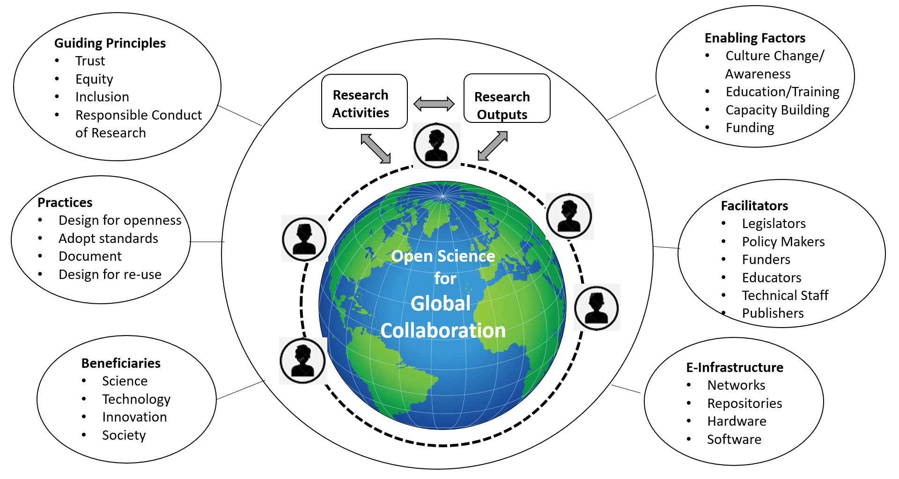

Slide 20
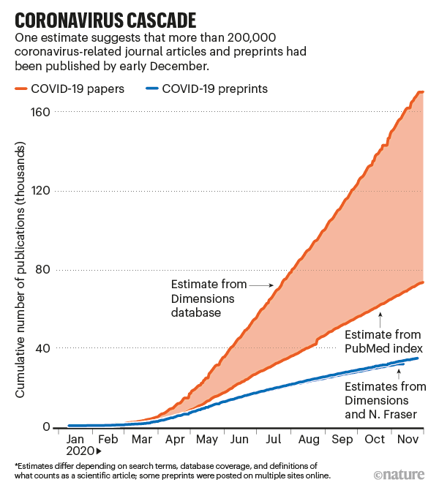
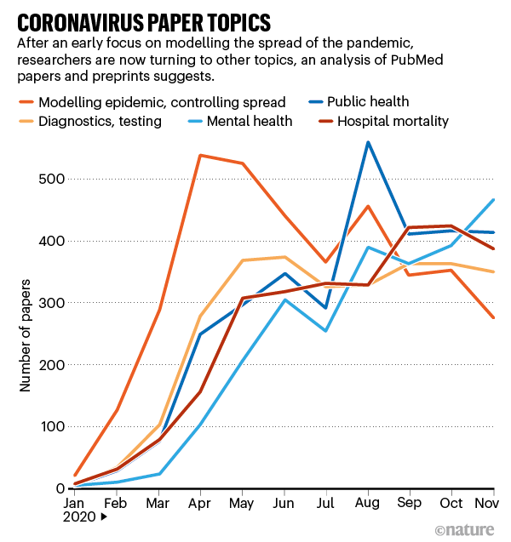
https://www.nature.com/articles/d41586-020-03564-y?WT.ec_id=NATURE 20201224&utm_source=nature_etoc&utm_medium=email&utm_campaign=20201224&sap-outbound-id=DBC51B6FAD2C09554C41D184BCAEBCF393093278

Slide 21
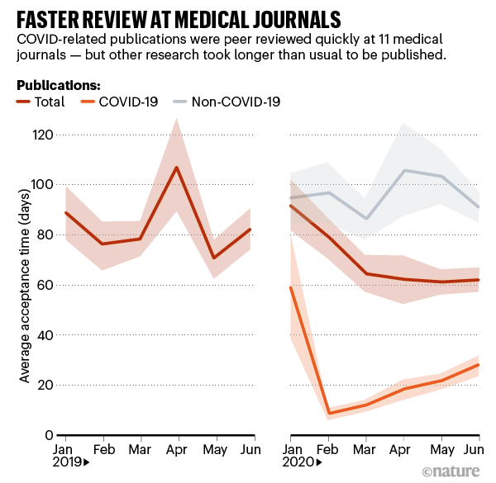
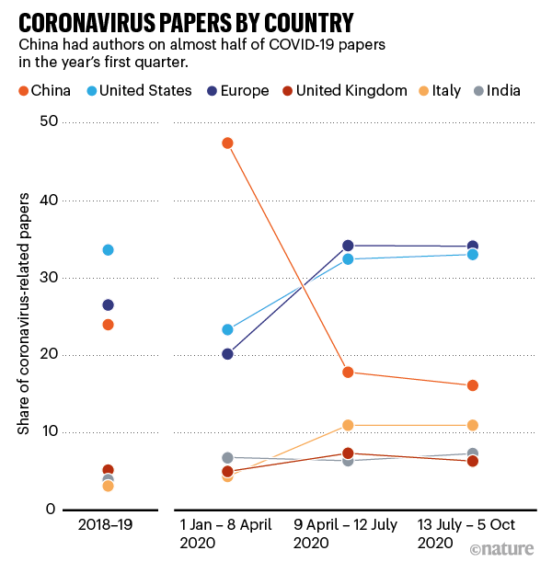
Speedy Review
https://www.nature.com/articles/d41586-020-03564-y?WT.ec_id=NATURE-20201224&utm_source=nature_etoc&utm_medium=email&utm_campaign=20201224&sap-outbound-id=DBC51B6FAD2C09554C41D184BCAEBCF393093278

Slide 22
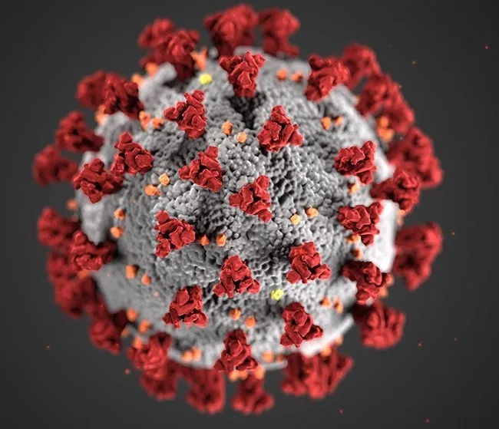
A journal took three days to accept a COVID-19 paper. It’s taken two months and counting to retract it.
A Springer Nature journal has issued an editor’s note —about how the novel coronavirus might infect white blood cells, akin to HIV.
The paper, “SARS-CoV-2 infects T lymphocytes through its spike protein-mediated membrane fusion,” appeared in early April in Cellular & Molecular Immunology.
The Editors-in-Chief are currently investigating this article [1] as concerns have been raised about methodology used and the reliability of the conclusions.
Because of the virus situation with everyone working from home, the process has been prolonged. SNRIG suggests that we publish an editor’s note on this paper to make readers aware that there is an ongoing investigation and we will update them once the investigation has concluded.
Over 87,000 research papers published on Covid-19 by October 2020: Analysis
https://retractionwatch.com/2020/06/15/a-journal-took-three-days-to-accept-a-covid-19-paper-its-taken-two-months-and-counting-to-retract-it/

Slide 23
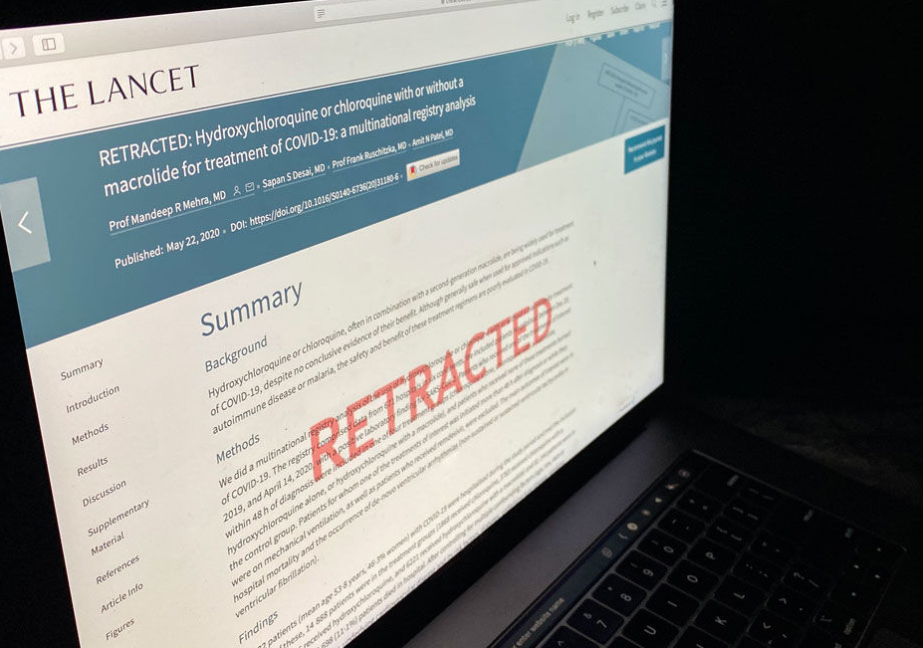
Many scientists citing two scandalous COVID-19 papers ignore their retractions Jan. 15, 2021
In June 2020, in the biggest research scandal of the pandemic so far, two of the most important medical journals each retracted a high-profile study of COVID-19 patients. Thousands of news articles, tweets, and scholarly commentaries highlighted the scandal, yet many researchers apparently failed to notice. In an examination of the most recent 200 academic articles published in 2020 that cite those papers, Science found that more than half—including many in leading journals—used the disgraced papers to support scientific findings and failed to note the retractions.
COVID-19 “is such a hot topic that publishers are willing to publish without proper vetting,” e.g. problematic citations to a retracted 1998 study in The Lancet falsely linking vaccination to autism.
Both of the retracted COVID-19 papers, one in The New England Journal of Medicine (NEJM) and the other in The Lancet, were based on what appeared to be a huge database of patient records compiled from hospitals worldwide by Surgisphere, a small company operated by vascular surgeon Sapan Desai, who was a co-author on each article. The 22 May 2020 Lancet paper ostensibly showed that hydroxychloroquine, an antimalarial drug promoted by President Donald Trump and others, could harm rather than help COVID-19 patients. Its publication led to a temporary halt in a major clinical trial and inflamed an already-divisive debate over the drug, which has proved to be no help against COVID-19. The 1 May NEJM article corroborated other evidence that people already taking certain blood pressure medicines did not face a greater risk of death if they developed COVID-19.
https://www.sciencemag.org/news/2021/01/many-scientists-citing-two-scandalous-covid-19-papers-ignore-their-retractions

Slide 24
Lessons from a pandemic: international science cooperation must continue beyond COVID-19
Open science has been at the heart of the fight-back against the virus. As other crises loom, this underlines the need for governments to avoid protectionist moves and foster collaborative international research
During the pandemic, some of the most effective means for coordinating research have been international initiatives, such as the Coalition for Epidemic Preparedness Innovations, which funded initial research on a number of different vaccines.
In an unprecedented global effort, the OECD estimates around $7.5 billion was raised for COVID-19 R&D by the end of last summer, of which around $2 billion was channelled through international initiatives.
To deal with future pandemics and other pressing issues, such as climate change, governments should provide more support.
The global research effort saw a total of 75,000 scientific papers on the virus published by November, over three quarters of which are open access. The genome of the virus was sequenced and the results were instantly made public.
The role China played in pandemic-related research affirmed the country as a global player. China is now the second largest R&D funder in the world and has been developing closer ties to the US, which was reflected in the COVID-19 co-publication patterns.
Moves to protectionist policies and increasing demands for reciprocity could endanger international collaboration.
New challenges
Open and collaborative research with players from around the globe is one piece of the puzzle. Another is taking a multi-disciplinary approach. Complex problems, such as COVID-19 and the green transition, require inputs from many different areas of research, but current R&D policies around the globe are ill-equipped to support this.
In the end, funding is not everything. Support for open and international research is the key priority.
https://sciencebusiness.net/covid-19/news/lessons-pandemic-international-science-cooperation-must-continue-beyond-covid-19
Jan. 14, 2021

Slide 25
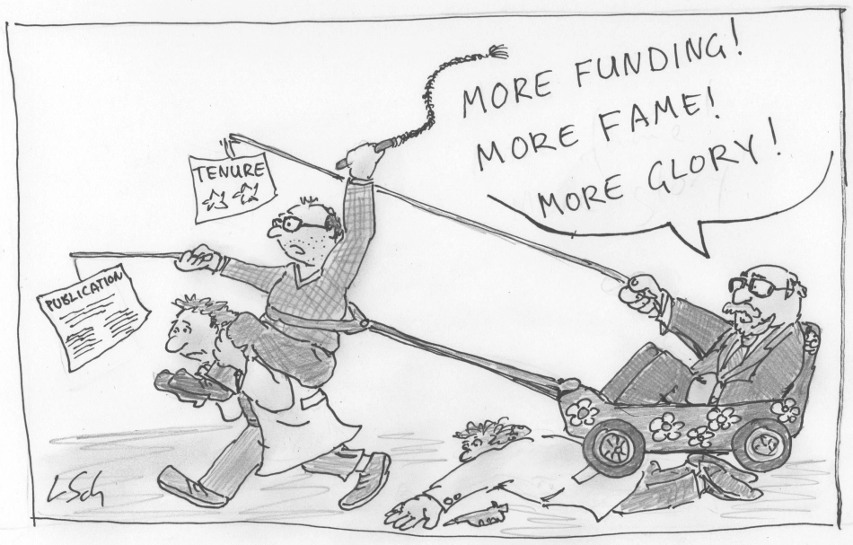
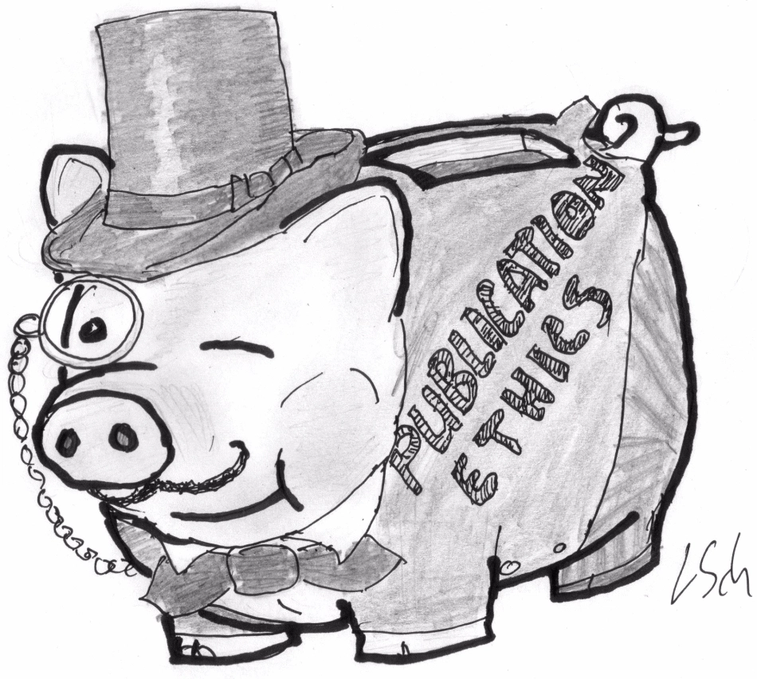
Science misconduct
Scholarly publishing is broken, and no repair is possible. At least let's point fingers at the elites and laugh. Can science trust Science?

Slide 26
Ethical Principles for Scientific Research
Adopted from RAND_RR2912 ethics & Res
Ethical Principle Definition Conflict of interest: Researchers should minimize financial and other influences on their research and on research participants that could bias research results. Conflict of interest is more frequently directed at the researcher, but it may also involve the research participants if they are provided with a financial or nonfinancial incentive to participate. Informed consent: All research participants must voluntarily agree to participate in research, without pressure from financial gain or other coercion, and their agreement must include an understanding of the research and its risks. When participants are unable to consent or when vulnerable groups are involved in research, specific actions must be taken by researchers and their institutions to protect the participants. Integrity: Researchers should demonstrate honesty and truthfulness. They should not fabricate data, falsify results, or omit relevant data. They should report findings fully, minimize or eliminate bias in their methods, and disclose underlying assumptions. Nondiscrimination: Researchers should minimize attempts to reduce the benefits of research on specific groups and to deny benefits from other groups. Nonexploitation: Researchers should not exploit or take unfair advantage of research participants. Privacy and confidentiality Privacy: Research participants have the right to control access to their personal information and to their bodies in the collection of biological specimens. Participants may control how others see, touch, or obtain their information. Confidentiality: Researchers will protect the private information provided by participants from release. Confidentiality is an extension of the concept of privacy; it refers to the participant’s understanding of, and agreement to, the ways identifiable information will be stored and shared. Professional competence: Researchers should engage only in work that they are qualified to perform, while also participating in training and betterment programs with the intent of improving their skill sets. This concept includes how researchers choose research methods, statistical methods, and sample sizes that are appropriate and would not cause misleading results. Professional discipline: Researchers should engage in ethical research and help other researchers engage in ethical research by promulgating ethical behaviors through practice, publishing and communicating, mentoring and teaching, and other activities.
Duty to society Beneficence | Researchers and research must contribute to the well-being of society. Researchers should have the welfare of the research participant in mind as a goal and strive for the benefits of the research to outweigh the risks.

Slide 27
Thanks Maryam and Sarwar

