Slide 1
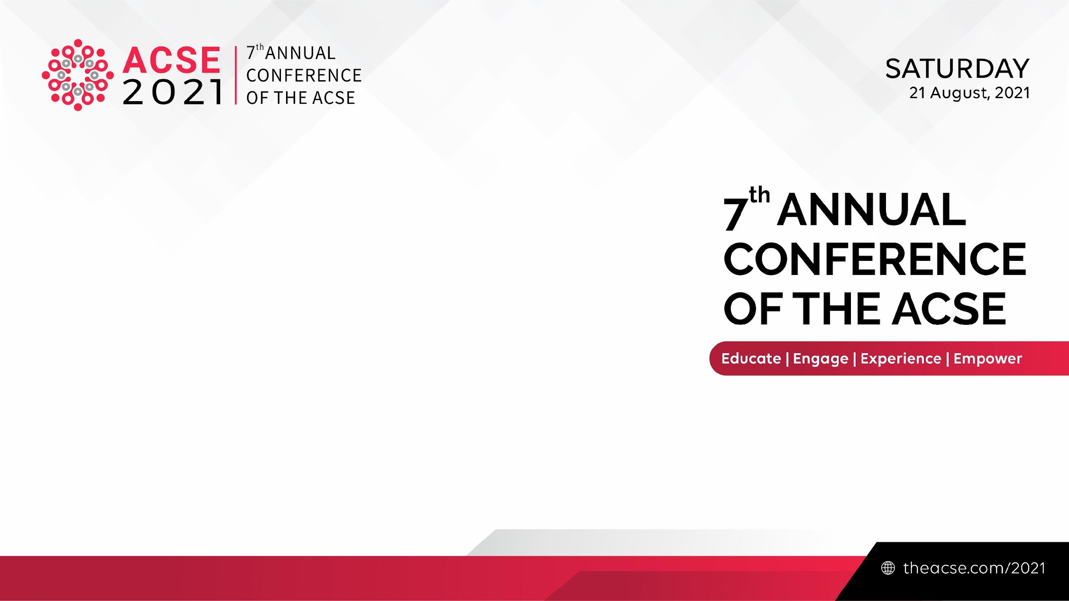
Publishing Innovation:
How Do International Publishers Use New Marketing Tools for Journal
Development
Charley MIAO
The ACSE & TrendMD

Slide 2
What Makes a Journal Successful?
Strategic journal development
good content acquisition
brand management
financial projection
Quality control, peer review and use of journal metrics
Wide visibility
Customer feedback/satisfaction

Slide 3
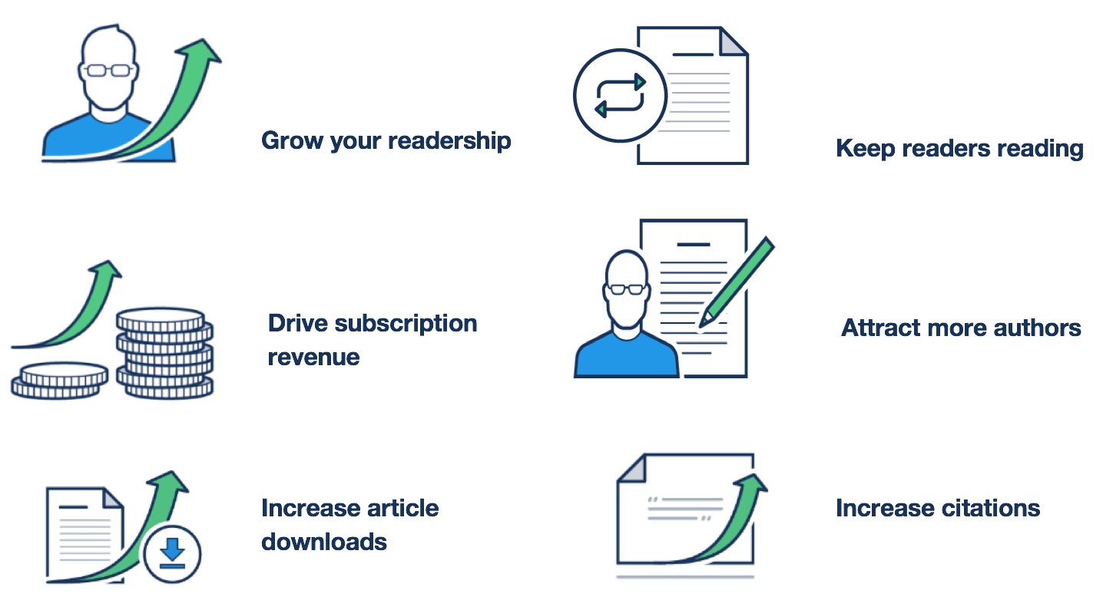
What Does Marketing Mean for Journal Development

Slide 4
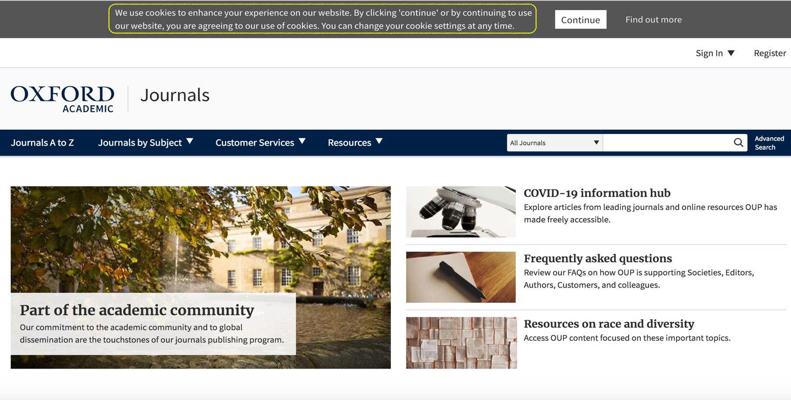
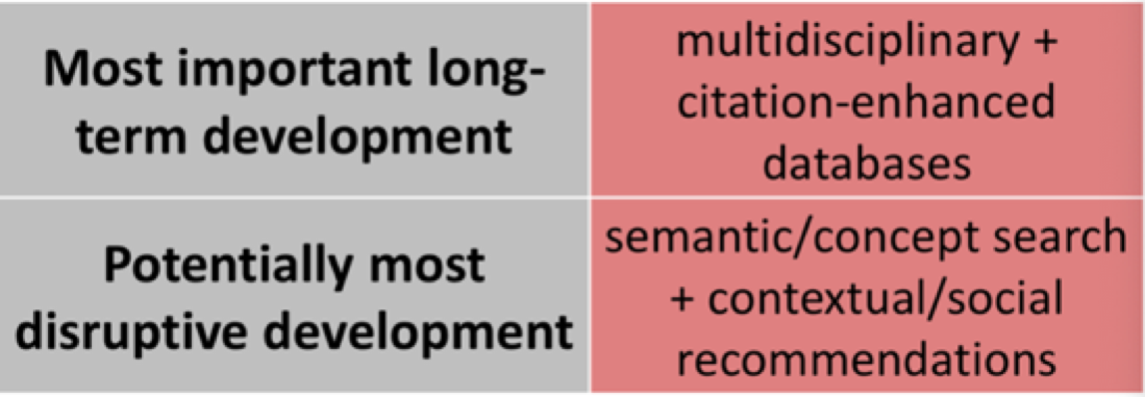

Slide 5
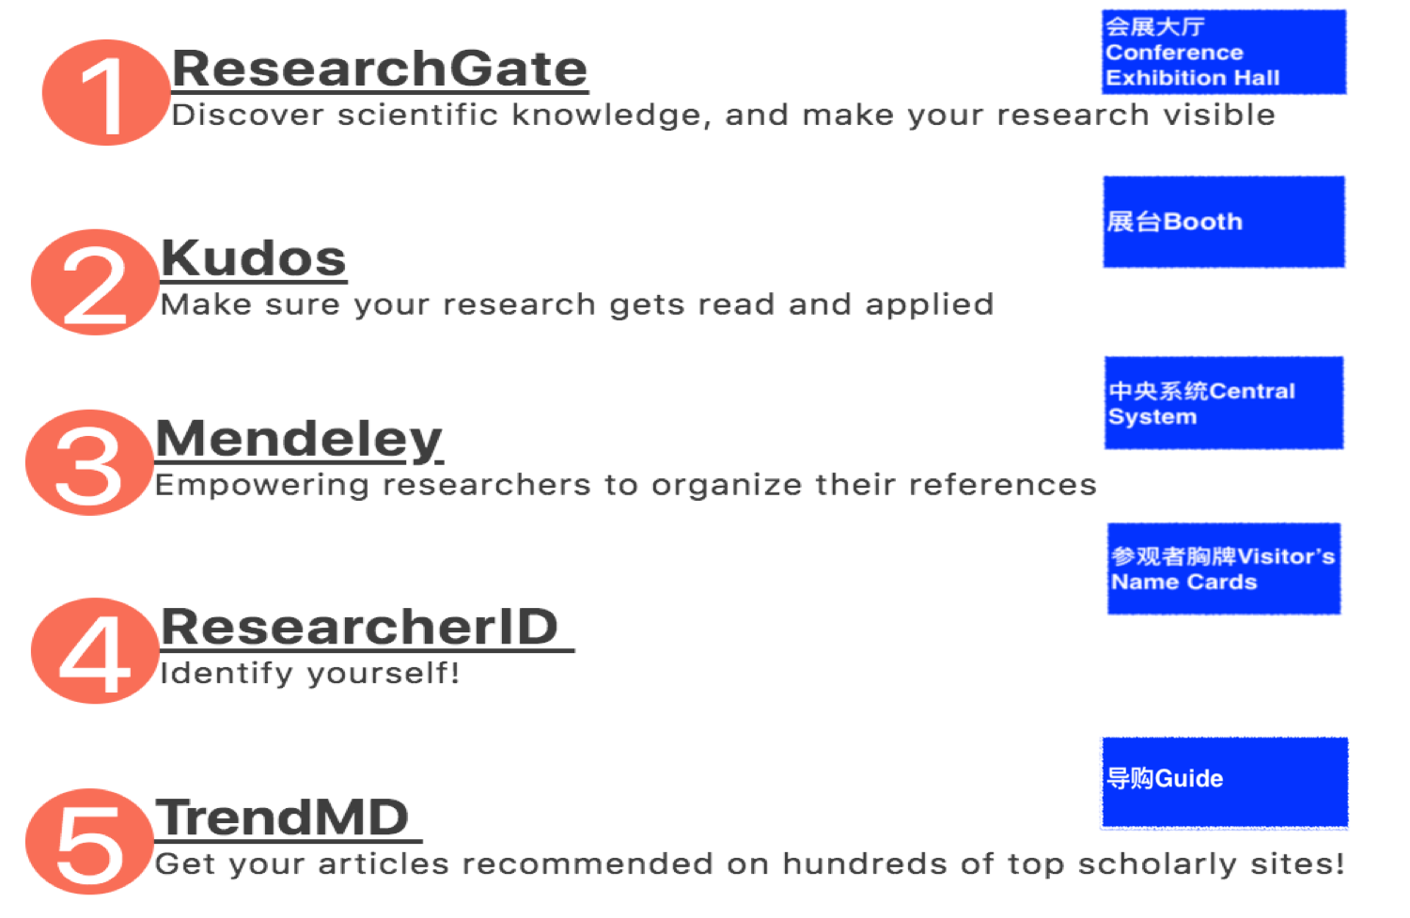
Enhance Academic Social Networks

Slide 6
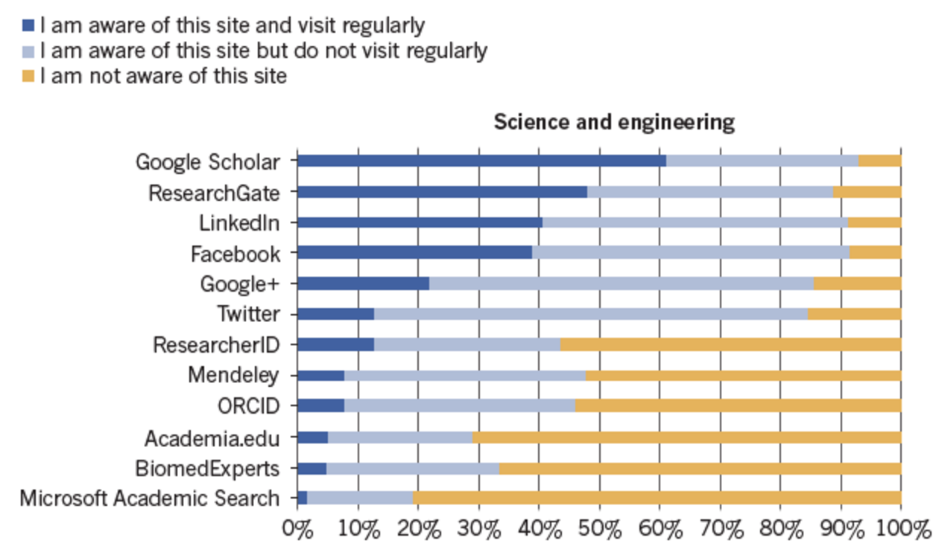
Van Noorden R. Online collaboration: Scientists and the social network. Nature. August 14, 2014:126-129.
<5% of Researchers Use Twitter Regularly

Slide 7
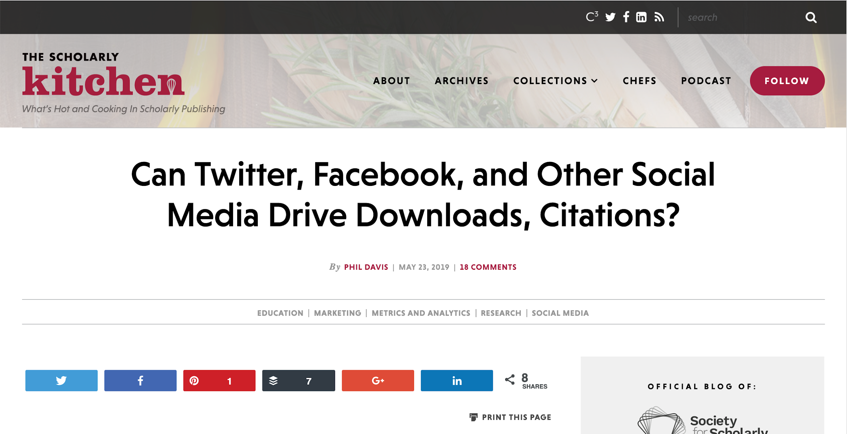
A Poster on the Scholarly Kitchen
More rigorous trials report little, if any, effect between social media interventions and readership!!!

Slide 8
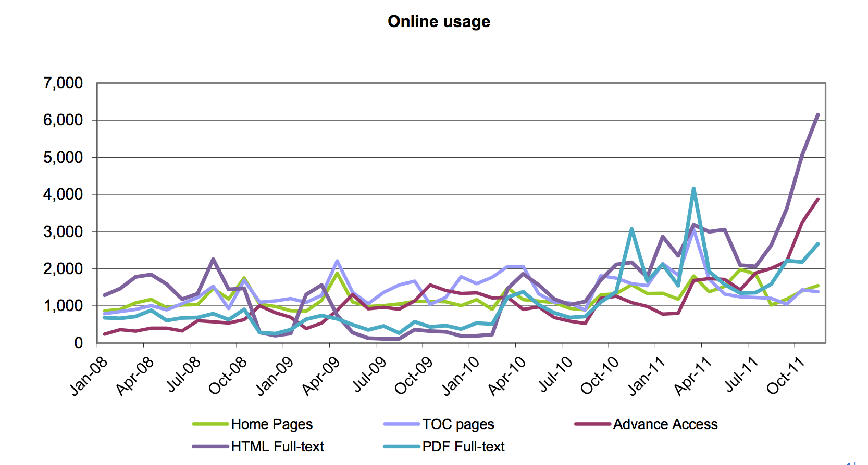
Case Study 1: The Chinese Journal of International Politics
Reprint issue: Rethinking China’s Rise, published in Sep 2010

Slide 9
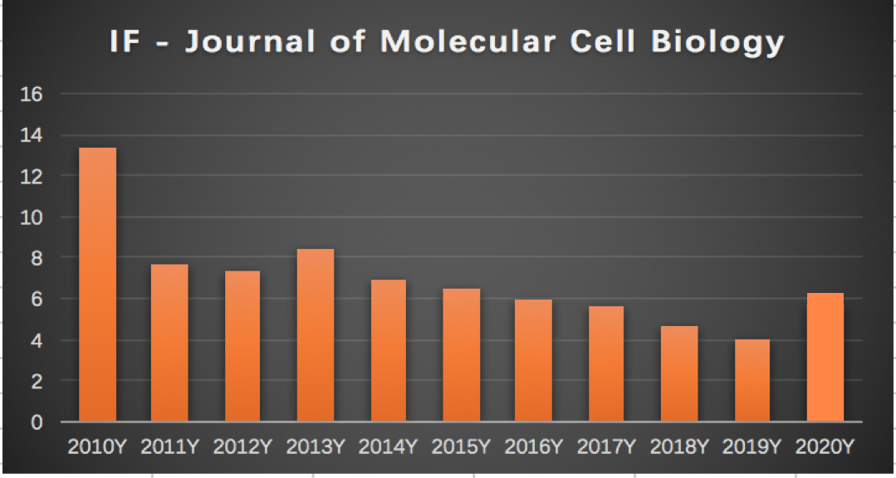
Case Study 2: Journal of Molecular Cell Biology

Slide 10
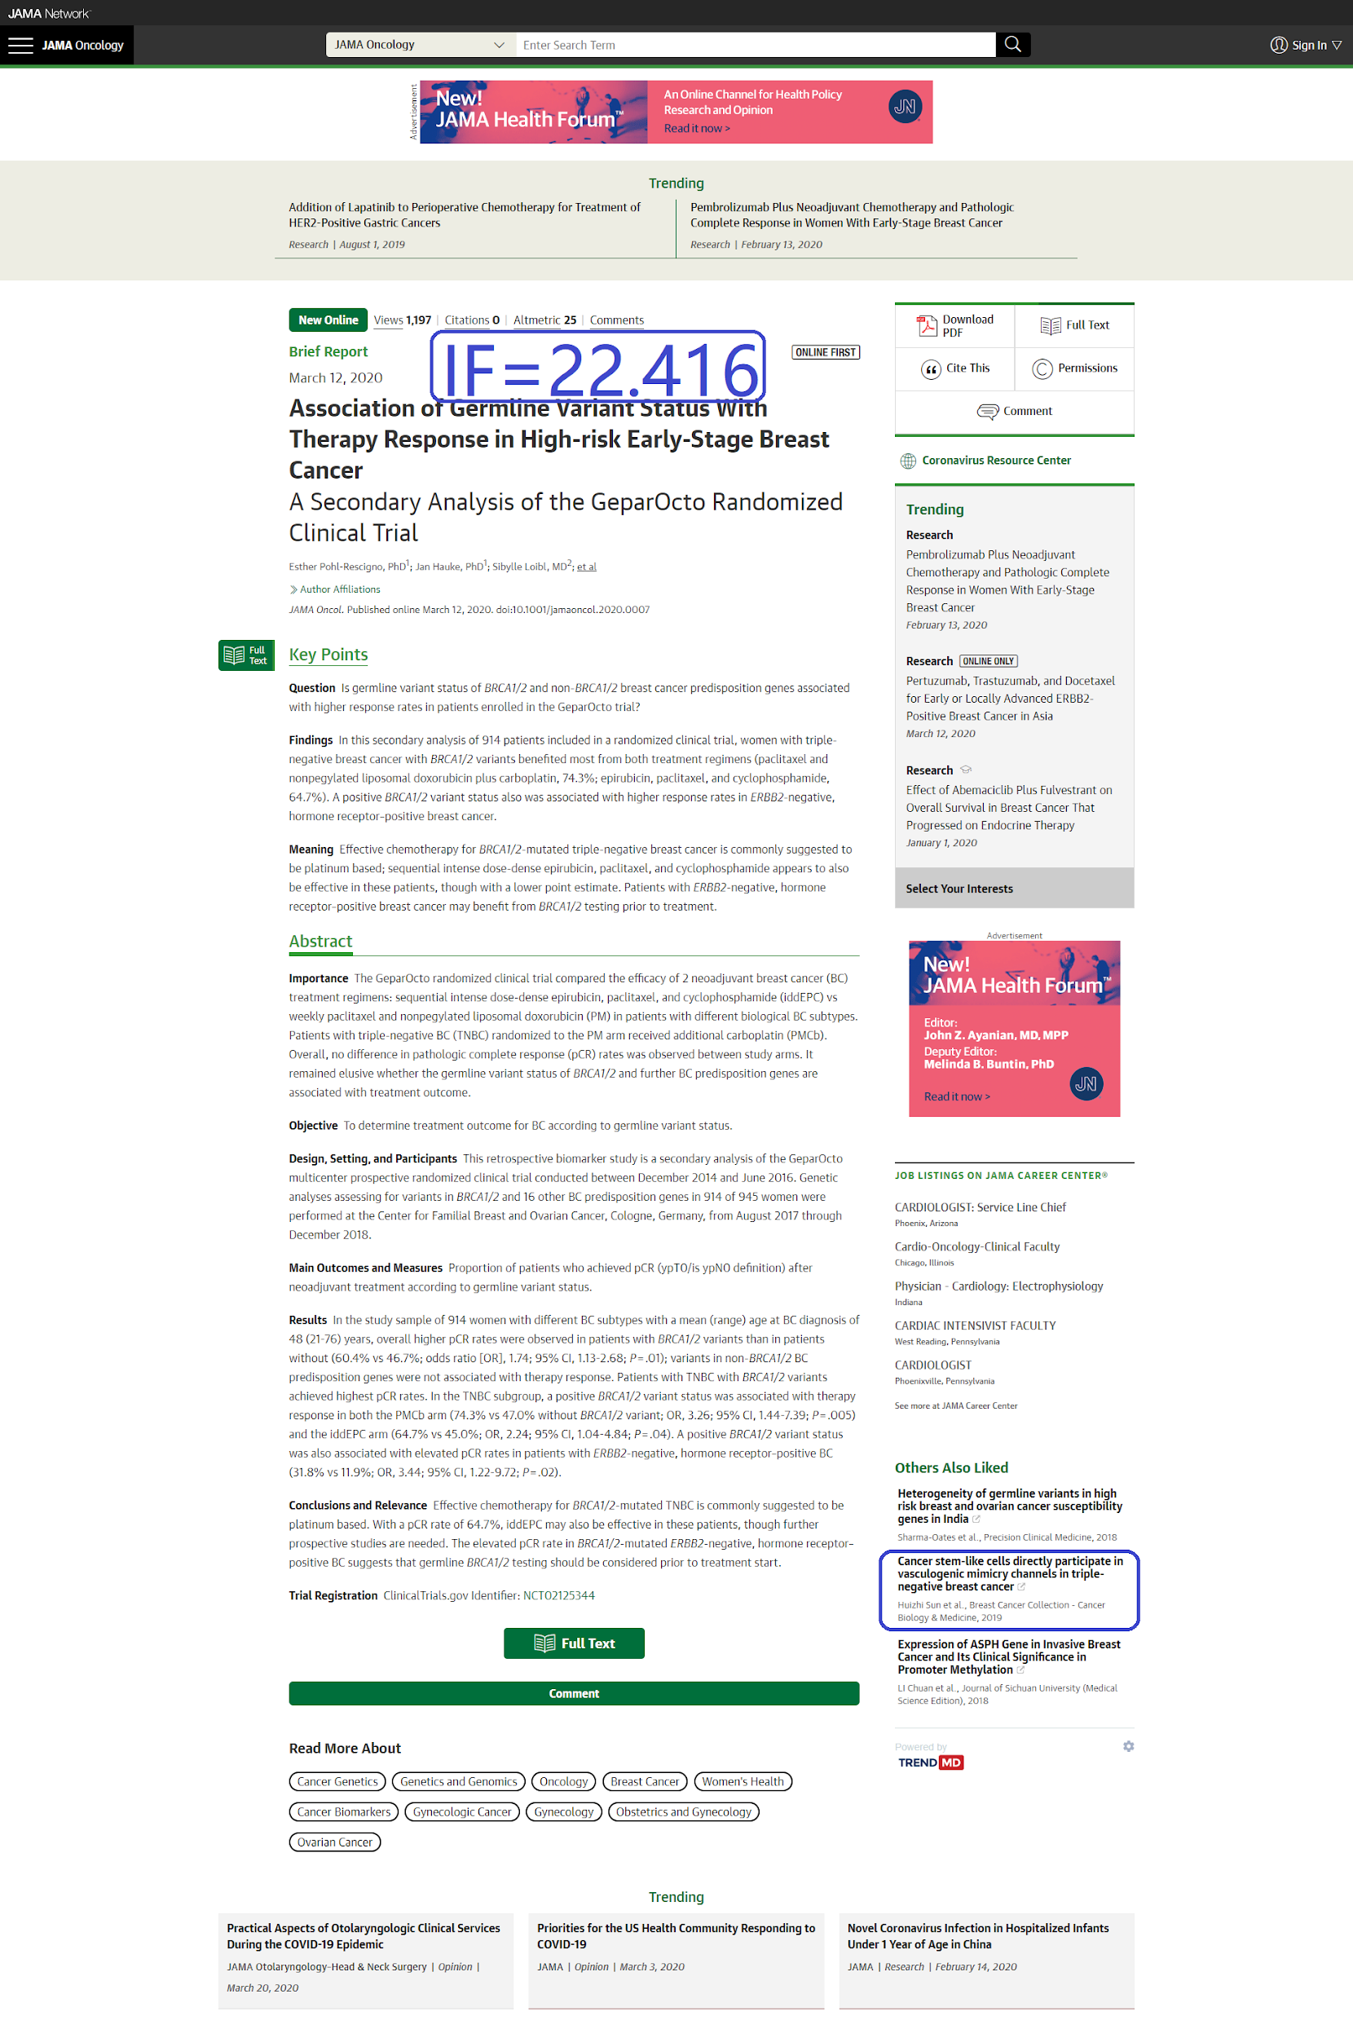
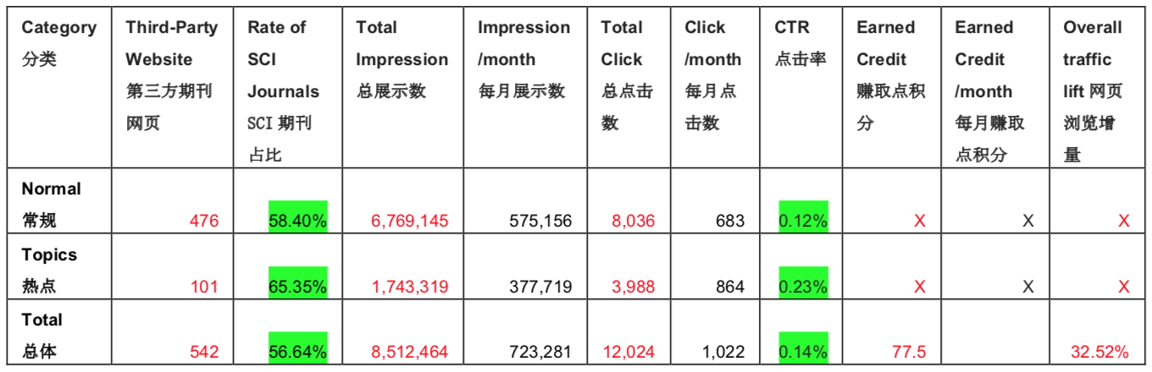
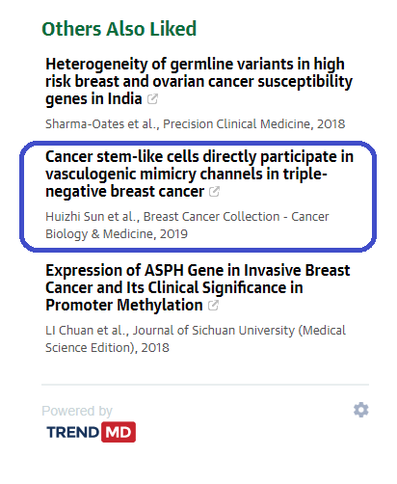
Case Study 3: Cancer Biology & Medicine

Slide 11
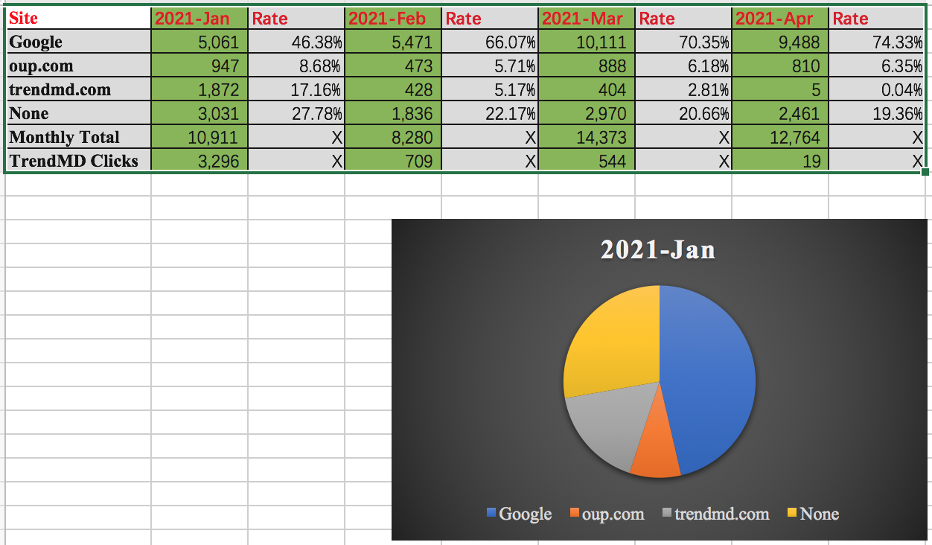
Case Study 4: Clean Energy

Slide 12
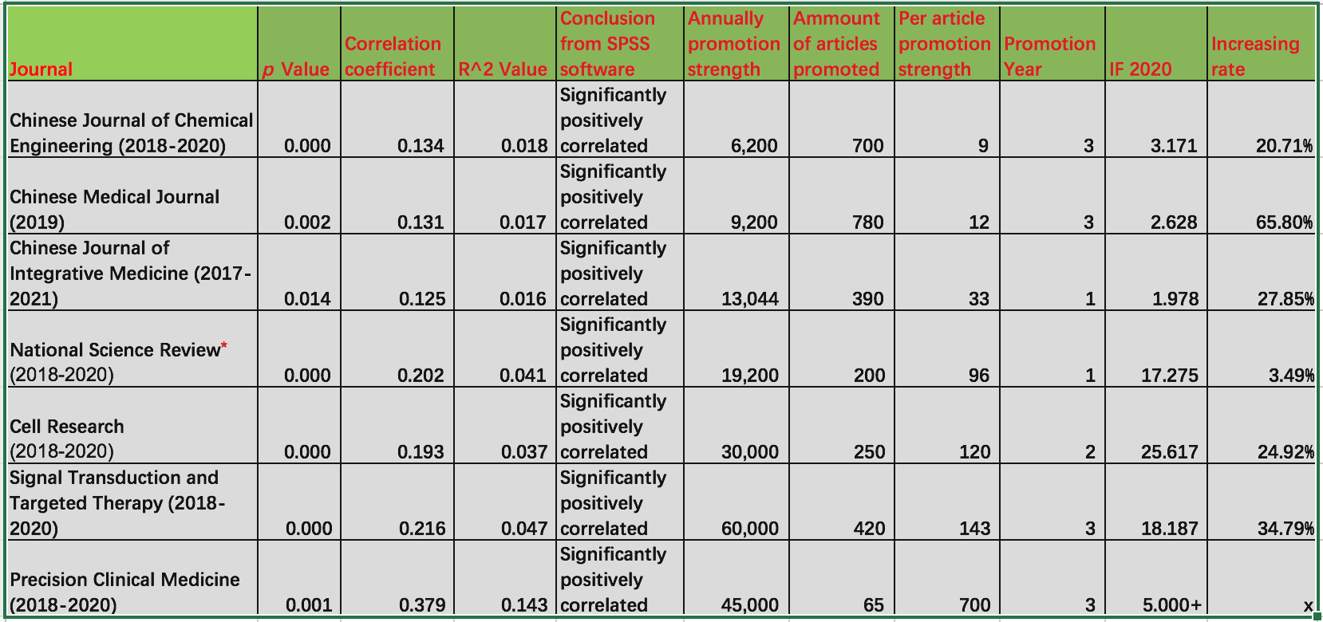
CASE Study 5: Article-Level TrendMD Clicks and SCI Citations

Slide 13
Summary
Change has been very rapid in the methods used to market journals
There is no single perfect solution
Marketers need to rely on lots of different solutions in a single strategy
It is extremely important that marketers accurately measure the results of their efforts

Slide 14
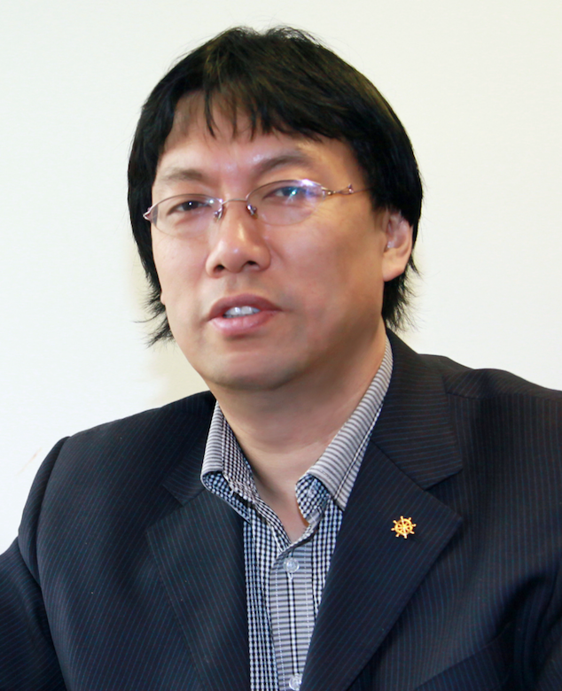
Thank you!
Charley MIAO
The ACSE & TrendMD
charley.miao@trendmd.com
+86 152 1015 5154

