Slide 1
Research in Social Sciences: COVID to Post-COVID Transformation
Prof. Dr. Rubina Hanif
Director/Tenured Professor
National Institute of Psychology
Centre of Excellence
Quaid-i-Azam University, Islamabad

Slide 2
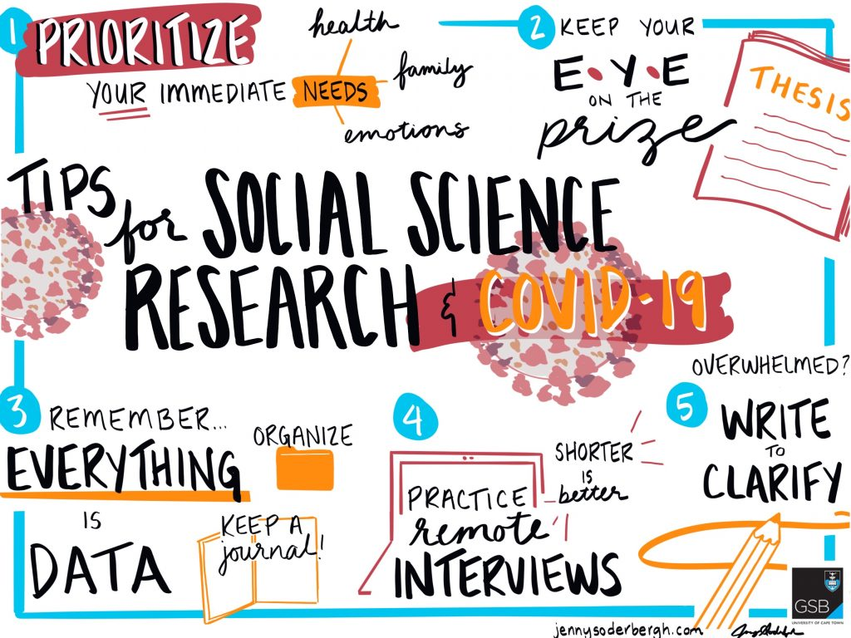
Todays’ Talk
Impact of COVID 19
Status of social Scientists
Published Research
Hazards in Research Process
Future Directions/Opportunities

Slide 3
“The evidence provides us with a vital insight into the immense social impact of Covid-19 and the substantial challenges we must address in the coming decade”
Abrams, 2021
Notes:
The outbreak of Covid 19 has had caused significant social, political and economic consequences worldwide. It’s a global crisis, a great challenge and a health crisis; however, it is much more than that.
COVID-19-related medical research is booming for reasons obvious and urgent. Perhaps less predictably, social science research is having a moment, too. Many social scientists see disasters as invaluable lenses through which to study the good, the bad and the ugly of human societies. And the coronavirus pandemic is one hell of a lens, they say.
“It’s during moments of crisis when often times we can learn most about the social order,”
said sociologist Lori Peek,
director of the Natural Hazards Center at the University of Colorado at Boulder.
COVID-19 has devastated communities and economies around the world and profoundly changed the ways in which we live and work. Many of those effects will no doubt prove to be temporary, but the pandemic has also created opportunities for us to “build back better” once the immediate threat recedes. While medical science has been front and centre of the response to the virus itself, social scientists have a powerful role to play in our recovery from it.
The social sciences don’t produce much in the way of patentable widgets or, indeed, life-saving vaccines. However, the analysis and insights they generate can and do underpin better-evidenced decisions and help guide and target insights from the ‘natural’ sciences.
Slide-1
research has shown how the pandemic has affected every aspect of contemporary life, from job security to mental health.
Global organizations and governments are striving to concurrently save human lives, and alleviate the economic and financial impact of the Pandemic.

Slide 4
Impact of COVID-19
COVID-19
HEALTH
ECONOMY
EDUCATION
The negative aggregate supply and demand effects of the COVID-19
Digital Transition
Learning Deficits
Distractions
Inflation, inequality and immigration

Slide 5
Health
The current COVID-19 pandemic has cut a swath around the globe due to decentralization and fragmentation of healthcare services in many severely affected countries
(Armocida et al. 2020)

Slide 6
Economy
The socioeconomic effects of COVID-19 pandemic have been seen all over the world irrespective of geographic region, religion, race, color, and income status. It is observed that most of the countries experienced a decline in the GDP and an increase in unemployment, especially in the informal sector, and consequently, it has led to increase in poverty levels, food insecurity, and malnutrition
(Siddiquei & Khan , 2020)

Slide 7
Education
The crisis that might have an immediate impact on children and youth?
(1) Losses in learning
(2) Increased dropout rates
(3) disproportionate opportunities due to various education systems
(Hanif & Ali, 2021)

Slide 8
Published Research in Psychology
Mental health issues, fear, apprehension, uncertainty, and death anxiety related to COVID 19
tolerance of uncertainty and accepting the alternate channels of education (such as online classes) and job (work from home)
tolerance of uncertainty and accepting the alternate channels of education (such as online classes) and job (work from home
Risk & Vulnerability
Symptomology
Psychosocial
Mechanism of coping
Recovery Interventions

Slide 9
Major Issues under investigation
Social Distancing
Space allocation
Digital Pressures
Learning Deficit
Bulk of Myths information
trust deficit
Mental Health
Adjustment
Inequalities

Slide 10
Hazards in Research Process
Restrictions to work on some topics
Field work/data collection
Comprimise on methodology
Repetetions & redundancy
Lack of fundings (underdeveloped countries)
Ethical imperative of self care (mental healtth professionals)
Lack of digital trainings

Slide 11
Public Health;
Clinical Care And Health Systems;
Engagement In Public Health Response;
Clinical Research, Media And Communications;
Sexual And Reproductive Health;
International Cooperation
Interdisciplinary Collaborations
(WHO, 2020)

Slide 12
Priorities of the Role of Social Sciences in Post-Covid World
Collaboration
Visibility
Credibility
Incentives
Interdisciplinary , Community, Industry,
Gov’t & non Gov’t Organizations
Accessibility and recognition in communities, businesses and policy- makers
Utility of the Research Excellence Framework in the round
Potential resource to support their efforts, and sincere and enthusiastic celebration of their success,

Slide 13
POST COVID DIRECTIONS
Behavioral & Public Health
Bias, Discrimination, & Equity
Education, Training, & Distance Learning
General Parenting & Caregiving
Physical Distancing & Isolation
PTSD & Trauma
Self-care
Stress, Anxiety, & Grief
Telementalhealth & Telepsychology
Work And Telework
(APA, 2021)

Slide 14
COVID to Post-COVID
Phase-3
Problems Assessment
Resilience & Adjustments
Recovery & Growth
Phase-2
Phase-1

Slide 15
Conclusion
The COVID-19 social science research agenda aims to:
(2) develop and employ strong methodologies and theoretical frameworks to tackle current epidemic challenges; and
(3) understand consequences of epidemic-control decisions. Priority thematic areas were also identified.
(1) generate high quality social science evidence for achieving the goals of national strategic public health response plans;

