Slide 1


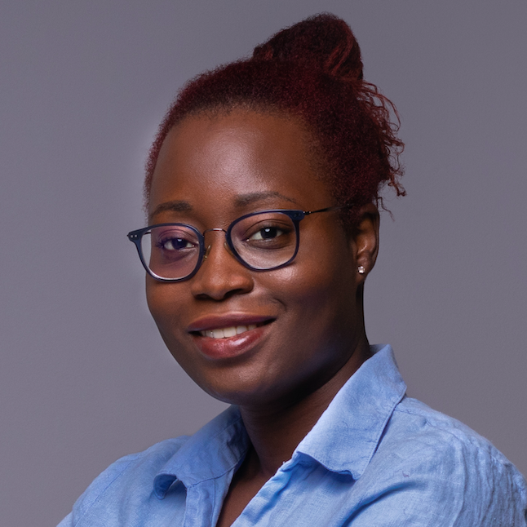
Boosting Readership & Citations of Scholarly Publications
Tash Brown
TrendMD, COO

Slide 2
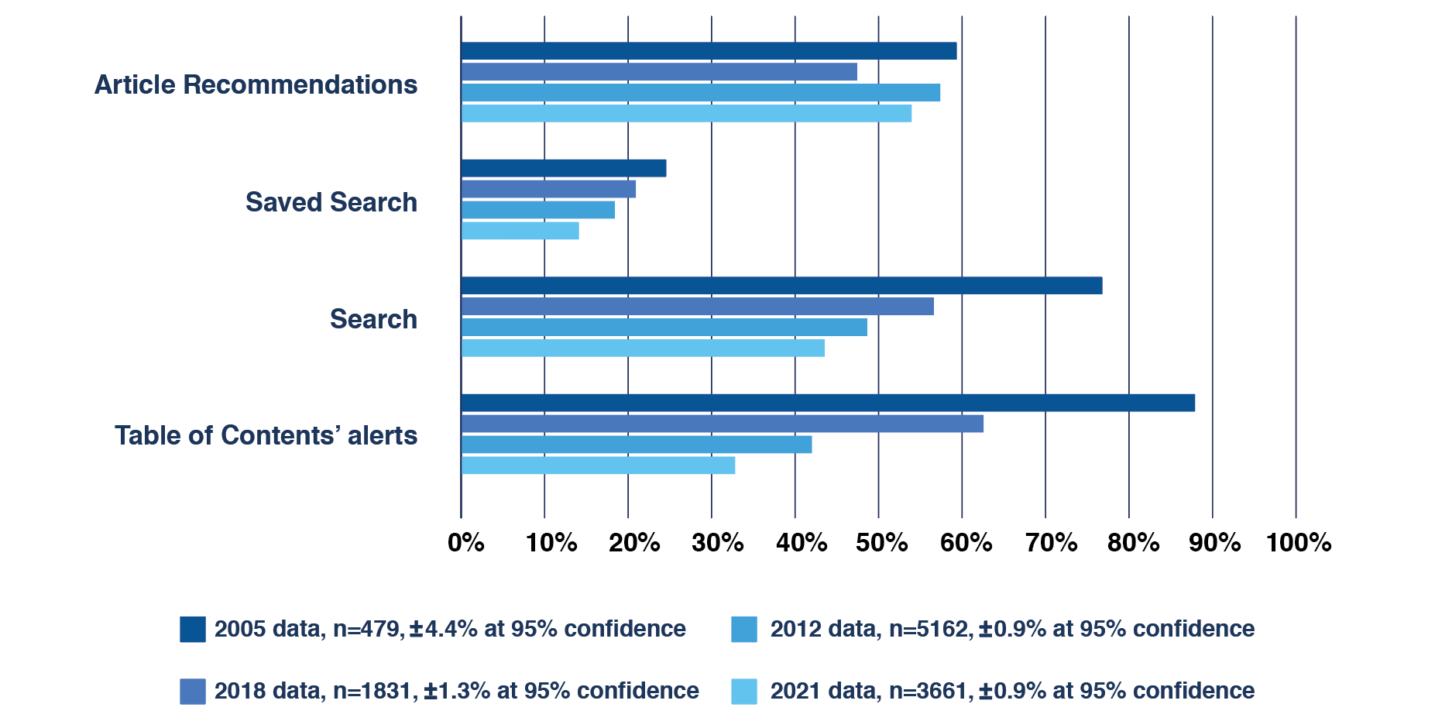
Browsing on publisher websites
“Related articles remain the most popular feature of a publisher website.”
How Readers Discover Content in Scholarly Publications, Gardner & Inger, Jul 2021
https://renewconsultants.com/wp-content/uploads/2021/07/How-Readers-Discover-Content-2021.pdf

Slide 3
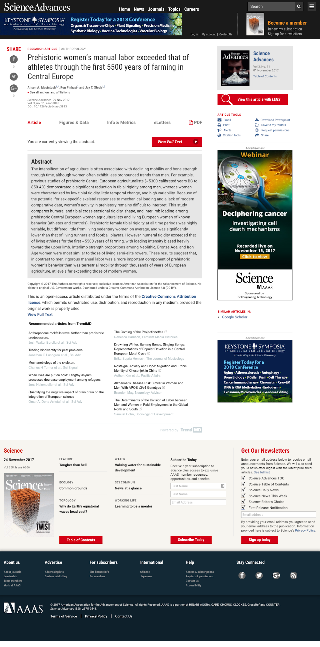
Readers discover new content, based on
What they are reading
What other users like them have read
What they have read in the past
1
2
3

Slide 4












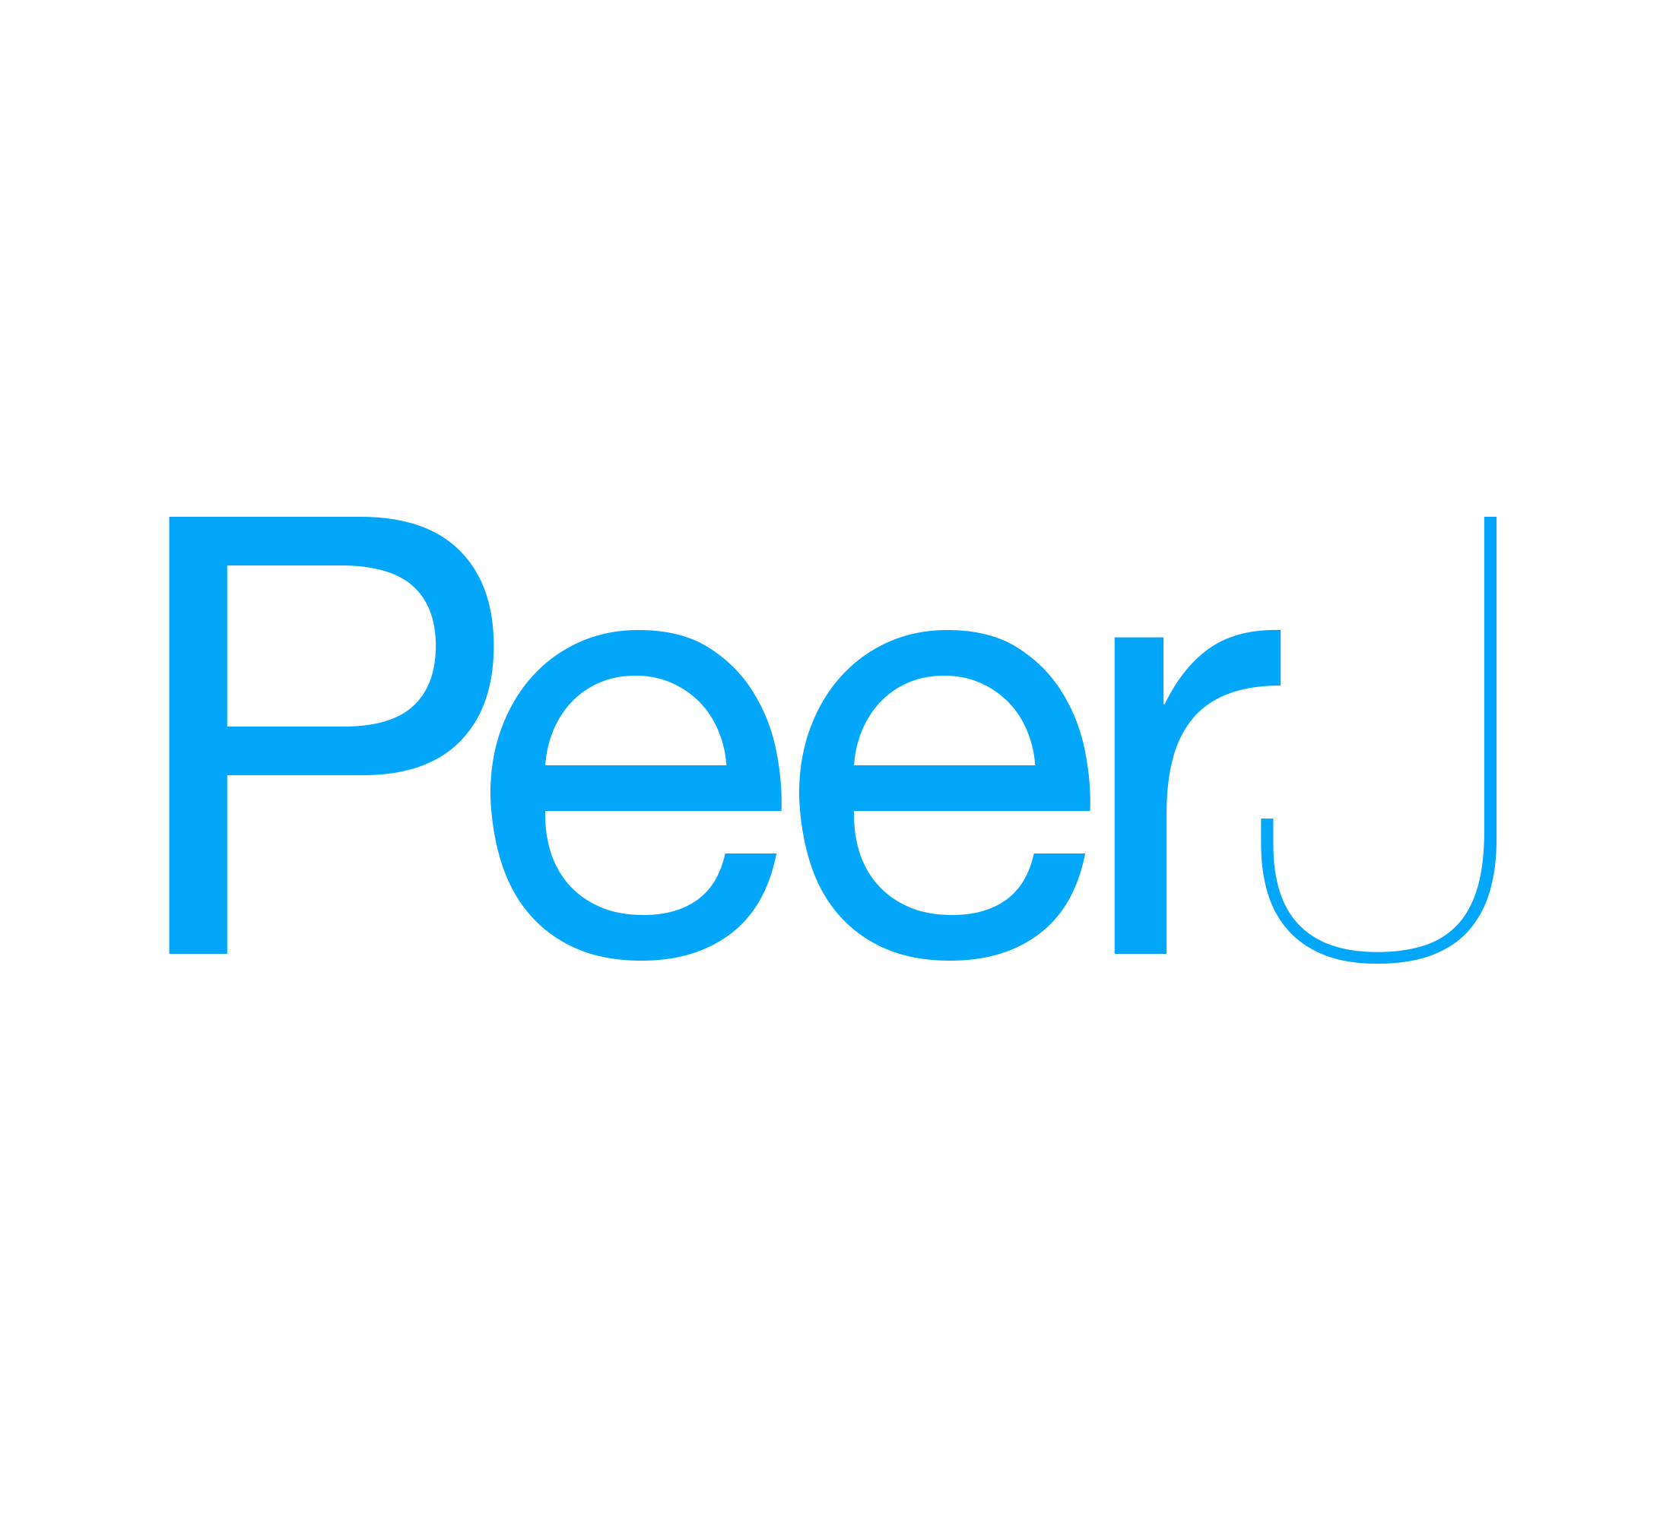













TrendMD is used on over 5,200 scholarly websites by 500+ publishers
Publishers
Integration partners

Slide 5






TrendMD audience reach
5M+
Monthly Clicks
102M+
Monthly Uniques Globally
60%
Desktop
40%
Mobile
85%
US academic reached
90%
US MDs reached

Slide 6
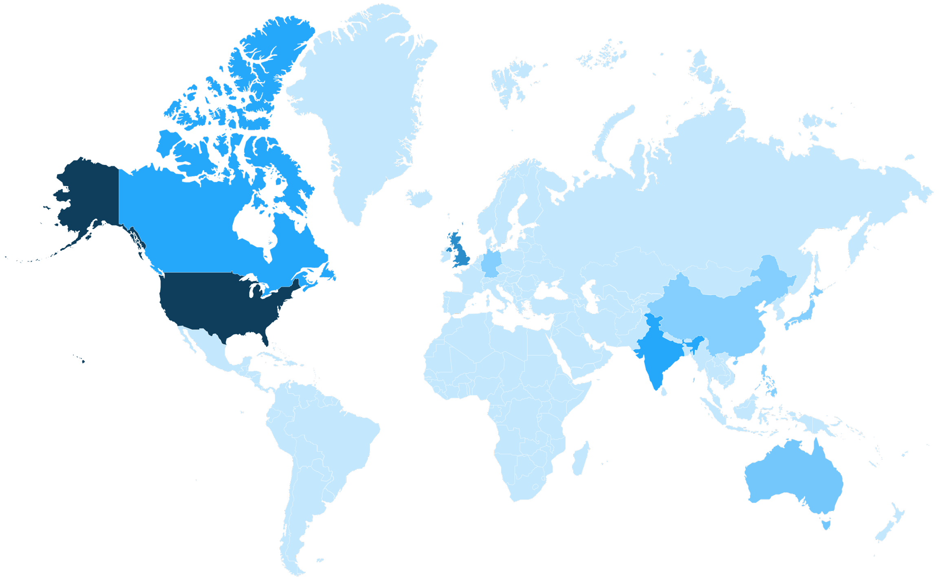
Global distribution
Country | Impressions | Global %
Total | 102.1M
United States | 49.0M | 48%
United Kingdom | 9.5M | 9.3%
India | 6.2M | 6.4%
Canada | 5.2M | 5.1%
Australia | 3.6M | 3.5%
Philippines | 1.6M | 1.6%
Germany | 1.4M | 1.4%
China | 1.2M | 1.2%
Japan | 1.1M | 1.1%
South Africa | 896K | 0.9%
France | 829K | 0.8%
Netherlands | 811K | 0.8%
Spain | 800K | 0.8%
Italy | 783K | 0.8%
Brazil | 714K | 0.7%
Singapore | 683K | 0.7%

Slide 7
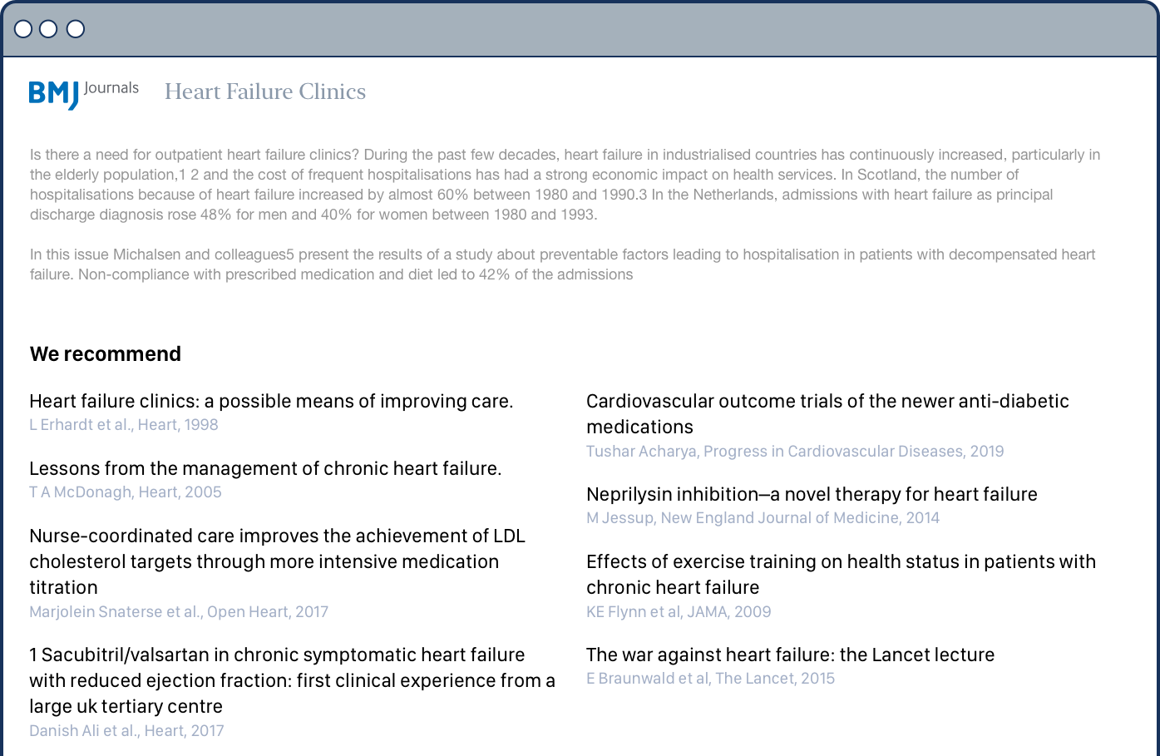
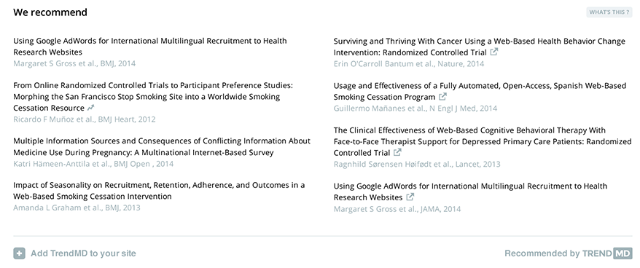

We provide recommendations within journals, blogs, other sites that academics, doctors, and researchers use in their day-to-day work
Article abstract
widget

Slide 8
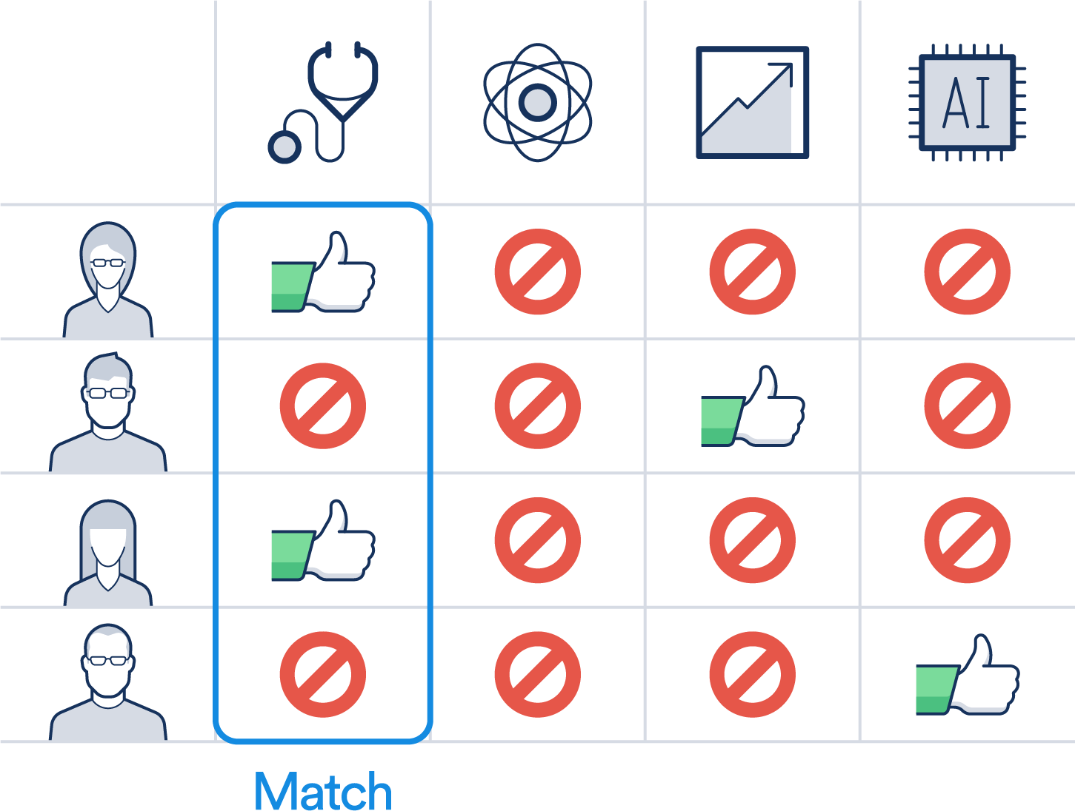
TrendMD generates recommendations via collaborative filtering i.e. ‘People who read this also read this’

Slide 9






Benefits: Publishers use TrendMD to maximize their growth
Grow your readership
Increase citations
Build brand awareness
Drive subscription revenue
Attract more authors
Drive conversions

Slide 10



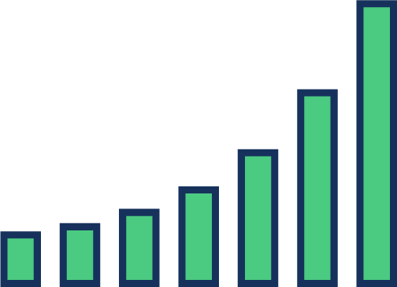
Understand more about your audience: analytics
How many additional readers did TrendMD refer?
Which articles are generating and receiving the most traffic?
What journals are my readers coming from?
In which third-party journals is your content trending?

Slide 11





Reader engagement
TrendMD readers view more articles per visit than readers from any other traffic source
0
1
2
3
4
Pages per session

Slide 12



With our campaigns you can choose targeting criteria important to you
Country or region (Global)
Institutional (Global) Target hospital networks, universities, colleges, organizations
User-targeting (Global) Target specific types of researchers and/or HCPs in the network, globally

Slide 13
Case study #1: Increasing Discoverability
Problem: Given the glut of information on Covid-19… How can the most valuable peer-reviewed content on the subject rise above the noise?
Publisher Experience: Covid- 19 Campaign
Number of articles promoted | 10
Number of days in campaign | 12
Total Budget | $1,500
Number of impressions | 5.6 million
Number of clicks | 1,600

Slide 14
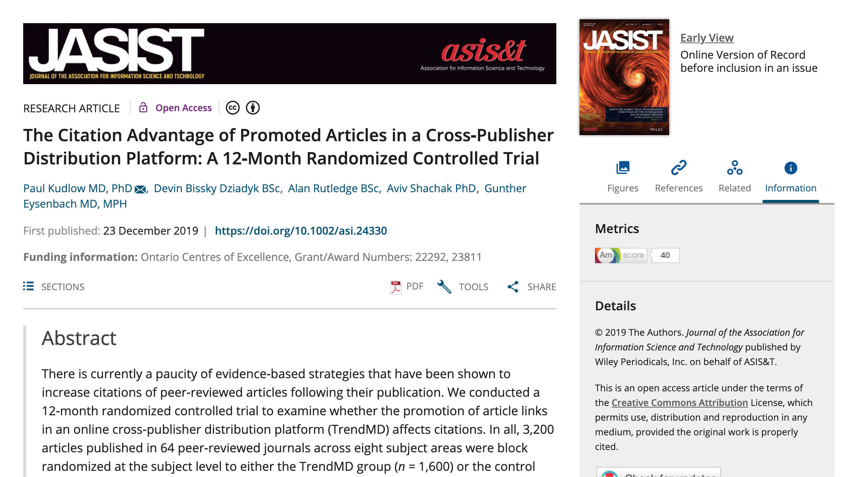
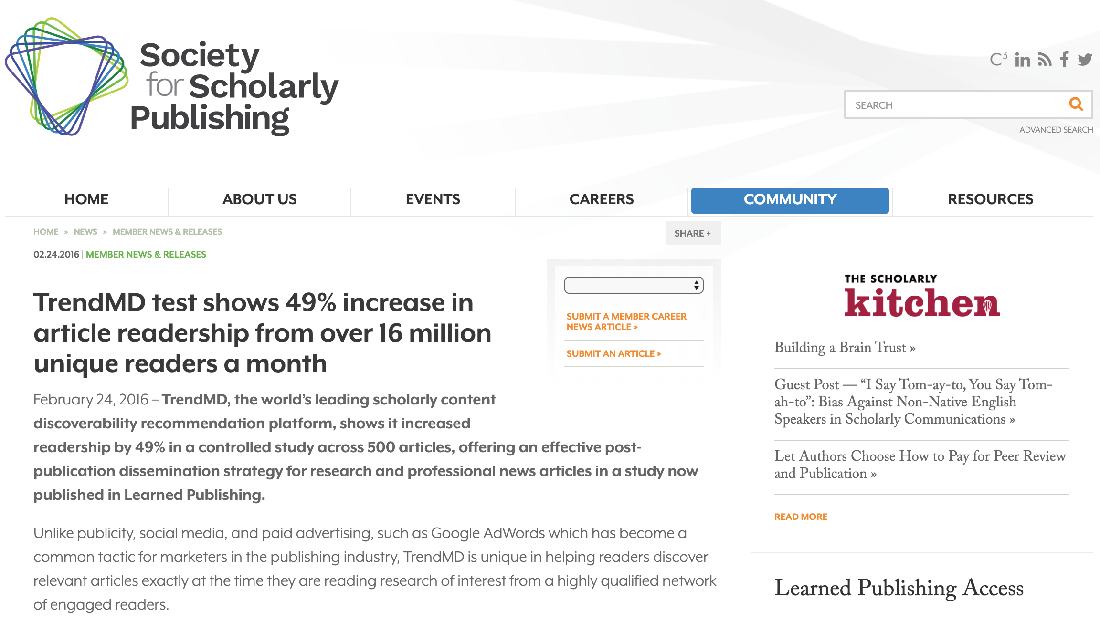
Case study #2: Increasing Citations and improving Impact Factor
12-Month Randomized Controlled Trial demonstrated that TrendMD-promoted articles received 50% more citations than the control group
https://asistdl.onlinelibrary.wiley.com/doi/10.1002/asi.24330

Slide 15
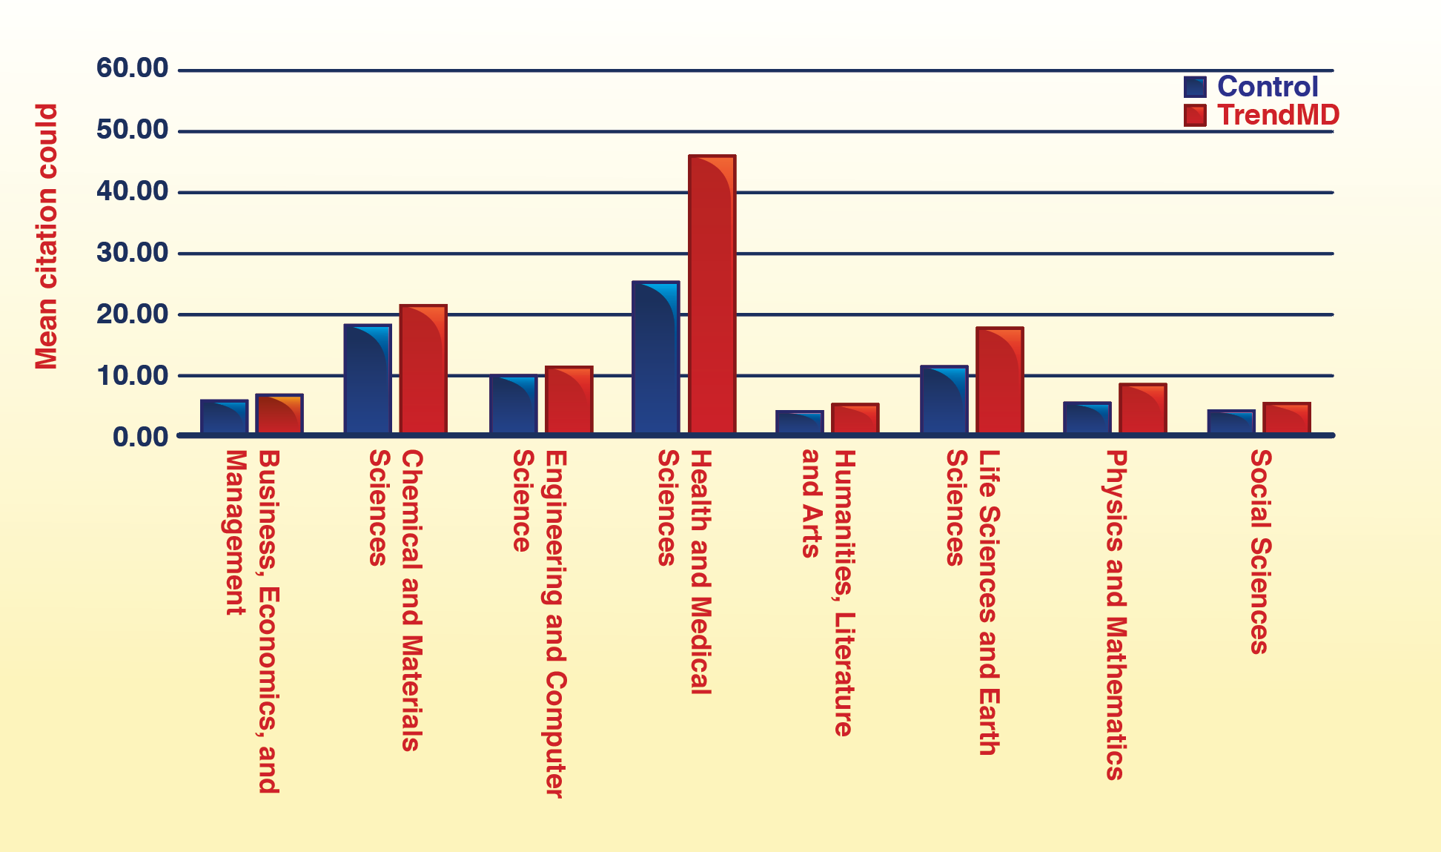
Mean citation counts by category over 12 months
Notes:
Mean citation counts by category over 12 months: TrendMD versus control

Slide 16
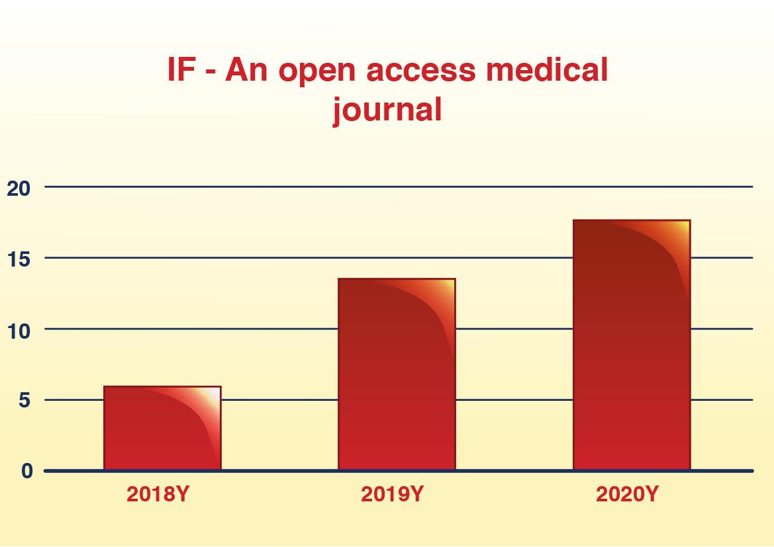
Case study #3: Continue Impact Factor growth for a Newer Journal
TrendMD Promotion:
6-month campaign from Aug. 2020
30K clicks
Estimated 2020 IF=18.187

Slide 17
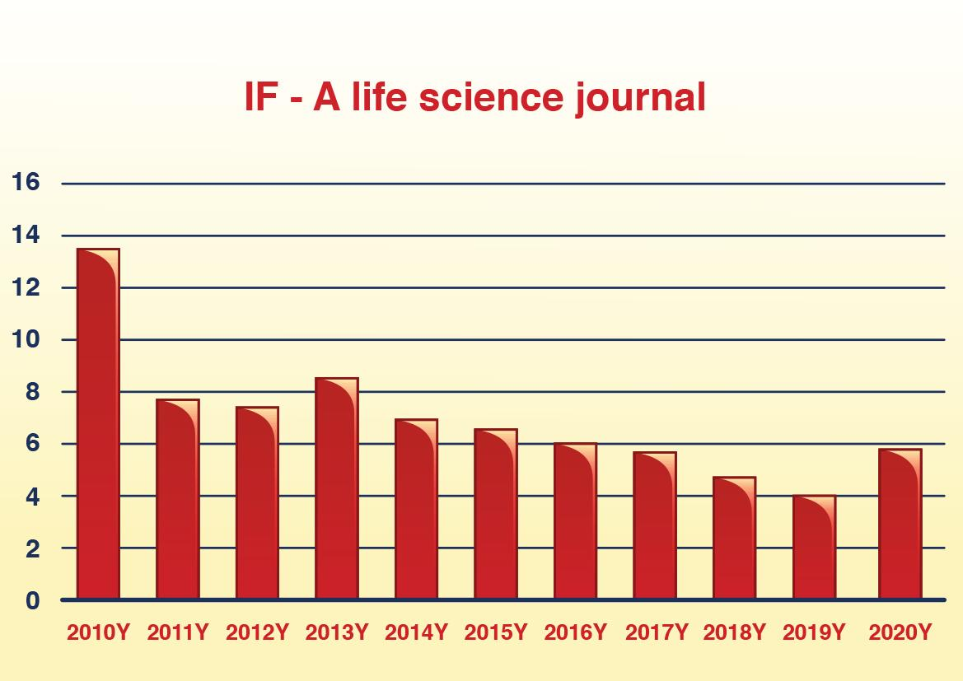
Case study #4: Reverse a downward trend
TrendMD Promotion:
Started campaign in July 2019
15K clicks/year
Estimated 2020 IF=6.216

Slide 18
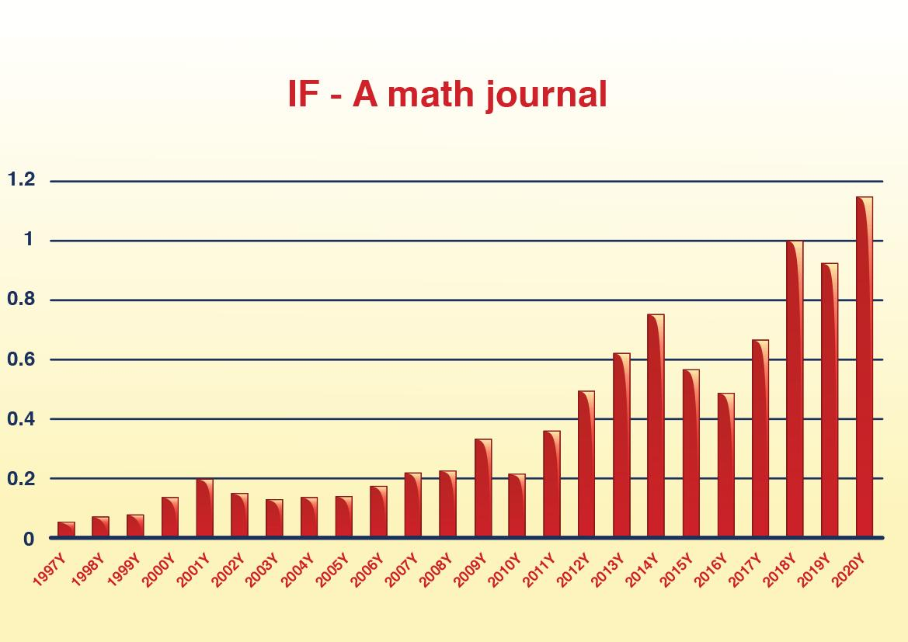
Case study #5: Accelerate growth
TrendMD Promotion:
Started campaign in 2017
13K clicks/year
Estimated 2020 IF=1.258

Slide 19

Thank you for listening!
For more info contact Charley MIAO
charley.miao@trendmd.com

