Slide 1
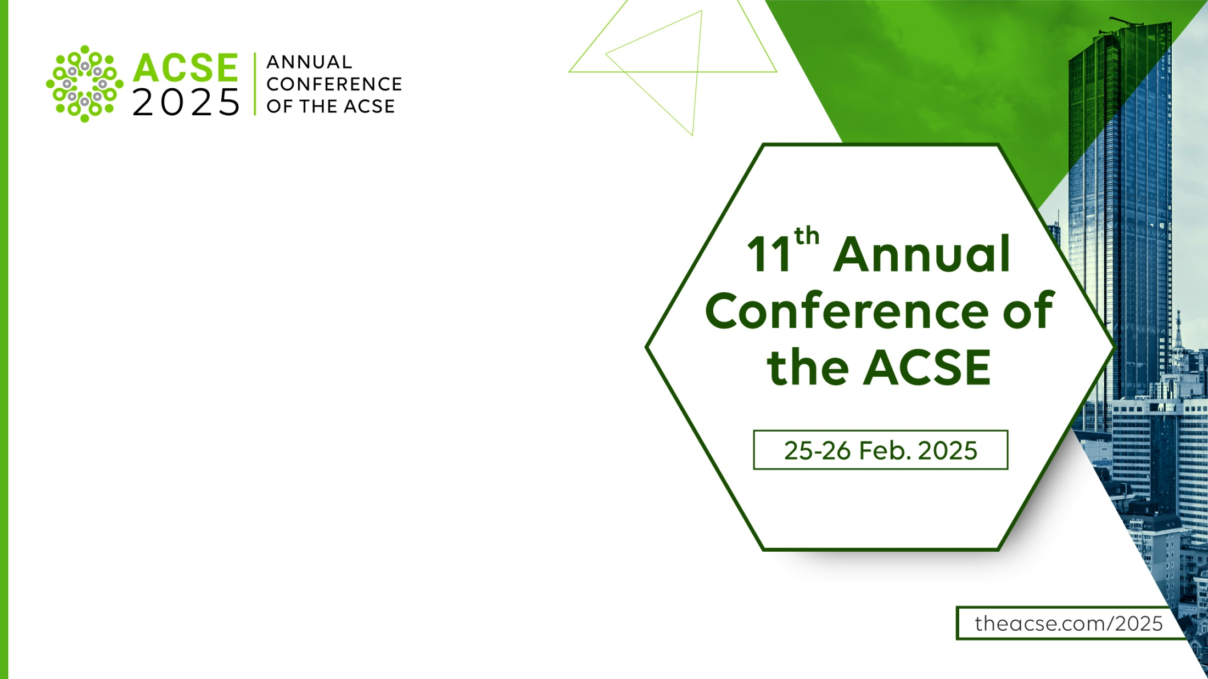



Path to Academic Excellence and Global Reach
Alexandru Barbu
Sales & Business Development Manager
Iga Serafin
Abstracting & Indexing Manager

Slide 2






Slide 3
Paradigm Publishing Services, a division of De Gruyter Brill, enables a scholarly publishing ecosystem that benefits all.
We provide open, closed, and hybrid solutions to societies, associations, publishers, and libraries in all disciplines and areas of the world.
We empower our partners to enhance their operations, extend global distribution, drive research integrity, and ensure financial sustainability.
Our Mission
Our Values
We tailor our services to meet our partners where they are and to provide the tools and knowledge to help them achieve their desired outcomes through:
Partnership
Sustainability
Impact
Independence

Slide 4

Expert Insights to Elevate Your Publishing Strategy
Publishing Expertise
Are you striving to obtain an Impact Factor for your journal?
Do you wonder what steps to take to meet the rigorous editorial standards of the Clarivate database?
Achieving this milestone requires a strategic development plan and strict adherence to best publishing practices—are you on the right path?

Slide 5
Expert Insights to Elevate Your Publishing Strategy
Publishing Expertise
123
We are proud to publish over 120 journals with Impact Factors
70% of them achieved this milestone through our support
Titles with Impact Factor
Our portfolio demonstrates a track record of helping journals achieve measurable success
We specialise in helping journals thrive, gain recognition, and reach their full potential in the academic publishing landscape
Impact Factor Catalogue

Slide 6

Comprehensive Title Evaluation
We assess key journal elements to ensure quality and competitiveness
Publishing Frequency – Ensuring consistency and alignment with stated guidelines
Authorship – Assessing diversity, expertise, and reputation of contributing authors
Citation Levels – Monitoring impact and influence within the academic community
Licensing Terms – Ensuring clarity and compliance with industry standards
Publishing Ethics – Assessing documents and policies to ensure compliance with requirements and essential ethical principles

Slide 7

Best Practices for Sustainable Growth
Practical steps to elevate your journal
Maintain Consistency
Publish on time and adhere to your stated frequency. If challenges arise, consider flexible publishing models like Open Volume. strengthen the journal’s presence and impact
Uphold Quality & Compliance
Maintain high language standards for clarity and readability
Ensure precise typesetting; include DOI numbers, correct volume and issue numbering, and all required statements (especially critical for medical and biomedical publications)
Clearly define licensing terms for open access journals to ensure transparency

Slide 8
Best Practices for Sustainable Growth
Practical steps to elevate your journal
Maximize Visibility
Promote top articles on social media and distribute regular call-for-papers to boost engagement
Engage Editors & Authors – Encourage active promotion to strengthen the journal’s presence and impact

Slide 9
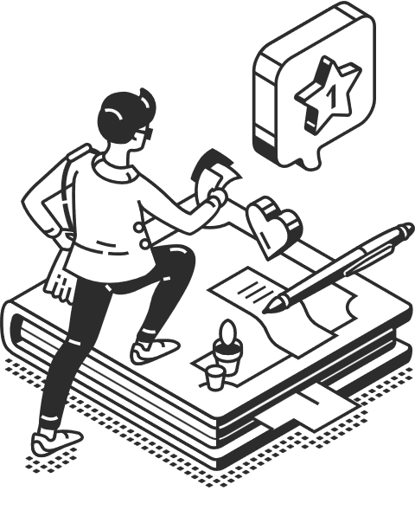
Customized Solutions for Your Journal’s Success
Get a Journal Development Plan designed for your specific goals
Who Can Benefit?
Emerging Journals – Working toward indexing, first metrics, and Impact Factor
Developing Titles – Looking to enhance performance and readership
Established Journals – Strengthening their market position
Editors – Balancing heavy workloads while seeking guidance and effective solutions
Publishers – Expanding global reach and brand visibility
Press Directors – Showcasing research internationally and strengthening portfolios

Slide 10


Case Study - Details
Folia Horticulturae – Case Study
Partnering with Sciendo since 2012
Recognition and Indexing Milestones
Indexed in Scopus (2016) and Clarivate (2017)
Expanded indexing coverage from 7 services (2012) to 41 (2023)
Impact Metrics Progression
Achieved first Impact Factor in 2020 at 1.873
Current Impact Factor: 2.2
Received first CiteScore in 2016 at 0.0 (2016)
Current CiteScore: 3.4
Recognition and Indexing Milestones
Annual Web of Science citations increased from 2 in 2012 to 424 in 2023

Slide 11
New In Our Offer
University Press Library
At Paradigm, we are honoured to collaborate with some of the most prestigious university presses, delivering their eBook collections to a global audience
This comprehensive portfolio encompasses over 100,000 titles from 49 distinguished partners, including:
Cornell University Press | Harvard University Press | University of California Press | Yale University Press
We invite libraries worldwide to join the UPL program, gaining access to this unparalleled academic resource.
Comprehensive Metadata: MARC Records and DOIs supplied for all eBooks to simplify cataloguing
DRM-Free Access: Users can download, print, and save content for their personal use without restrictions
Ownership Model: Libraries purchase and own the content, eliminating recurring access fees.

Slide 12
New In Our Offer
Professional Collection
In addition to the UPL program, Sciendo is proud to offer access to a dedicated collection of professional eBooks
Our mission is to revolutionize how academic libraries access and deliver professional knowledge, empowering educators and learners to stay at the forefront of their fields.
The collection highlights some of the most in-demand disciplines, offering resources in rapidly evolving fields. These materials bridge the gap between theoretical foundations and practical applications, equipping students with hands-on knowledge to address real-world challenges in their future careers.
Our partners include leading publishers such as Packt and IT Governance, among many others.

Slide 13
Thank you for your attention
Join us to discuss how we can help enhance your publication!

