Slide 1

Rewarding Reviewers, Accelerating Publications, and Safeguarding Research Integrity with Reviewer Credits
Catherine Anderson
Reviewer Credits / Head of Sales

Slide 2
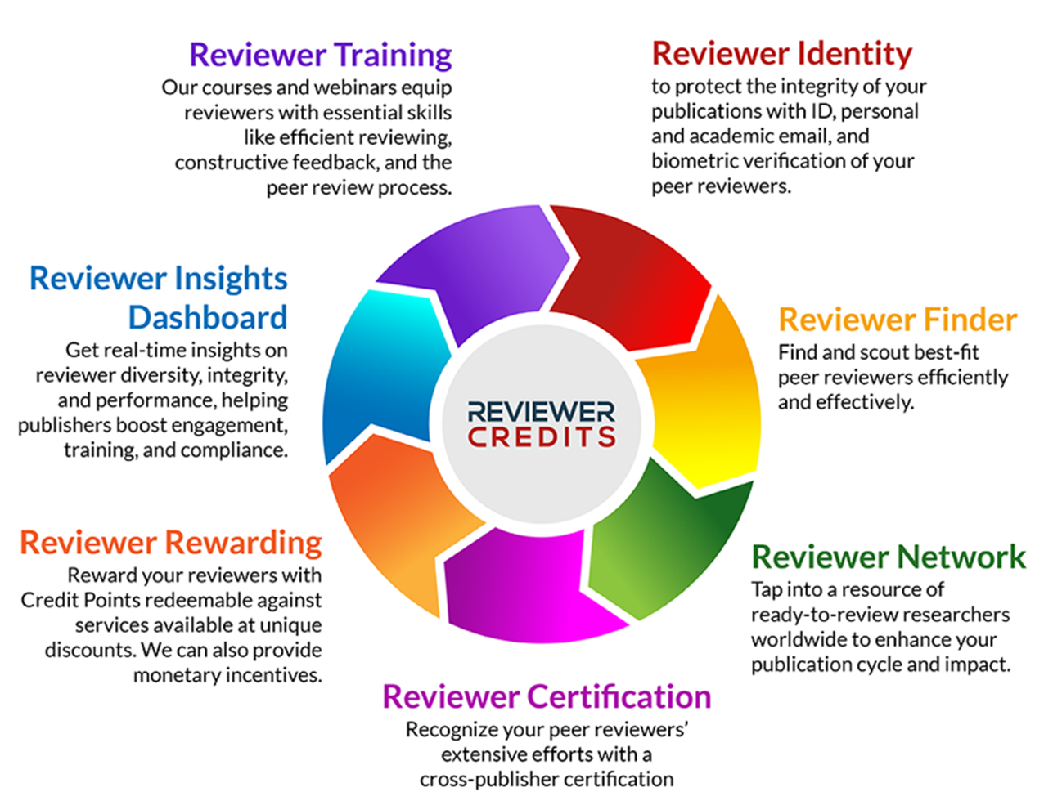
What do we do at Reviewer Credits?

Slide 3
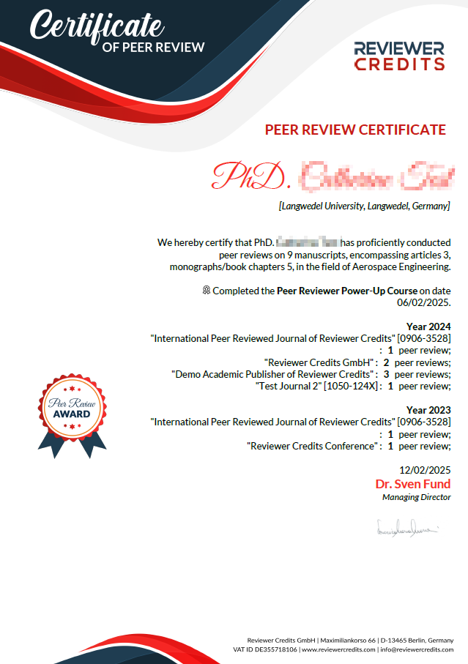


Benefits to Reviewers
Recognition and visibility
Tangible rewards
Tailored review opportunities
Workload management
Professional development

Slide 4
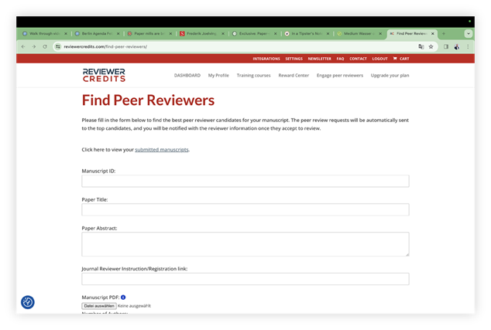
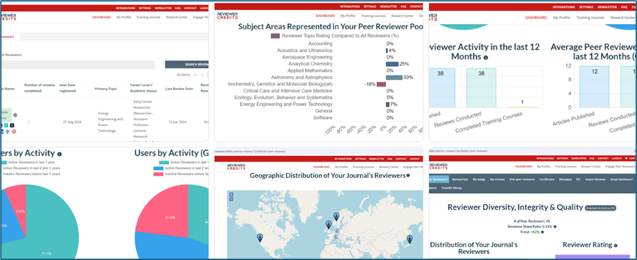
Benefits to Editors
Access to a verified expert network
Efficient reviewer search and matching with an AI-powered tool
Build a diverse reviewer pool
Accelerate publication times
Reward reviewers
Integration with existing systems
Enhanced journal reputation

Slide 5

To learn more…

Slide 6

How to get involved
Sign up for free here: https://www.reviewercredits.com/journal-signup/
Enjoy the benefits of the free subscription
Contact us for a tailored offer for your journal for the Premium features
Together we can help to improve the recognition of peer review, reward reviewers for their valuable review work, accelerate publications, improve the quality of reviews, and safeguard research integrity
Email: catherine.anderson@reviewercredits.com
Web: www.reviewercredits.com
LinkedIn: https://www.linkedin.com/company/10976749/admin/dashboard/

