Slide 1
Understanding Local Insights
&Global Impact:
Strategies for Inclusivity in Research and Publications
Dikran Toroser PhD
University California San Diego
Feb 25th, 2025

Slide 2
AGENDA
RELEVANCE – Diversity & Inclusivity in research
CHALLENGES – Communication, resources, scaling
BEST PRACTICES & Next Steps – Leadership in inclusivity

Slide 3
CONTEXT & IMPORTANCE
• Local Insights & Global Impact…
“Rising research collaboration in global science”
• CHALLENGES in scaling local research insights globally (overcoming cultural, resource differences).
Puyvallee and Kittelsen (2018) Disease knows no borders…Pandemics, Publics, and Politics 4: 59-73
Benefits, Motivations, and Challenges of International….Dusdal and Powell 2019 Science and Public Policy 48(2) 221, 235

Slide 4
INDUSTRY RELEVANCE
The Role of Inclusive Research in INDUSTRY
BIG PHARMA
DIVERSITY in CLINICAL TRIALS
A review of the Evolving Landscape of Inclusive Research and Improved Clinical Trial Access. Mohan and Freedmann 2022, Clinical Pharmacology & Therapeutics

Slide 5
CHALLENGES IN INCLUSIVE COLLABORATION
Communication barriers across regions
Uneven resource allocation
Regulatory and compliance differences
Natalie DiMambro (2022)……Challenges to Global collaboration in pharma and how to overcome them.

Slide 6
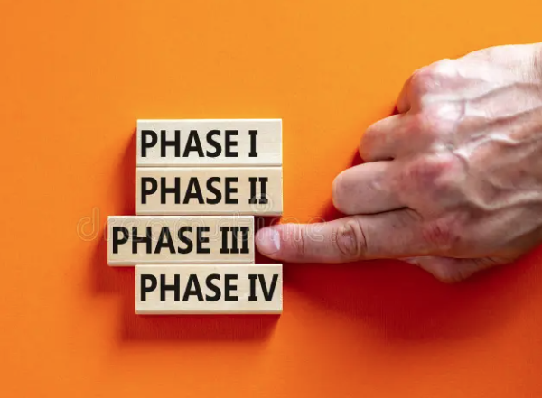
FRAMEWORK FOR SUCCESS
• Effective Communication
• Timing
• Pillars that support STRATEGY and INCLUSIVE RESEARCH
Ajudd & McKinnon (2021) A systematic map of inclusion equity and Diversity in Science communication. Frontiers in Communication
Ford & Alemneh (2024) Inclusive global scholarly communication: Toward a just and healthier information ecosystem. asist&t

Slide 7
LOCAL INSIGHTS: WHY THEY ARE CRUCIAL
• Importance of capturing regional diversity (e.g., disease prevalence).
• Case study or example: Tailoring strategies for underserved or emerging markets (eg, China DOPPS).
2023 Digital Health Monitor for the Pharma Sector (link: https://worldcomgroup.com/wp-content/uploads/2024/12/Worldcom_PharmaMonitor_2023-compressed.pdf)
Zuo et al (2016) Anemia management in the China Dialysis Outcomes and Practice Patterns Study. Blood Purif 42, 33-43 https://pubmed.ncbi.nlm.nih.gov/27045519/

Slide 8
TRANSLATING LOCAL INSIGHTS TO GLOBAL STRATEGIES
• LOCAL ↔ GLOBAL
• STRATEGIES:
Data-driven insights to identify global trends.
Voices of local experts.
Scalability without losing local nuances.

Slide 9
TECHNOLOGY IN INCLUSIVE COLLABORATION
Tools for Driving Inclusive Research
• Technology can bridge gaps:
• AI/ML to analyze diverse datasets.
• Digital platforms for global-local collaboration.
• Virtual/Hybrid models for co-creation.

Slide 10
BEST PRACTRICES IN COLLABORATION
• Strategies for Effective Collaboration
• Examples:
Knowledge-sharing (sessions) across regions.
Cultural competency as a core team value.

Slide 11
INDUSTRY SUCCESS STORIES
• Real-World Examples of Inclusive Collaboration
• Pharmaceutical clinical trials recruiting diverse populations.
• Product design leveraging cultural insights for regional adoption.

Slide 12
CALL TO ACTION
• Building a More Inclusive Research Ecosystem
• Audit current research collaboration practices for inclusivity.
• Invest in tools/training to empower local teams.

Slide 13
QUESTIONS / COMMENTS
Dikran Toroser PhD
UC San Diego
dtoroser@ucsd.edu
https://www.linkedin.com/in/dikrantoroser/

