Slide 1

Promises and Pitfalls of AI-Driven Content Creation in Academia
Hong Zhou
Senior Director of AI Services, Wiley

Slide 2
Outline
Context for AI writing
Available AI writing tools in the research journey
Wiley AI tools for writing
Wiley’s Guidelines for Responsible AI Use
Some suggestions
Final thoughts

Slide 3
How Generative AI is Related to Other AI Concepts
Now
Future Goal
Artificial Narrow Intelligence (ANI)
AI Generated Content (AIGC)
Output produced by generative AI in the form
of text, images, video, music, code…
Artificial General Intelligence(AGI)
Generative AI such as ChatGPT, Bard,
DALLE 2
Utilize LLMs as the underlying tech and train and finetune with more data to create content such as text, images, videos
Other Applications based on LLMs such as Language translation, Sentiment analysis, Information discovery…
A type of AI that possesses general intelligence which is similar to human intelligence
Large Language Models(LLMs) such as GPT-X, BERT
Trained on vast amounts of text data and can understand human language and used for content generation, translation, summarization, classification, Q&A and more
Notes:
There are some popular AI terms such as Large Language Models (LLMs), Generative AI (GAI), AI Generated Content (AIGC) that often appear alongside ChatGPT in the news and media. Before I show you some real applications, it is key to make clear what these concepts are and how they are related.
There are many large language models such as GPT, BERT which are trained on huge amounts of text and are considered to be the foundation on which to build generative AI.
Generative AI is just one type of AI specifically designed to generate original text, images or videos. There are also other types of AI that serve other purposes.
AIGC is the content/output produced by generative AI.
All these still belong to ANI which mainly performs a narrow range of tasks in specific areas.
But our ultimate goal is moving towards AGI where AI can processes general intelligence to solve different problems in different areas much like humans.

Slide 4
AI tools for text generation
Language tools lacking real-world understanding*
but mimic human speech.
On their own, they generate answers based on learned patterns, without true comprehension* of the content or fact-checking capacity.
*COMMON INTELLIGENCE TRAITS:
Reasoning, Knowledge Representation/Common Sense, Planning, Learning, Communicating in a Natural Language, Integration of all skills
They are statistical models learning patterns between words. Without a separate layer of verification from an updated source, output could be unreliable.
*M. Mitchel, D.C. Krakauer. “The debate over understanding in AI’s large language models”, PNAS 120 (13) e2215907120.
https://www.pnas.org/doi/10.1073/pnas.2215907120 | https://stackoverflow.blog/2023/07/03/do-large-language-models-know-what-they-are-talking-about/ | https://jeremyhadfield.com/why-llms-will-not-understand-language/
Notes:
Whether LLMs have “True Comprehension/Understanding” is hotly debated by AI experts, linguists, and philosophers. Some say that they cannot handle complex reasoning or extract true meaning, nor have critical thinking, common sense, intuition, contextualization, creativity, emotional grasp, or ethical/moral considerations. But they have also shown multistep thinking, problem solving, and produce creative output. Who’s right?
ChatGPT doesn’t give you information. It gives you information shaped sentences from Tweets of Neil Gilan

Slide 5



























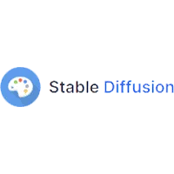

























AI Writing on the Research Journey
AI Writing on the Research Journey
Direction & Focus area
Literature Review
Experiment
& Conclusion
Publication
& Feedback
Peer
Review
Idea Generation
& Brainstorming →
AI-assisted research questions
Literature Summarization
& Reviews →
Extracting key insights.
Coding, Testing, Data Analysis & Visualization →
Automating insights from datasets.
Manuscript Drafting & Enhancement & Reformatting→
AI powered writing assistance
Review report drafting
& enhancement→
AI powered peer review assistance
Notes:
Writing is not only about writing text but also write code, create images, summarization, create ideas,
Writing is not only happened at authoring stage
Grammar, style, and coherence improvements.
Translation and localization
I would like to highlight that every publisher will have its own policies on what is and isn't permissible, and that we, for example, do not support writing peer review reports using AI

Slide 6
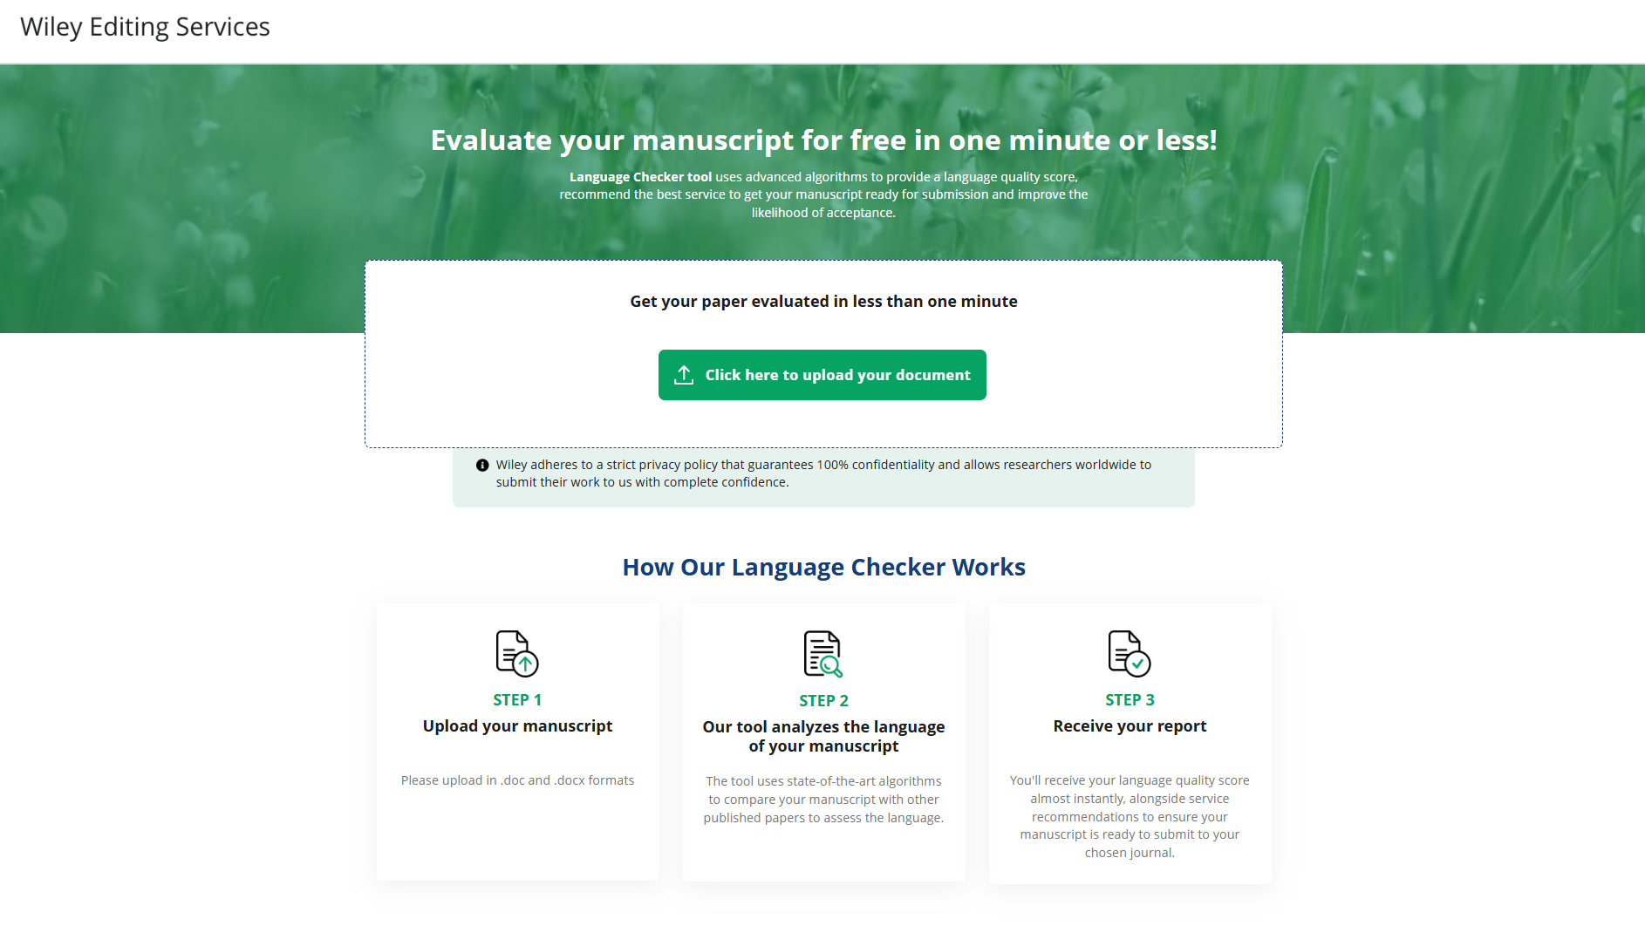
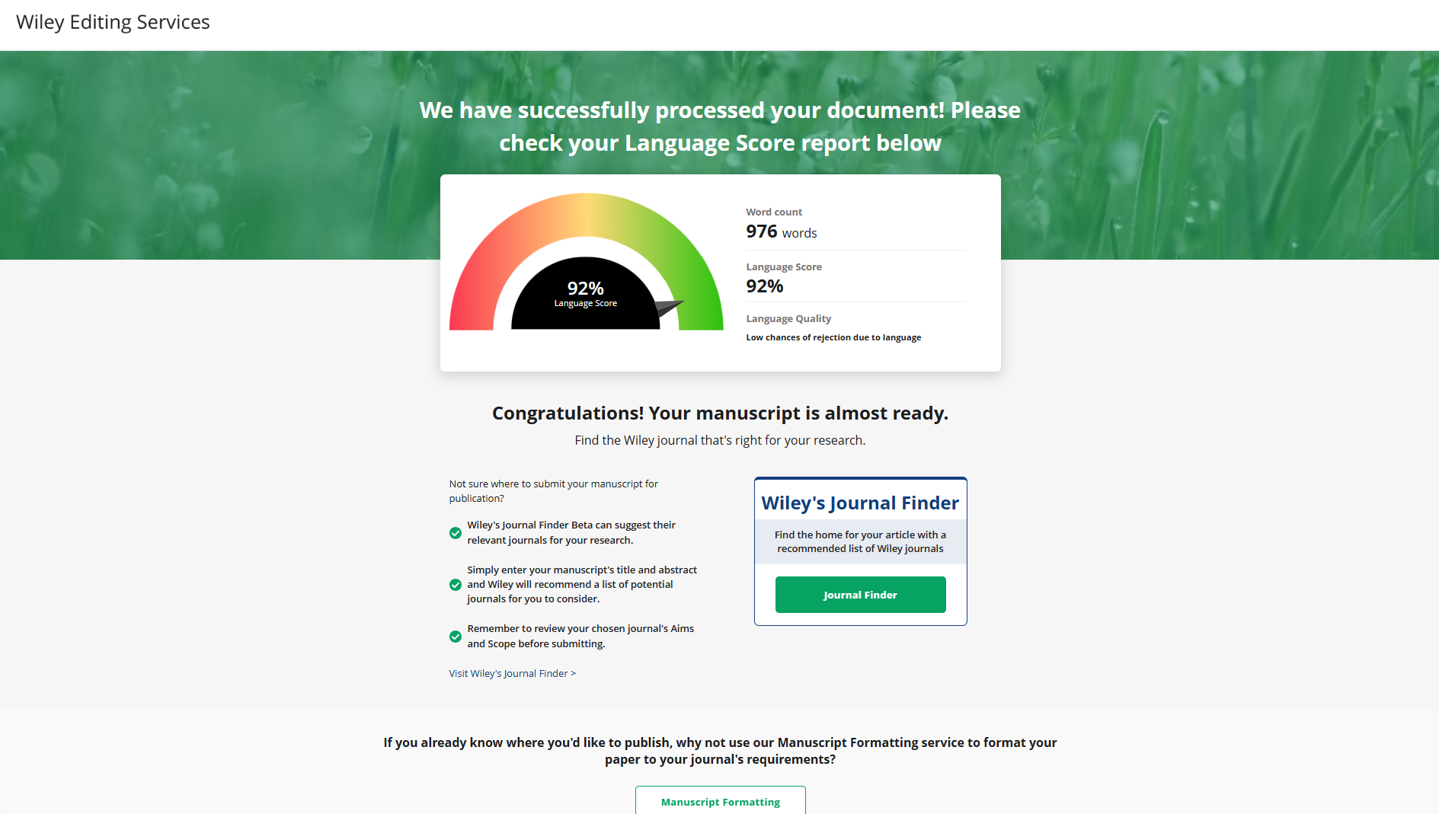
Wiley’s Manuscript Language Checker Tool

Slide 7
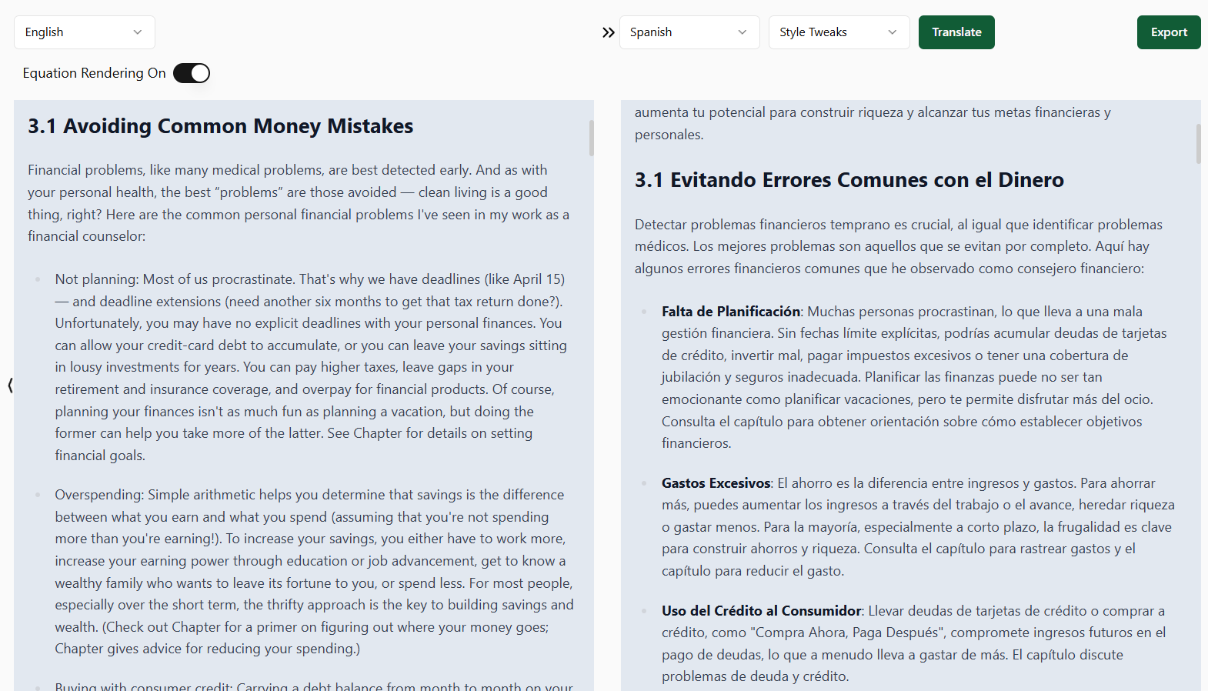
AI Studio: Wiley’s Experimental AI Suite
A Wiley-developed AI-powered suite of tools designed to support collaboration, content creation, and prototyping.
Key Capabilities:
  Collaborative authoring – AI-assisted writing in a shared environment.
  Bespoke tools – Translation, localization, and content summarization.
  Prototyping & Testing – Secure space for developing new AI-powered tools.
  AI Assistance – General support powered by OpenAI’s GPT models.
Looking Ahead
AI Studio is a testing ground for innovation at Wiley. While the platform itself is for internal use, the tools and capabilities we develop here will help shape future products for researchers, authors and other users.

Slide 8
AI tools for text generation: Key Issues
Pros
Cons
  Improved language modeling and translation
  Increased efficiency in monotonous/labor-intensive tasks.
    Summarizing texts
    Transcribing audio & retrieving structured information
    Automating transactions
    Content editing
  Speed in memorizing and analyzing data, helping users generate insights quicker.
    Optimized searches
    Assisted idea generation
    Organizing large amounts of data + easy access
  Training set limitations
    LLM training sets have cut-off dates
  Misinformation (false/inaccurate info, e.g. due to inherent errors dataset)
    LLMs cannot fact-check training info
  Disinformation (deliberately creating false info)
    AI HALLUCINATION; LLMs respond based on patterns & associations, not facts
  Biased Information
    Because of the training set and lack of transparency, LLMs can reflect biases
  Copyright and Privacy Concerns & Unwanted Data Mining
    Who owns the input? Output?
  Ethical, Philosophical & Environmental Points
https://deepchecks.com/top-5-risks-of-large-language-models/
https://medium.com/@fenjiro/large-language-models-llms-emergent-abilities-chatgpt-talks-moroccan-dialect-as-an-example-c945f93aa63a
Notes:
The Pitfalls & Ethical Considerations
Authorship & Accountability: Who takes responsibility for AI-generated content?
Plagiarism & Hallucinations: AI can fabricate references or misinterpret sources.
Bias & Misinformation: AI models trained on biased data can reinforce errors.

Slide 9
Wiley’s AI Principles for Responsible AI Use
Wiley embraces AI as a transformative technology. Our approach to AI is both visionary and vigilant: we believe AI presents an opportunity to accelerate the pace of innovation in research, learning, and academic publishing, but we are also aware of the risks associated with AI and are taking steps to mitigate them.
Human Oversight
Trustworthiness
and Transparency
Safety and Fairness
Governance and Accountability
Wiley believes AI solutions must be developed, leveraged, and maintained with human oversight.
Wiley makes transparency and trustworthiness core elements of our AI use and development.
Wiley is committed to ensuring our AI systems and processes are safe and fair.
Wiley will maintain appropriate governance over our use of AI and its incorporation into our business to manage risks and assure accountability.

Slide 10
Wiley GenAI ethics guidelines
As AI continues to evolve, so do our ethical requirements on the use of Gen AI in journal articles.
These guidelines will continue to evolve with the technology.
Transparency in Manuscripts
Restrictions
Editorial Decisions
  Any use of GenAI tools by authors must be described in detail in the Methods section, Acknowledgements, or via a disclosure statement.
  Authors are responsible for the accuracy of information provided by GenAI tools.
  Correct referencing of supporting work is required.
  GenAI tools must not be used to create, alter, or manipulate original research data and results.
  Tools used for spelling, grammar, and general editing are not included in these guidelines.
  Final decision on the appropriateness of GenAI tool use lies with the journal’s editor or responsible party.
Notes:
If an author has used a GenAI tool to develop any portion of a manuscript, its use must be described, transparently and in detail, in the Methods section (or via a disclosure or within the Acknowledgements section, as applicable). The author is fully responsible for the accuracy of any information provided by the tool and for correctly referencing any supporting work on which that information depends. GenAI tools must not be used to create, alter or manipulate original research data and results. Tools that are used to improve spelling, grammar, and general editing are not included in the scope of these guidelines. The final decision about whether use of a GenAI tool is appropriate or permissible in the circumstances of a submitted manuscript or a published article lies with the journal’s editor or other party responsible for the publication’s editorial policy.

Slide 11

GenAI authorship considerations
Authorship
Submission
Peer Review
Editorial Review
Production
Authorship
GenAI cannot:
  Initiate original research without human direction
  Be held accountable for published work or research design
  Hold or assign copyright because it lacks legal standing
  Fulfill the role of or be listed as an author
Notes:
GenAI tools cannot be considered capable of initiating an original piece of research without direction by humans. Tools cannot be accountable for a published work or for research design, which is a generally held requirement of authorship nor does it have legal standing or the ability to hold or assign copyright. Therefore—in accordance with COPE’s position statement on Authorship and AI tools—these tools cannot fulfil the role of, nor be listed as, an author of an article.

Slide 12

GenAI peer review considerations
Authorship
Submission
Peer Review
Editorial Review
Production
Production
Peer Review
GenAI tools can be used to improve written feedback in peer review reports:
  Use must be transparently declared upon report submission
  Editors and peer reviewers should not upload manuscripts or parts thereof into GenAI tools
  Use of input data by GenAI tools could violate confidentiality, privacy, and copyright
  Peer review is a human responsibility and must align with journal editorial policies
  Responsibility for peer review reports lies with individuals, not GenAI tools
Notes:
GenAI tools should be used only on a limited basis in connection with peer review. A GenAI tool can be used by an editor or peer reviewer to improve the quality of the written feedback in a peer review report. This use must be transparently declared upon submission of the peer review report to the manuscript’s handling editor. Independent of this limited use case, editors or peer reviewers should not upload manuscripts (or any parts of manuscripts including figures and tables) into GenAI tools or services. GenAI tools may use input data for training or other purposes, which could violate the confidentiality of the peer review process, privacy of authors and reviewers, and the copyright of the manuscript under review. Moreover, the peer review process is a human endeavor and responsibility and accountability for submitting a peer review report, in line with a journal’s editorial polices and peer review model, sits with those individuals who have accepted an invitation from a journal to undertake the peer review of a submitted manuscript. This process should not be delegated to a GenAI tool.

Slide 13
Your five-fold test in considering any ai tool: L-O-C-A-D
L: Limitations
  What was this AI tool designed to do? What is its purpose? What are its limits? Terms of use?
O: Ownership
  Copyright issues: Who owns the input? The product? The training set? Were proper licenses obtained?
  Can I use/reuse the product freely for the medium/purpose I am planning?
  Could I run into any copyright infringement problems?
C: Confidentiality
  Will I inadvertently disclose confidential information?
  Could I put my work in danger of being scooped?
  Are my data/prompts being used in the training set?
  Is my data protected?
A: Accuracy
  Is the output accurate? Can I trust this output?
  Have I done my own accuracy check of it? Am I prepared to take responsibility for this accuracy?
  Does the AI/app use current/validated information to produce the result?
D: Disclosure
  Does my institute, the journal, the publisher allow usage? What are the SOPs for disclosure?
Notes:
Before using AI tools, What was this AI tool designed to do? What are its limits?. Who owns your data? Will I disclose confidential information?
Is your input being used for AI training? Have I done my own accuracy check of it? Am I prepared to take responsibility for this accuracy?
Does your institute allow usage of tools on your work?

Slide 14
Final thoughts
Do not be afraid of AI tools. Familiarize & train yourself.
Read the fine print; L-O-C-A-D.
Use them lawfully and ethically. Let them enhance the way you do research,
but not replace human critical thinking, analysis, and creativity.
Notes:
AI is here to stay—embrace it responsibly.
Researchers must balance productivity gains with ethical concerns.
Publishers & institutions should provide clear AI usage policies

Slide 15
Questions?
Thank you!
https://scholarlykitchen.sspnet.org/author/hongzhou/

