Slide 1

Responsible Use of AI
in Peer Review
Jeffrey Robens
Head of Community Engagement
Nature Portfolio

Slide 2

Importance of peer review
Journals are expected to publish papers that are trustworthy and relevant for the field
Notes:
Photo by Edward Jenner: https://www.pexels.com/photo/portrait-of-female-scientist-in-white-lab-coat-smiling-4031690/

Slide 3
Importance of peer review
Journals are expected to publish papers that are trustworthy and relevant for the field
Journal editors may lack the technical and/or subject expertise to assess every submitted paper
Notes:
Photo by Edward Jenner: https://www.pexels.com/photo/portrait-of-female-scientist-in-white-lab-coat-smiling-4031690/

Slide 4
Importance of peer review
Journals are expected to publish papers that are trustworthy and relevant for the field
Journal editors may lack the technical and/or subject expertise to assess every submitted paper
Inviting experts from the field who have the appropriate expertise can address this issue
Notes:
Photo by Edward Jenner: https://www.pexels.com/photo/portrait-of-female-scientist-in-white-lab-coat-smiling-4031690/

Slide 5
Importance of peer review
Journals are expected to publish papers that are trustworthy and relevant for the field
Journal editors may lack the technical and/or subject expertise to assess every submitted paper
Inviting experts from the field who have the appropriate expertise can address this issue
However, reviewers are often overworked and (usually) not paid for their efforts
Notes:
Photo by Edward Jenner: https://www.pexels.com/photo/portrait-of-female-scientist-in-white-lab-coat-smiling-4031690/

Slide 6
Importance of peer review
Journals are expected to publish papers that are trustworthy and relevant for the field
Journal editors may lack the technical and/or subject expertise to assess every submitted paper
Inviting experts from the field who have the appropriate expertise can address this issue
However, reviewers are often overworked and (usually) not paid for their efforts
Can AI help?
Notes:
Photo by Edward Jenner: https://www.pexels.com/photo/portrait-of-female-scientist-in-white-lab-coat-smiling-4031690/

Slide 7

The benefits of AI
While most researchers enjoy peer review, some tasks are mundane or challenging
Notes:
Photo by Andrea Piacquadio: https://www.pexels.com/photo/woman-sitting-on-chair-while-leaning-on-laptop-3791136/

Slide 8
The benefits of AI
While most researchers enjoy peer review, some tasks are mundane or challenging
Checking all the references
Notes:
Photo by Andrea Piacquadio: https://www.pexels.com/photo/woman-sitting-on-chair-while-leaning-on-laptop-3791136/

Slide 9
The benefits of AI
While most researchers enjoy peer review, some tasks are mundane or challenging
Checking all the references
Ensuring statistics are appropriate
Notes:
Photo by Andrea Piacquadio: https://www.pexels.com/photo/woman-sitting-on-chair-while-leaning-on-laptop-3791136/

Slide 10
The benefits of AI
While most researchers enjoy peer review, some tasks are mundane or challenging
Checking all the references
Ensuring statistics are appropriate
Ensuring there is data duplication or manipulation
Notes:
Photo by Andrea Piacquadio: https://www.pexels.com/photo/woman-sitting-on-chair-while-leaning-on-laptop-3791136/

Slide 11
The benefits of AI
While most researchers enjoy peer review, some tasks are mundane or challenging
Checking all the references
Ensuring statistics are appropriate
Ensuring there is data duplication or manipulation
These tasks can be managed by AI to allow reviewers to spend more time on higher level evaluation of the study
Notes:
Photo by Andrea Piacquadio: https://www.pexels.com/photo/woman-sitting-on-chair-while-leaning-on-laptop-3791136/

Slide 12

Proofig AI – used by many journals including Nature and Science
3rd party AI tool that can detect numerous data manipulations

Slide 13
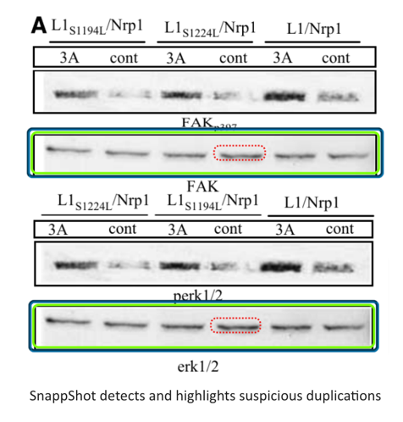
Snapp Shot from Springer Nature
In-house AI-trained tool used to detect figure manipulation
Currently can only detect duplication of immunoblots
Currently training on other image types
Currently training on detecting plagiarized images (i.e., previously published)

Slide 14

Is it okay for AI to be a reviewer?
Journals are expected to publish papers that are trustworthy and relevant for the field
Notes:
Image created by Microsoft Copilot

Slide 15
Is it okay for AI to be a reviewer?
Journals are expected to publish papers that are trustworthy and relevant for the field
Can AI match the technical and subject expertise of human reviewers?
Notes:
Image created by Microsoft Copilot

Slide 16
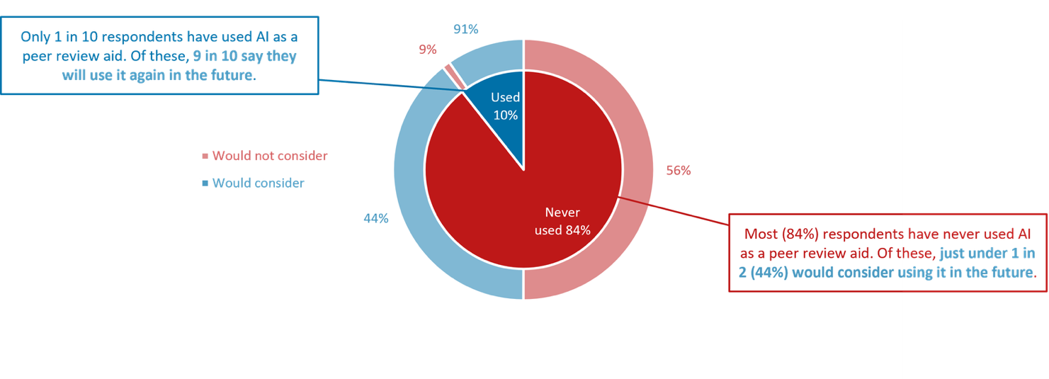
What do researchers think?
We asked over 3000 researchers for their views on using AI in peer review
10% have already used it and 90% would use it again

Slide 17
What do researchers think?
We asked over 3000 researchers for their views on using AI in peer review
10% have already used it and 90% would use it again
Of those who haven’t used it yet, 44% said they would consider it in the future

Slide 18
What is Springer Nature’s current policy?
“Peer reviewers play a vital role in scientific publishing. Their expert evaluations and recommendations guide editors in their decisions and ensure that published research is valid, rigorous, and credible. Editors select peer reviewers primarily because of their in-depth knowledge of the subject matter or methods of the work they are asked to evaluate. This expertise is invaluable and irreplaceable. Peer reviewers are accountable for the accuracy and views expressed in their reports, and the peer review process operates on a principle of mutual trust between authors, reviewers and editors. Despite rapid progress, generative AI tools have considerable limitations: they can lack up-to-date knowledge and may produce nonsensical, biased or false information. Manuscripts may also include sensitive or proprietary information that should not be shared outside the peer review process. For these reasons we ask that, while Springer Nature explores providing our peer reviewers with access to safe AI tools, peer reviewers do not upload manuscripts into generative AI tools.”
https://www.nature.com/nature-portfolio/editorial-policies/ai

Slide 19
What is Springer Nature’s current policy?
“Peer reviewers play a vital role in scientific publishing. Their expert evaluations and recommendations guide editors in their decisions and ensure that published research is valid, rigorous, and credible. Editors select peer reviewers primarily because of their in-depth knowledge of the subject matter or methods of the work they are asked to evaluate. This expertise is invaluable and irreplaceable. Peer reviewers are accountable for the accuracy and views expressed in their reports, and the peer review process operates on a principle of mutual trust between authors, reviewers and editors. Despite rapid progress, generative AI tools have considerable limitations: they can lack up-to-date knowledge and may produce nonsensical, biased or false information. Manuscripts may also include sensitive or proprietary information that should not be shared outside the peer review process. For these reasons we ask that, while Springer Nature explores providing our peer reviewers with access to safe AI tools, peer reviewers do not upload manuscripts into generative AI tools.”
https://www.nature.com/nature-portfolio/editorial-policies/ai

Slide 20
What is Springer Nature’s current policy?
“Peer reviewers play a vital role in scientific publishing. Their expert evaluations and recommendations guide editors in their decisions and ensure that published research is valid, rigorous, and credible. Editors select peer reviewers primarily because of their in-depth knowledge of the subject matter or methods of the work they are asked to evaluate. This expertise is invaluable and irreplaceable. Peer reviewers are accountable for the accuracy and views expressed in their reports, and the peer review process operates on a principle of mutual trust between authors, reviewers and editors. Despite rapid progress, generative AI tools have considerable limitations: they can lack up-to-date knowledge and may produce nonsensical, biased or false information. Manuscripts may also include sensitive or proprietary information that should not be shared outside the peer review process. For these reasons we ask that, while Springer Nature explores providing our peer reviewers with access to safe AI tools, peer reviewers do not upload manuscripts into generative AI tools.”
https://www.nature.com/nature-portfolio/editorial-policies/ai

Slide 21
What is Springer Nature’s current policy?
“Peer reviewers play a vital role in scientific publishing. Their expert evaluations and recommendations guide editors in their decisions and ensure that published research is valid, rigorous, and credible. Editors select peer reviewers primarily because of their in-depth knowledge of the subject matter or methods of the work they are asked to evaluate. This expertise is invaluable and irreplaceable. Peer reviewers are accountable for the accuracy and views expressed in their reports, and the peer review process operates on a principle of mutual trust between authors, reviewers and editors. Despite rapid progress, generative AI tools have considerable limitations: they can lack up-to-date knowledge and may produce nonsensical, biased or false information. Manuscripts may also include sensitive or proprietary information that should not be shared outside the peer review process. For these reasons we ask that, while Springer Nature explores providing our peer reviewers with access to safe AI tools, peer reviewers do not upload manuscripts into generative AI tools.”
https://www.nature.com/nature-portfolio/editorial-policies/ai

Slide 22

We want to know what reviewers think, not AI!
Notes:
Photo by Alena Darmel via Pexels (CC0)

Slide 23
What is Springer Nature’s current policy?
“Peer reviewers play a vital role in scientific publishing. Their expert evaluations and recommendations guide editors in their decisions and ensure that published research is valid, rigorous, and credible. Editors select peer reviewers primarily because of their in-depth knowledge of the subject matter or methods of the work they are asked to evaluate. This expertise is invaluable and irreplaceable. Peer reviewers are accountable for the accuracy and views expressed in their reports, and the peer review process operates on a principle of mutual trust between authors, reviewers and editors. Despite rapid progress, generative AI tools have considerable limitations: they can lack up-to-date knowledge and may produce nonsensical, biased or false information. Manuscripts may also include sensitive or proprietary information that should not be shared outside the peer review process. For these reasons we ask that, while Springer Nature explores providing our peer reviewers with access to safe AI tools, peer reviewers do not upload manuscripts into generative AI tools.”
https://www.nature.com/nature-portfolio/editorial-policies/ai

Slide 24
What is Springer Nature’s current policy?
“Peer reviewers play a vital role in scientific publishing. Their expert evaluations and recommendations guide editors in their decisions and ensure that published research is valid, rigorous, and credible. Editors select peer reviewers primarily because of their in-depth knowledge of the subject matter or methods of the work they are asked to evaluate. This expertise is invaluable and irreplaceable. Peer reviewers are accountable for the accuracy and views expressed in their reports, and the peer review process operates on a principle of mutual trust between authors, reviewers and editors. Despite rapid progress, generative AI tools have considerable limitations: they can lack up-to-date knowledge and may produce nonsensical, biased or false information. Manuscripts may also include sensitive or proprietary information that should not be shared outside the peer review process. For these reasons we ask that, while Springer Nature explores providing our peer reviewers with access to safe AI tools, peer reviewers do not upload manuscripts into generative AI tools.”
https://www.nature.com/nature-portfolio/editorial-policies/ai

Slide 25

Notes:
Photo by SIMON LEE on Unsplash

Slide 26
Positive results
Notes:
Photo by SIMON LEE on Unsplash

Slide 27
Positive results
Failed attempts
Negative results
Optimizations
Notes:
Photo by SIMON LEE on Unsplash

Slide 28
Positive results
Gen AI is limited by its training data
Biased towards positive results in published articles
Failed attempts
Negative results
Optimizations
Notes:
Photo by SIMON LEE on Unsplash

Slide 29
Positive results
Gen AI is limited by its training data
Biased towards positive results in published articles
Researchers have broader experience
Editors choose reviewers based on their subject and technical expertise
Failed attempts
Negative results
Optimizations
Notes:
Photo by SIMON LEE on Unsplash

Slide 30
What is Springer Nature’s current policy?
“Peer reviewers play a vital role in scientific publishing. Their expert evaluations and recommendations guide editors in their decisions and ensure that published research is valid, rigorous, and credible. Editors select peer reviewers primarily because of their in-depth knowledge of the subject matter or methods of the work they are asked to evaluate. This expertise is invaluable and irreplaceable. Peer reviewers are accountable for the accuracy and views expressed in their reports, and the peer review process operates on a principle of mutual trust between authors, reviewers and editors. Despite rapid progress, generative AI tools have considerable limitations: they can lack up-to-date knowledge and may produce nonsensical, biased or false information. Manuscripts may also include sensitive or proprietary information that should not be shared outside the peer review process. For these reasons we ask that, while Springer Nature explores providing our peer reviewers with access to safe AI tools, peer reviewers do not upload manuscripts into generative AI tools.”
https://www.nature.com/nature-portfolio/editorial-policies/ai

Slide 31
What is Springer Nature’s current policy?
“Peer reviewers play a vital role in scientific publishing. Their expert evaluations and recommendations guide editors in their decisions and ensure that published research is valid, rigorous, and credible. Editors select peer reviewers primarily because of their in-depth knowledge of the subject matter or methods of the work they are asked to evaluate. This expertise is invaluable and irreplaceable. Peer reviewers are accountable for the accuracy and views expressed in their reports, and the peer review process operates on a principle of mutual trust between authors, reviewers and editors. Despite rapid progress, generative AI tools have considerable limitations: they can lack up-to-date knowledge and may produce nonsensical, biased or false information. Manuscripts may also include sensitive or proprietary information that should not be shared outside the peer review process. For these reasons we ask that, while Springer Nature explores providing our peer reviewers with access to safe AI tools, peer reviewers do not upload manuscripts into generative AI tools.”
https://www.nature.com/nature-portfolio/editorial-policies/ai

Slide 32
What is Springer Nature’s current policy?
“Peer reviewers play a vital role in scientific publishing. Their expert evaluations and recommendations guide editors in their decisions and ensure that published research is valid, rigorous, and credible. Editors select peer reviewers primarily because of their in-depth knowledge of the subject matter or methods of the work they are asked to evaluate. This expertise is invaluable and irreplaceable. Peer reviewers are accountable for the accuracy and views expressed in their reports, and the peer review process operates on a principle of mutual trust between authors, reviewers and editors. Despite rapid progress, generative AI tools have considerable limitations: they can lack up-to-date knowledge and may produce nonsensical, biased or false information. Manuscripts may also include sensitive or proprietary information that should not be shared outside the peer review process. For these reasons we ask that, while Springer Nature explores providing our peer reviewers with access to safe AI tools, peer reviewers do not upload manuscripts into generative AI tools.”
https://www.nature.com/nature-portfolio/editorial-policies/ai

Slide 33

What does the future look like?
As models and their training data improve to decrease hallucinations and biases, their role in peer review will become more common…
Notes:
Pexel – RF studio

Slide 34
What does the future look like?
As models and their training data improve to decrease hallucinations and biases, their role in peer review will become more common…
But reviewer and editorial oversight will always be necessary!
Notes:
Pexel – RF studio

Slide 35
What does the future look like?
As models and their training data improve to decrease hallucinations and biases, their role in peer review will become more common…
But reviewer and editorial oversight will always be necessary!
In-house tools for data privacy and security
Notes:
Pexel – RF studio

Slide 36
What does the future look like?
As models and their training data improve to decrease hallucinations and biases, their role in peer review will become more common…
But reviewer and editorial oversight will always be necessary!
In-house tools for data privacy and security
Transparency in the use of these tools
Notes:
Pexel – RF studio

Slide 37
What does the future look like?
As models and their training data improve to decrease hallucinations and biases, their role in peer review will become more common…
But reviewer and editorial oversight will always be necessary!
In-house tools for data privacy and security
Transparency in the use of these tools
Adherence to accepted international standards
Notes:
Pexel – RF studio

Slide 38

Thank you
Dr. Jeffrey Robens
Head of Community Engagement
jeffrey.robens@nature.com

