Slide 1

Redefining Scholarly Success: Alternative Metrics and Open
Access in Publishing
Liu Jinjin, Assoc. Prof., Ph.D.
Managing editor at Journal of Acute Disease, Hainan Medical University

Slide 2
Outline
Traditional Metrics in Publishing & Limitations
Alternative Metrics: A Multi-Dimensional Approach
Why Open Access Matters: Key Benefits
The Role of Open Access in Enabling Alternative Metrics
Discussion & Conclusion

Slide 3
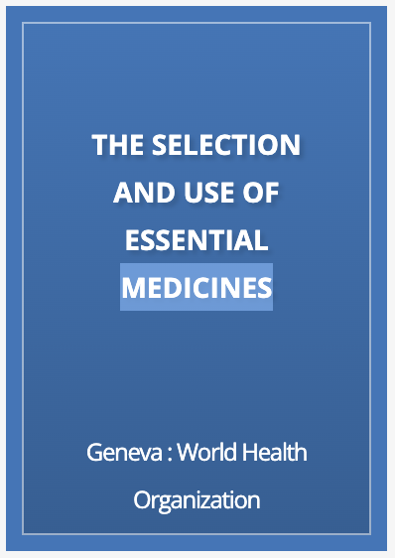
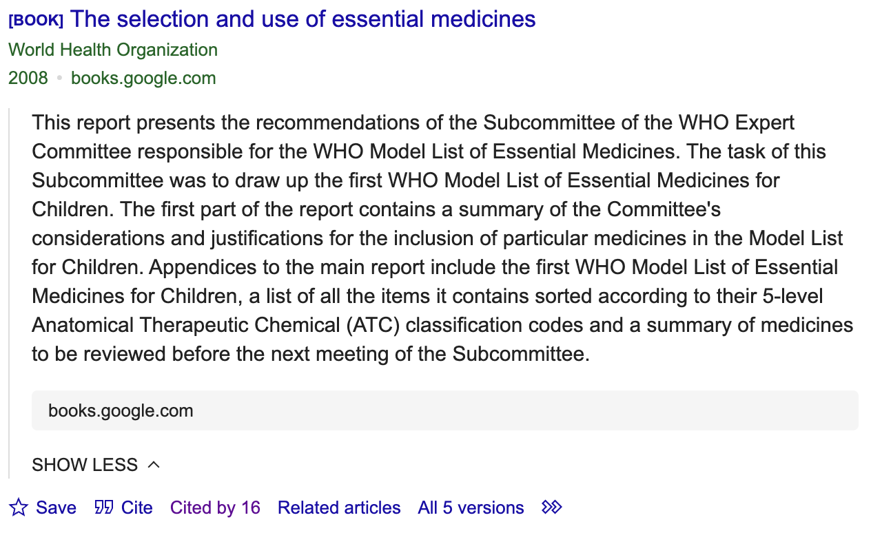
Think About This
Do you believe that groundbreaking study in a niche field may not attract high citations but could have significant real-world impact?
How do you think influence can be measured beyond just citation counts?
Accessed on 12 January, 2025

Slide 4


Traditional metrics in publishing
Impact Factor (IF)
CiteScore
SCImago Journal Rank (SJR)
Source-Normalized Impact per Paper (SNIP)
Eigenfactor
Journal
Research
H-index

Slide 5
Limitations of Traditional Metrics
Short-Term Focus
Ignores Non-Citation Impacts
Bias Against Interdisciplinary Research
Neglect of Emerging Research Types
Field-Specific Disparities
Lack of Transparency
Overemphasis on Journal Prestige
Regional and Language Bias
Gaming the System
Focus on Quantity Over Quality

Slide 6








Alternative Metrics: A Multi-Dimensional Approach
Data and Code Reuse
Collaborative Network Influence
Public Engagement
Clinical Guidelines
Views and Downloads
Social Media Mentions
Educational Resource
Inclusion
Policy Citations

Slide 7



Why Open Access Matters: Key Benefits
Visibility
Accessibility
Transparency

Slide 8
The Role of Open Access in Enabling Alternative Metrics
Social Engagement
Policy Influence
OA
Reproducibility
Interdisciplinarity

Slide 9

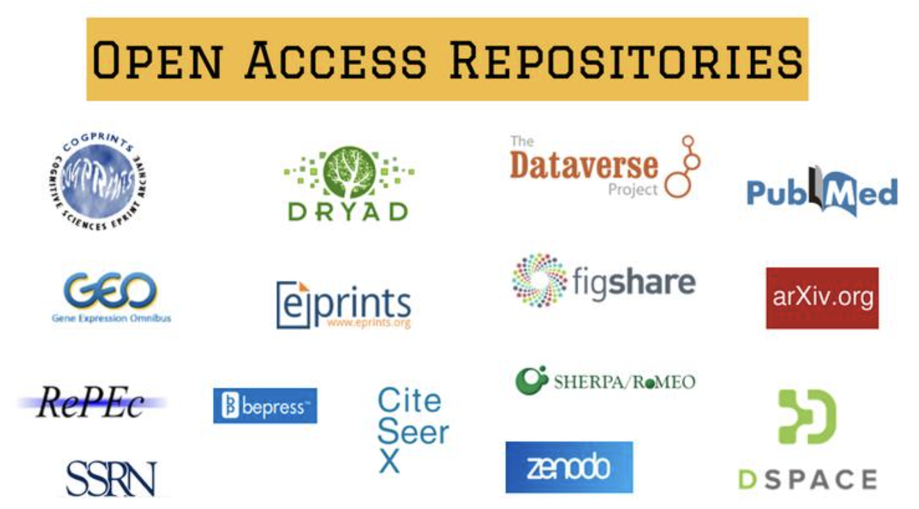






Challenges and Opportunities
Challenges
  Standardizing alternative metrics across disciplines.
  Risks of gaming metrics like social media engagement.
  Institutional resistance to moving beyond the Impact Factor.
Tools for Measuring Alternative Metrics
https://plos.org/dora/

Slide 10

Discussion & Conclusion
Redefine Success with Alternative Metrics
Adapt to Evolving Publishing Models
Broaden Research Impact

Slide 11
References
Seglen, P.O. (1997) Why the impact factor of journals should not be used for evaluating research. The BMJ 314: 498–502.
Nicola Francesco Dotti, Julia Walczyk. What is the societal impact of university research? A policy-oriented review to map approaches, identify monitoring methods and success factors. Evaluation and Program Planning 2022; 95: 102157.
https://plos.org/dora/
Sam Rye. Visibility in Open Access Publishing. Academic Resources, Open Access, Open Science 2023. Available from: https://blog.mdpi.com/2023/10/20/visibility-in-open-access/?utm_source=chatgpt.com
Sunaina Singh. Are we there yet? Making open access truly open and accessible. Editage Insights 2023. Available from: https://www.editage.com/insights/are-we-there-yet-making-open-access-truly-open-and-accessible?utm_source=chatgpt.com
John Lenahan. Unlocking knowledge: How open access initiatives are bridging resource gaps. JSTOR 2023. Available from: https://about.jstor.org/blog/open-access-initiatives/?utm_source=chatgpt.com
http://www.eigenfactor.org/
http://www.scimagojr.com/
http://altmetrics.org/tools/
https://doaj.org/

Slide 12
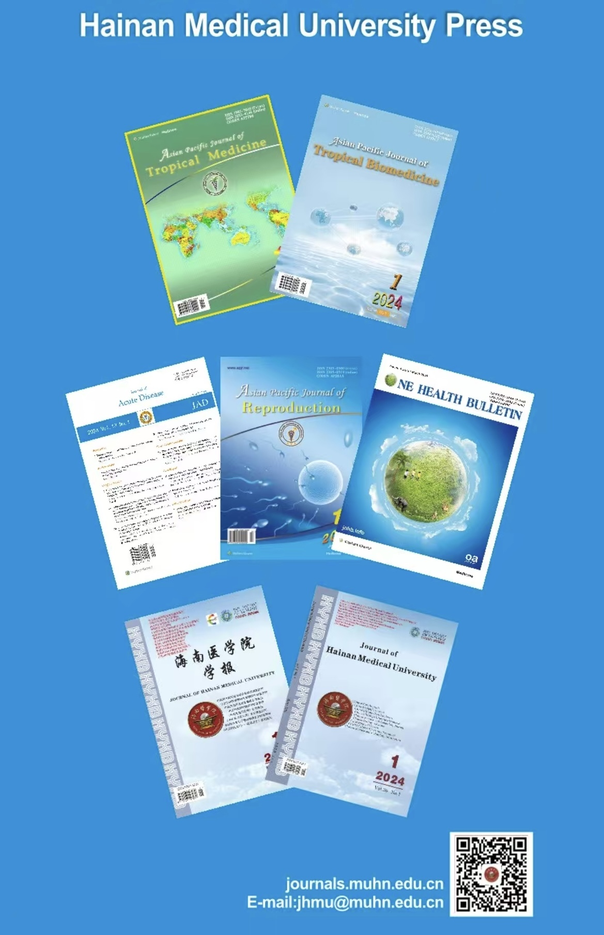

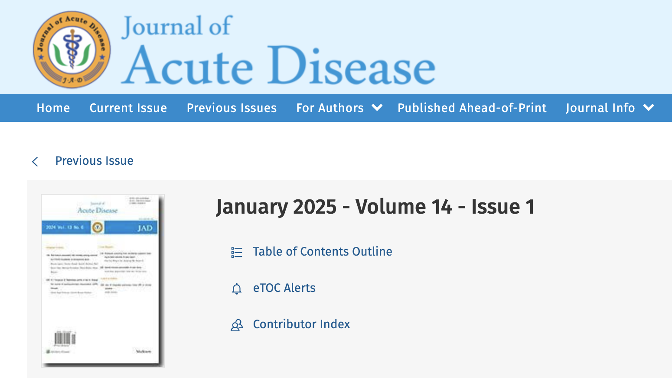
Journal of Acute Disease - a publication of Hainan Medical University
Scope:
Pre-hospital and hospital emergency medicine
Disaster medicine
Critical diseases
Related medical specialties
Diamond OA
JAD is indexed by
Web of Science-ESCI
DOAJ
EMBASE/Excerpta Medica
We’re recruiting Editorial Board Members & Young Editorial Board Members & Guest Editors
Welcome to submit at: jad@muhn.edu.cn

Slide 13
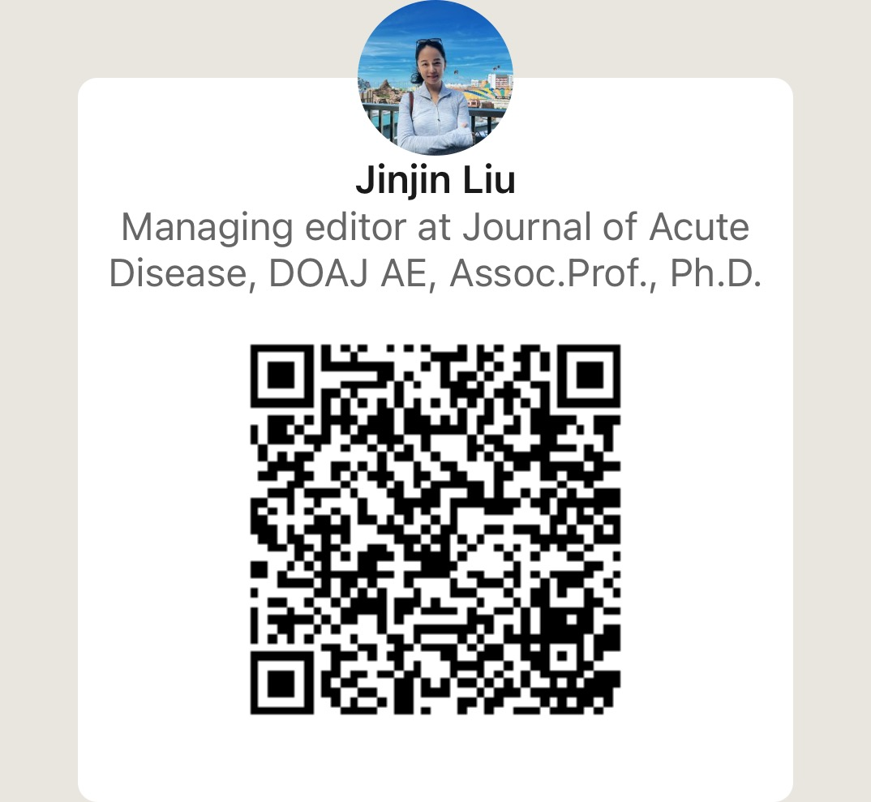

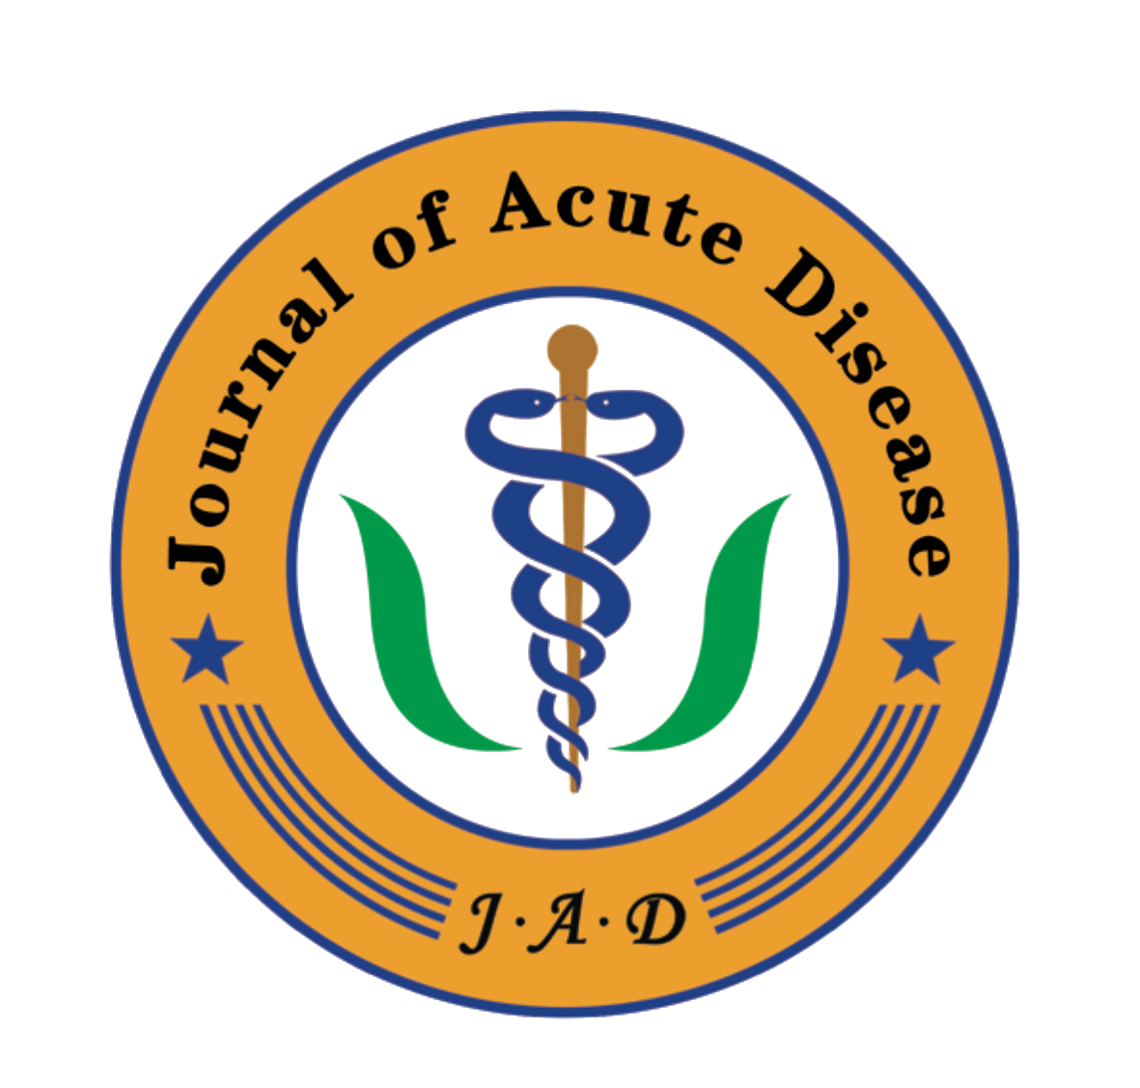

Open Access is not just about access; it’s about unlocking the potential of research to change lives.
Thank you!
Scan to connect on LinkedIn
Email address: liujinjin_2007@126.com

