Slide 1
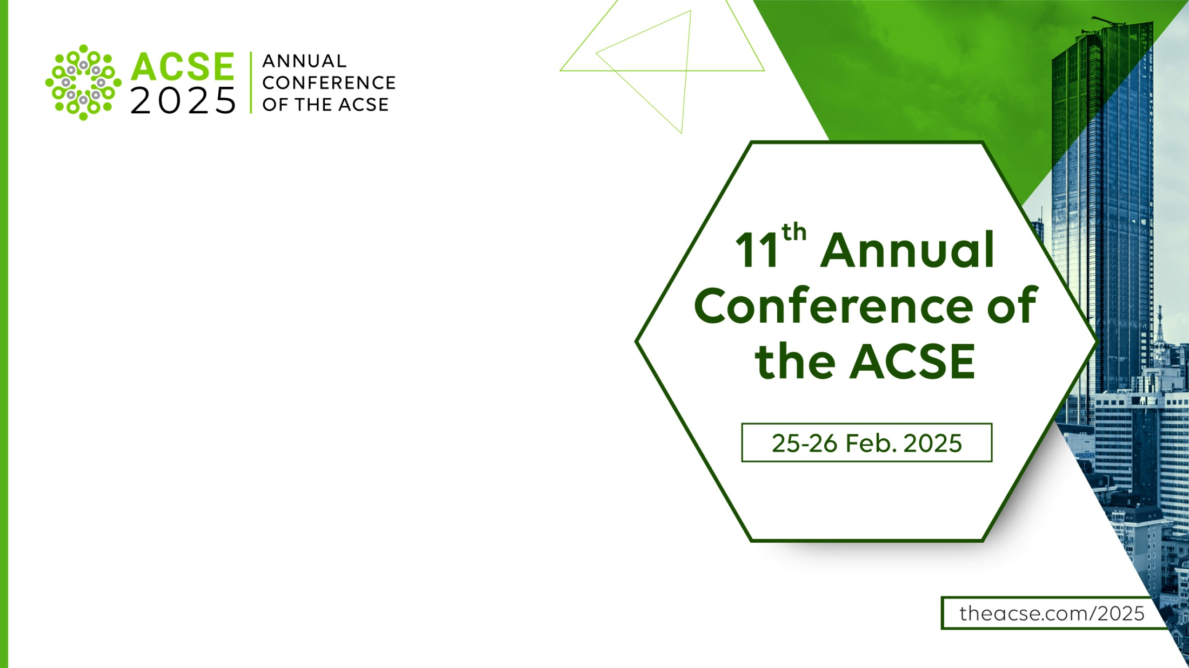
Is Gen AI a Way to Make
Peer Review Multilingual?
Maria Machado
Affiliate Senior Associate
Maverick Publishing Specialists

Slide 2
From an actual review report…
Comment Y:
Several of the cited articles are written in a language other than English (a, x, k), so their content will not be understood by most XXX journal readers.
Would it be possible to replace them with English-language publications?

Slide 3
A single universal language in science
Facilitates international scientific communication
Enables more widespread international mobility
Unified repository for publications and data
Possibility of large gaps within global databases, affecting policy, management, and decision-making
Limits the geographical and taxonomic coverage in biodiversity studies
Pressure to improve language skills is heavier on learners whose dominant language is highly divergent from English
Notes:
Relative number of mathematics, physics, and computer science documents citing non-English works

Slide 4
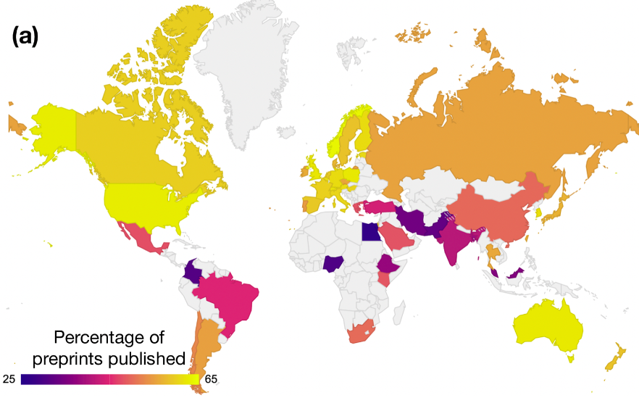
From the rebuttal
Distinguish between
the relatively limited demand for non-English sources among most readers
the practice of excluding such references from the scientific record
WHY?
Credit
Reduce plagiarism
Ensure originality
Eckmann P, Bandrowski A (2023) PreprintMatch: A tool for preprint to publication detection shows global inequities in scientific publication. PLoS ONE 18(3): e0281659. https://doi.org/10.1371/journal.pone.0281659

Slide 5

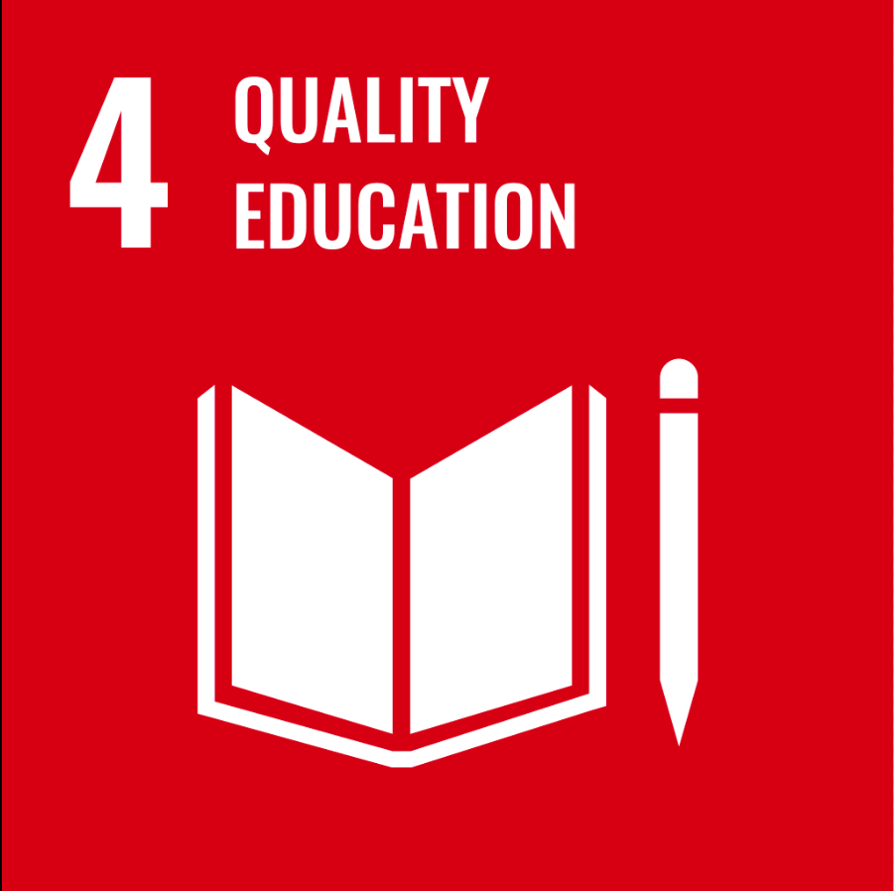
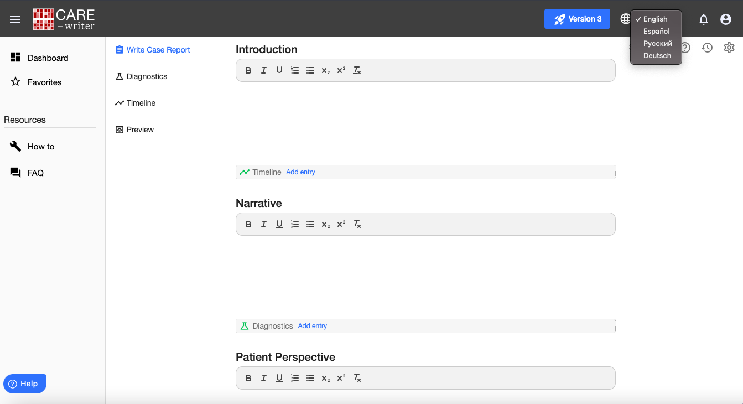
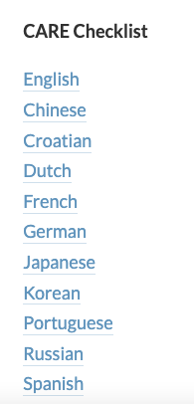
How can AI help?
CARE-writer is an online application that helps authors organize and format the information necessary to write systematic and transparent case reports while following the CARE guidelines.

Slide 6
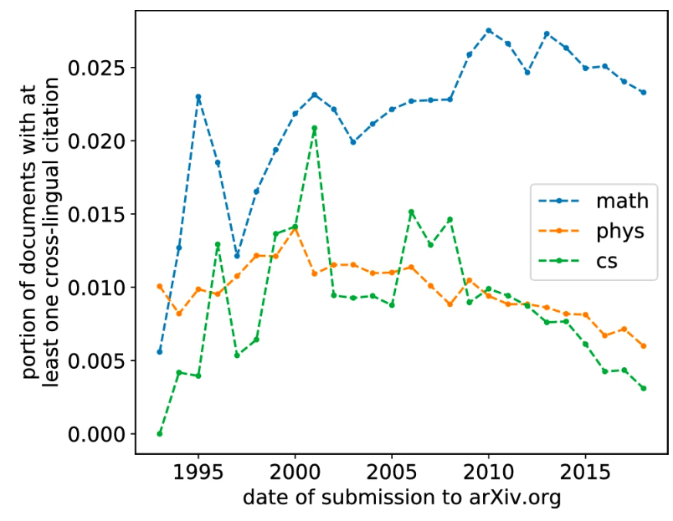
Citations are an essential tool for scientific practice
…PubMed Central may accept non-English articles and/or English articles with non-English parts (titles, abstracts, etc.)
… However, manuscripts written in scripts other than Latin (e.g., Russian, Japanese) cannot be processed by the NIHMS
https://www.ncbi.nlm.nih.gov/pmc/pmcdoc/tagging-guidelines/article/genprac.html
Saier, T., Färber, M. & Tsereteli, T. Cross-lingual citations in English papers: a large-scale analysis of prevalence, usage, and impact. Int J Digit Libr 23, 179–195 (2022). https://doi.org/10.1007/s00799-021-00312-z

Slide 7
What about Peer Review?
Biases during peer review may lead non-Anglophones to publish in lesser-known journals or in regional journals that publish in other languages, making their research less discoverable (Mur Dueñas 2012).
Mur Dueñas P, Getting research published internationally in English: An ethnographic account of a team of Finance Spanish scholars' struggles.
Ibérica, Revista de la Asociación Europea de Lenguas para Fines Específicos [Internet]. 2012; (24):139-155. Recuperado de: https://www.redalyc.org/articulo.oa?id=287024476012
These burdens intensify the dependence of many non-Anglophone scientists on scientists with high English proficiency (Ordóñez-Matamoros et al. 2011).
Ordóñez-Matamoros G, Cozzens SE, Garcia-Luque M. 2011. North-South and South-South research collaboration: What differences does it make for developing countries? The case of Colombia. Pages 1–11 in Melkers J, Monroe-White T, Cozzens SE, eds. 2011 Atlanta Conference on Science and Innovation Policy. IEEE. doi:10.1109/ACSIP.2011.6064479
Ultimately, these barriers can impede non-Anglophones from obtaining jobs, tenure, or promotion (Moreno 2010).
Moreno A. 2010. Researching into English for research publication purposes from an applied intercultural perspective. Pages 59–73 in Ruiz-Garrido MF, Palmer-Silveira JC, Fortanet-Gómez I, eds. English for Professional and Academic Purposes. Utrecht Studies in Language and Communication, vol. 22. Rodopi.

Slide 8
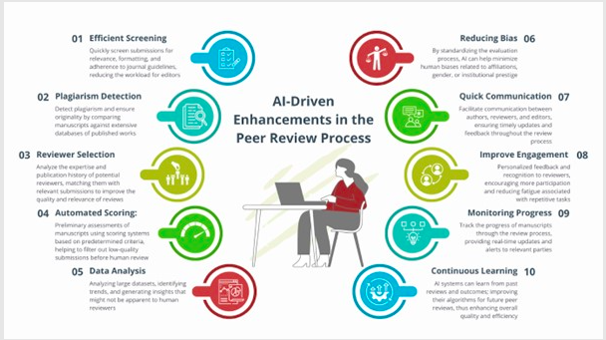
Balancing technological advancements with human expertise
Sarwar M, Machado MJ, Robens J, Dyke G, Sayab M. (2025) Bridging tradition and technology: expert insights on the future of innovation in peer review Sci Ed. 48. doi: 10.36591/SE-4801-01

Slide 9
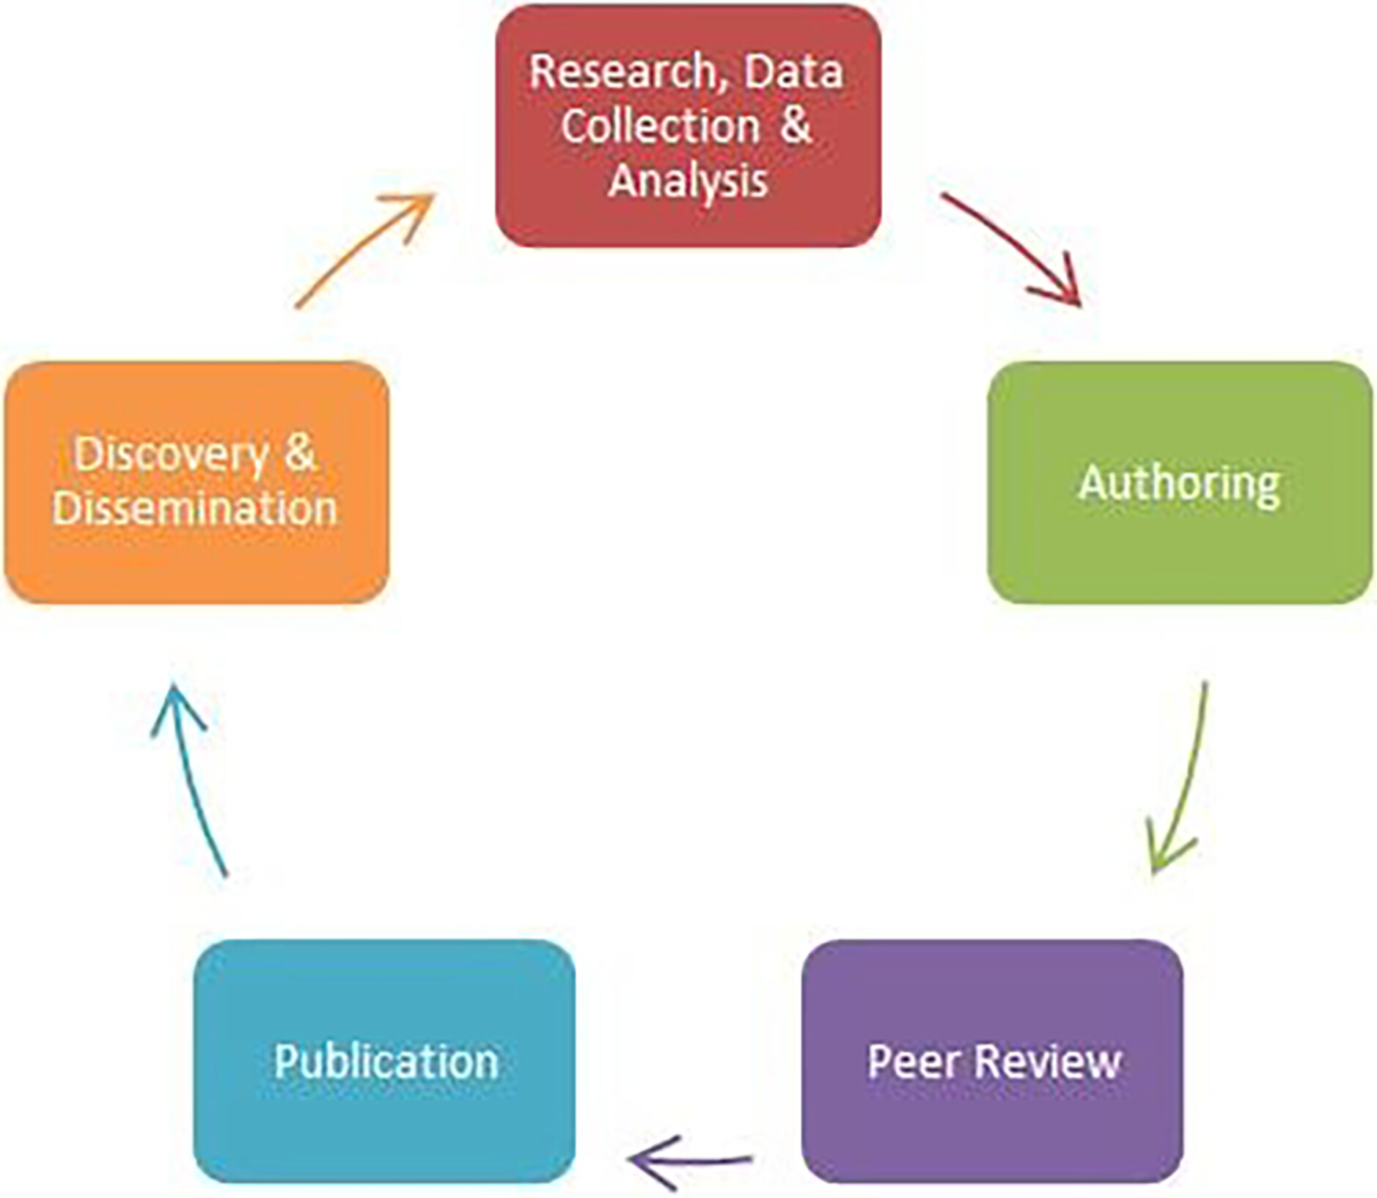
Peer review is a fundamental aspect of the communication of research in scholarly publishing
The peer review process is majorly imbalanced in terms of power
Consider accessibility and share training materials asynchronously
Provide hands-on experiences to promote early involvement
Target outreach for potential audiences to optimize resources
Diversify the voices delivering the content to link all the steps of the scholarly communication cycle
do Amaral JC, Sarich N, Hensley MK, Machado MJ (2025) Librarians at the Center of Peer Review Training: Increasing Collaboration Among Scholarly Communication Stakeholders. Learned Publishing, 38: e1657. https://doi.org/10.1002/leap.1657
Scholarly Communication Cycle, Association of College & Research Libraries

Slide 10
What else can editors do to help?
Cross-lingual citation is widely recognized by scholars as an essential way to prevent the "siloing" of scientific discoveries across linguistic barriers
Using the appropriate language is paramount for effective communication, so we all know what we are talking about.
Transparent citation and metadata deposition policies are essential in ensuring diversity in cultural backgrounds for authors and reviewers
We need an easy and reliable method for identifying cross-lingual citations
”We translate Cochrane evidence to make it more accessible, and
to reduce the linguistic barrier to global evidence-informed health decisions.”

Slide 11
When and how to translate own research output
Do you meet one or more of these conditions:
My work is conducted in a region where the primary language is not English
My primary language or that of one or more of my collaborators is not English
My work directly or indirectly affets a group of people whose primary language is not English
Translate by hand, or employ a medical translator/writer, or use machine translators and then correct for accuracy
Translate using machine translators and provide a disclaimer with the translation that explains it was not corrected
Consider translating your research for a lay audience (eg, a plain language summary, blog post, comic strip, podcast, etc.)
Steigerwald, E., Ramírez-Castañeda, V., Brandt, D. Y. C., Báldi, A., Shapiro, J. T., Bowker, L., & Tarvin, R. D. (2022). Overcoming Language Barriers in Academia: Machine Translation Tools and a Vision for a Multilingual Future. Bioscience, 72(10), 988–998. https://doi.org/10.1093/biosci/biac062

Slide 12
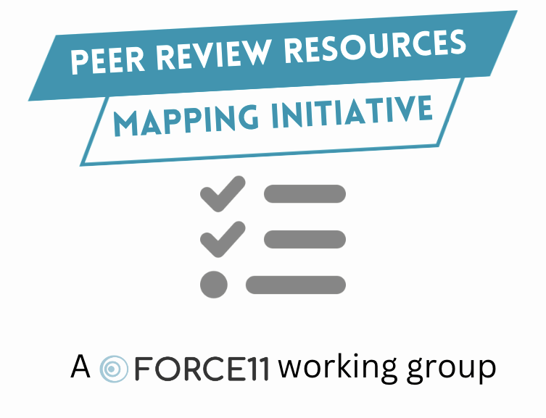
Advocating for standardization
Publishers
Editors
Librarians
Researchers
Machado MJ, Dyke G, Havemann J. (2024) Enhancing Peer Review Standards for Quality Research Publications, Access 2 Perspectives [Preprint]. doi:10.21428/51e64700.fcd86e15.
Notes:
I’m often asked “Who reviews the reviewers?”. In the traditional publishing model, journal editors choose reviewers based on their expertise. Reviewers can choose to post comments on preprints that they have a particular interest in, based on their own research experience. Crowd-sourced models have also begun to flourish. But there is no definition of what a GOOD peer review is and how to recognise it. That’s what we aim to change, by providing curated resources for training, quality standards, and raising pertinent questions that evolved from the current context. We want to help maintain integrity in the peer review process, by involving the community in assessing their own training needs.

Slide 13


Take-aways
Require identifiers (ORCID; RRID; PMID/PMCID; ISSN)
Soften word limits
Accept methodological shortcut citations
Provide templates for standardized statements
Supply Latinized article titles
Publish peer review reports with their own DOI
Engage diverse researcher communities through training
Maria Machado

