Slide 1

The Origin of Academic Publishing
and Its Future in the AI Era
By Mingfang Lu, Guoxing Liu, Fengjie Cen,
and Liping Xu
Mingfang Lu
AiScholar

Slide 2
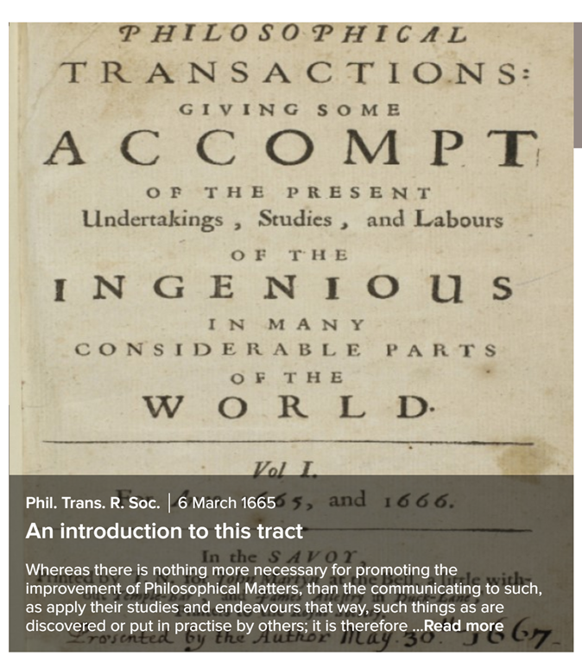
Introduction
Overview and Outline
  Historical origins
  Evolution over time
  Current state of academic publishing
  Future prospects with AI
The Importance of Academic Publishing
  Facilitates dissemination of research
  Supports academic and scientific advancement
Key Topics
  Historical milestones
  Technological advancements
  AI's transformative role
  The future of academic publishing

Slide 3

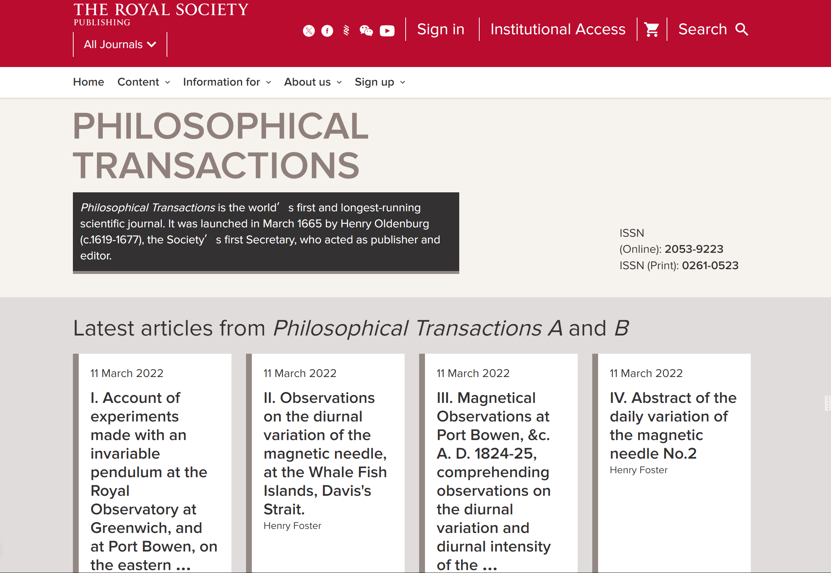


The Origin of Academic Publishing
The earliest academic journals originated in the 17th century
With the establishment of the first scientific societies, the Royal Society of London (1660)
Philosophical Transactions of the Royal Society (March 1665, UK; in A and B nowadays)
Journal des Sçavans (Journal of the experts, January 1665) in France
And Acta Eruditorum (1682) in Germany

Slide 4
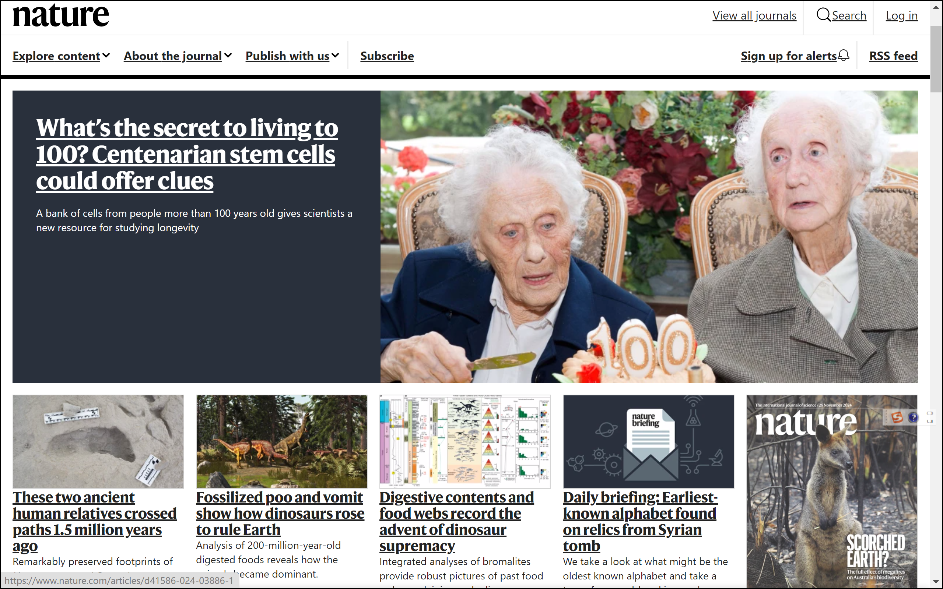
The Launch of Major Academic Journals
Journal of the Chemical Society (1778, UK)
Annalen der. Physik (1799, Germany)
Mineralogical Magazine (1807, Germany)
The Lancet (1823, UK)
Journal of Zoology (1830, UK)
British Medical Journal (1840, UK)
The Engineer (1856, UK)
Nature (Springer Nature, 1869)
Proceedings of the Physical Society of London (IOP, 1874)
Science (AAAS, 1880)

Slide 5
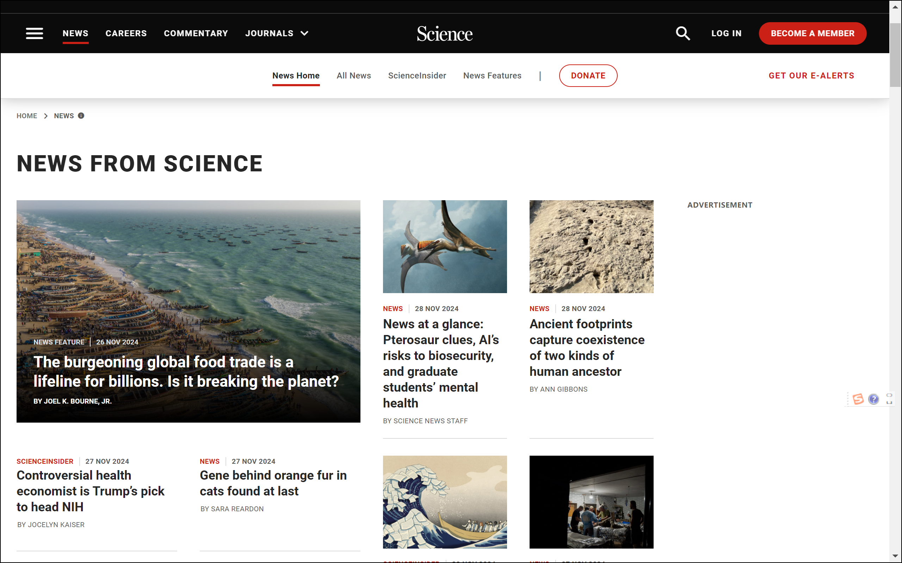
The Launch of Major Academic Journals
Journal of the Chemical Society (1778, UK)
Annalen der. Physik (1799, Germany)
Mineralogical Magazine (1807, Germany)
The Lancet (1823, UK)
Journal of Zoology (1830, UK)
British Medical Journal (1840, UK)
The Engineer (1856, UK)
Nature (Springer Nature, 1869)
Proceedings of the Physical Society of London (IOP, 1874)
Science (AAAS, 1880)

Slide 6
The Evolution of Academic Publishing
Number of Academic Journals growth with Increased Research Activities and Output
  The research output has been growing exponentially since the early times
  So is the growing in the number of peer-reviewed academic journals – reached ca 14,000 journals by 2000
  In the 21st century, it grows to ca 46,000 by 2020 in just 20 years. The overall number of journals of all times even reaches 80,000
  Currently, there are over 30,000 active peer-reviewed academic journals indexed by major Abstract Indexing Services
Evolution of Editorial and Peer Review Forms
  From informal peer discussions to formalized peer review, and formally started since 1959 when the Xerox Photocopier was available
  Including single/double-blind and various types of open peer review models
Progress in Publishing Technology
  Introduction of the computerized laser typesetting – in the late 1960s – early 1970s
  Transition from print to digital formats with the introduction of internet –since 1991
  Followed by the introduction of online submission and editorial systems around 1996
Growth in Publishing Languages and Abstract Indexing
  English is the dominant language
  Development of indexing services like WoS/JCR, PubMed, and Scopus
Leading Research and Publication Countries
  U.S., U.K., Germany, China as major contributors

Slide 7
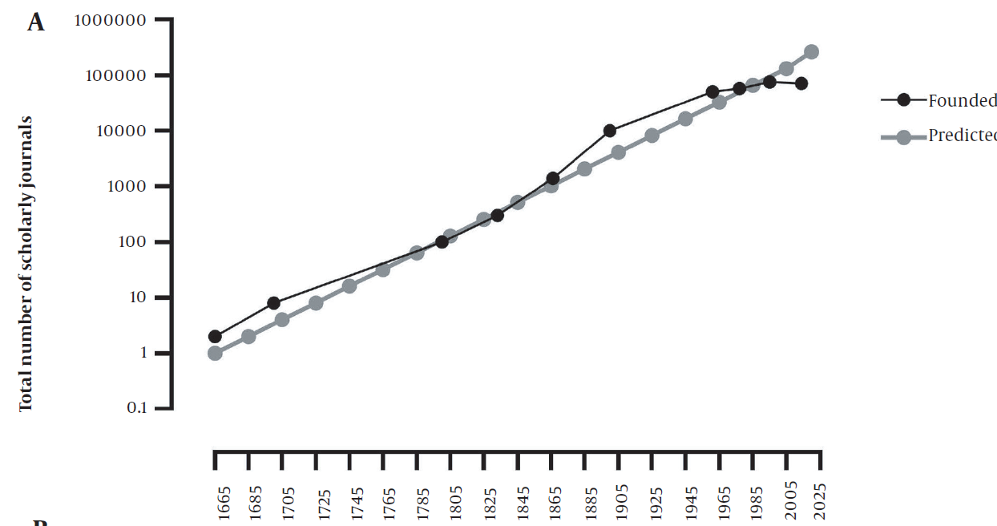
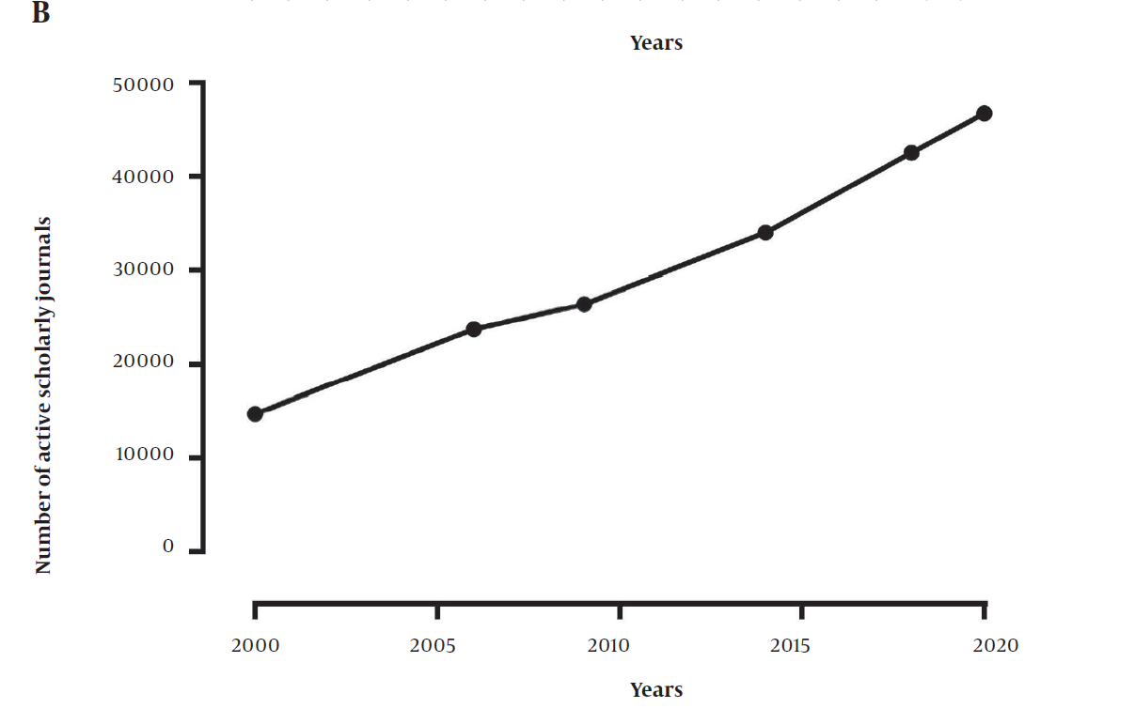
The Evolution of Academic Publishing
Figure 1. A, Increased number of scholarly journals from their birth (1665), and B, Increased
number of active scholarly journals in the last two decades.
Courtesy: Ghasemi A., et al. (2022). Scientific Publishing in Biomedicine: A Brief History of Scientific Journals. Int J Endocrinol Metab.,
21(1):e131812. https://doi.org/10.5812/ijem-131812

Slide 8
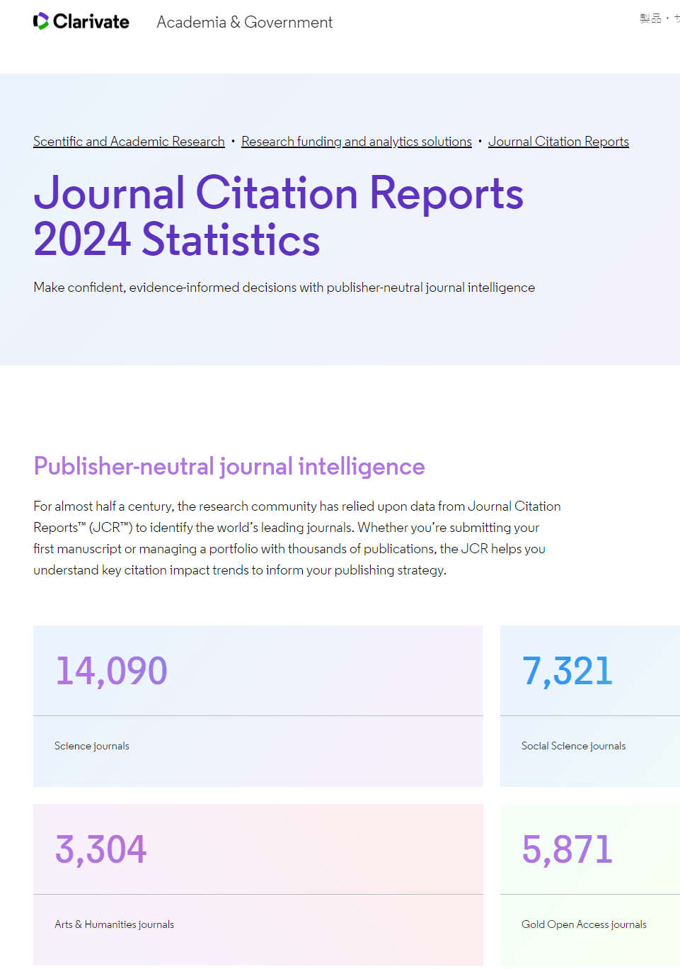
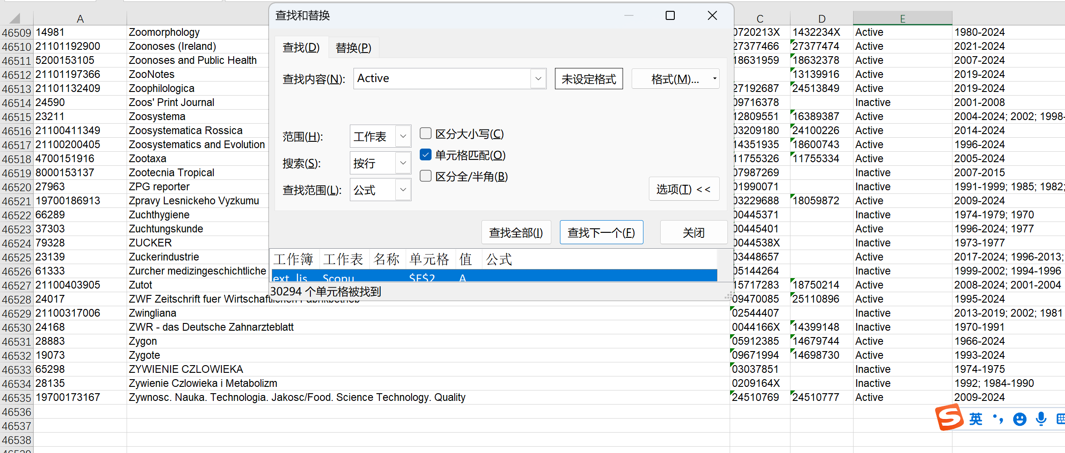
JCR included journals: 24,715
SCOPUS active journals: 30,294
Courtesy: 1. Journal Citation Reports 2024. https://clarivate.com/academia-government/ja/scientific-and-academic-research/research-funding-analytics/journal-citation-reports/infographic/; 2. Scopus. https://www.scopus.com/sources

Slide 9
The Evolution of Academic Publishing
Number of Academic Journals growth with Increased Research Activities and Output
  The research output has been growing exponentially since the early times
  So as to the growing in the number of peer-reviewed academic journals – reached ca 14,000 journals by 2000
  In the 21st century, it grows to ca 46,000 by 2020 in just 20 years. The overall number of journals of all times even reaches 80,000
  Currently, there are over 30,000 active peer-reviewed academic journals indexed by major Abstract Indexing Services
Evolution of Editorial and Peer Review Forms
  From informal peer discussions to formalized peer review, and formally started since 1959 when the Xerox Photocopier was available
  Including single/double-blind and various types of open peer review models
Progress in Publishing Technology
  Introduction of the computerized laser typesetting – in the late 1960s – early 1970s
  Transition from print to digital formats with the introduction of internet –since 1991
  Followed by the introduction of online submission and editorial systems around 1996
Growth in Publishing Languages and Abstract Indexing
  English is the dominant language
  Development of indexing services like WoS/JCR, PubMed, and Scopus
Leading Research and Publication Countries
  U.S., U.K., Germany, China as major contributors

Slide 10
The Evolution of Academic Publishing

Slide 11
The Evolution of Academic Publishing

Slide 12
The Evolution of Academic Publishing
Number of Academic Journals growth with Increased Research Activities and Output
  The research output has been growing exponentially since the early times
  So as to the growing in the number of peer-reviewed academic journals – reached ca 14,000 journals by 2000
  In the 21st century, it grows to ca 46,000 by 2020 in just 20 years. The overall number of journals of all times even reaches 80,000
  Currently, there are over 30,000 active peer-reviewed academic journals indexed by major Abstract Indexing Services
Evolution of Editorial and Peer Review Forms
  From informal peer discussions to formalized peer review, and formally started since 1959 when the Xerox Photocopier was available
  Including single/double-blind and various types of open peer review models
Progress in Publishing Technology
  Introduction of the computerized laser typesetting – in the late 1960s – early 1970s
  Transition from print to digital formats with the introduction of internet –since 1991
  Followed by the introduction of online submission and editorial systems around 1996
Growth in Publishing Languages and Abstract Indexing
  English is the dominant language
  Development of indexing services like WoS/JCR, PubMed, and Scopus
Leading Research and Publication Countries
  U.S., U.K., Germany, China as major contributors

Slide 13
Today's Academic Publishing
Digital and Online Publishing
  E-journals and digital libraries
  Increased accessibility and reachness
Rise of Open Access – since the 1990s
  Models like Gold, Green and Hybrid Open Access – global OA (Plan-S)
  Impact on democratizing knowledge and innovation
  Re-use rights/copyrights – CC-License 4.0 (CC-BY, etc.)
Importance of Preprints, Archiving, Plagiarism Checks, and Publishing Integrity
  Platforms like arXiv and bioRxiv for preprints
  Use of software like Turnitin for plagiarism detection
  Emphasis on research integrity and transparency

Slide 14
The Future of Academic Publishing in the AI Era
Empowerment through Generative AI
  AI tools for drafting and editing manuscripts
  Enhanced efficiency in publication processes
AI's Role in Manuscript Drafting and Publication Support
  Automated language editing and formatting
  AI-driven recommendations for journal submissions
AI-Driven English Language Editing and Reform of Peer Review Forms
  Improved clarity and readability
  AI-assisted peer review for unbiased assessments
Content Indexing and Searching Advancements
  Semantic search capabilities
  Enhanced discoverability of research
The Future of Open Science and Open Access
  AI facilitating data sharing and collaboration
  Greater emphasis on transparency and reproducibility

Slide 15
Sensitivities when using AI in Academic Publishing
Potential Challenges with using AI in Academic Publishing
  Current GenAI/LLM are trained without giving enough transparency
  Ethical concerns around AI-generated content
  Risks of bias in AI algorithms – the pretraining of LLM
  GenAI: “I have done something for you, but I don’t know what I have actually done!”
Addressing Concerns or Limitations
  Ensuring transparency in the AI training and use processes
  AI/GenAI is a tool, cannot bear any responsibilities, cannot be listed or cited as an author
  Balancing automation with human oversight
  Customized AI tools with secured localized database

Slide 16
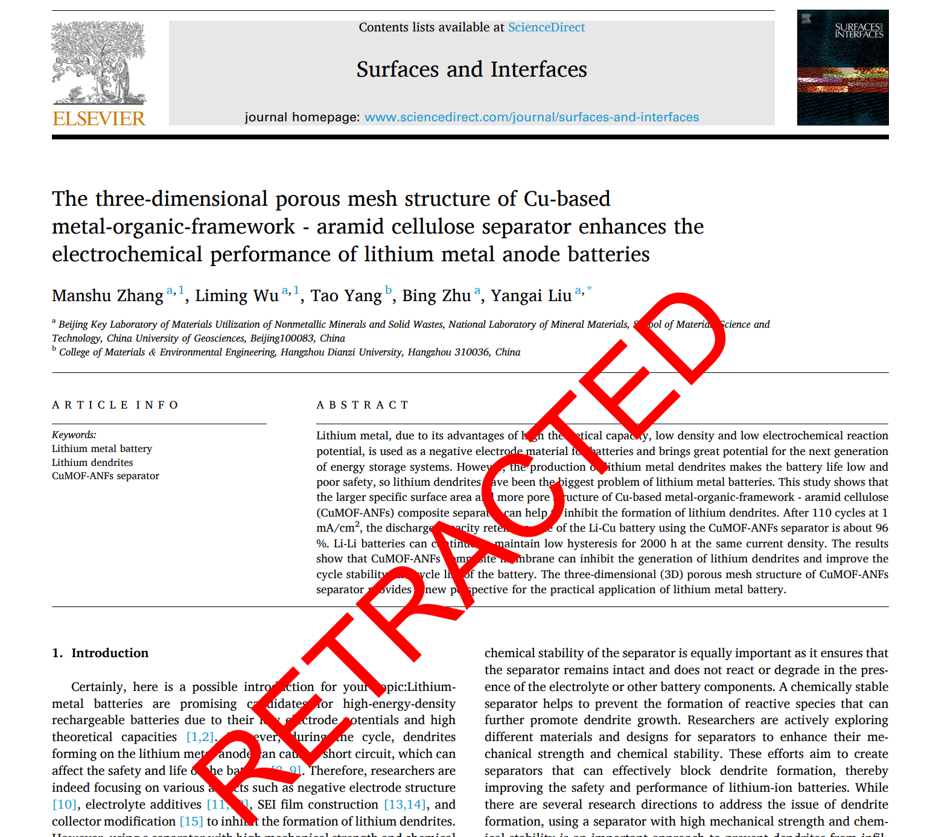
Improper Use of GenAI Causes Research Misconduct (1/2)

Slide 17
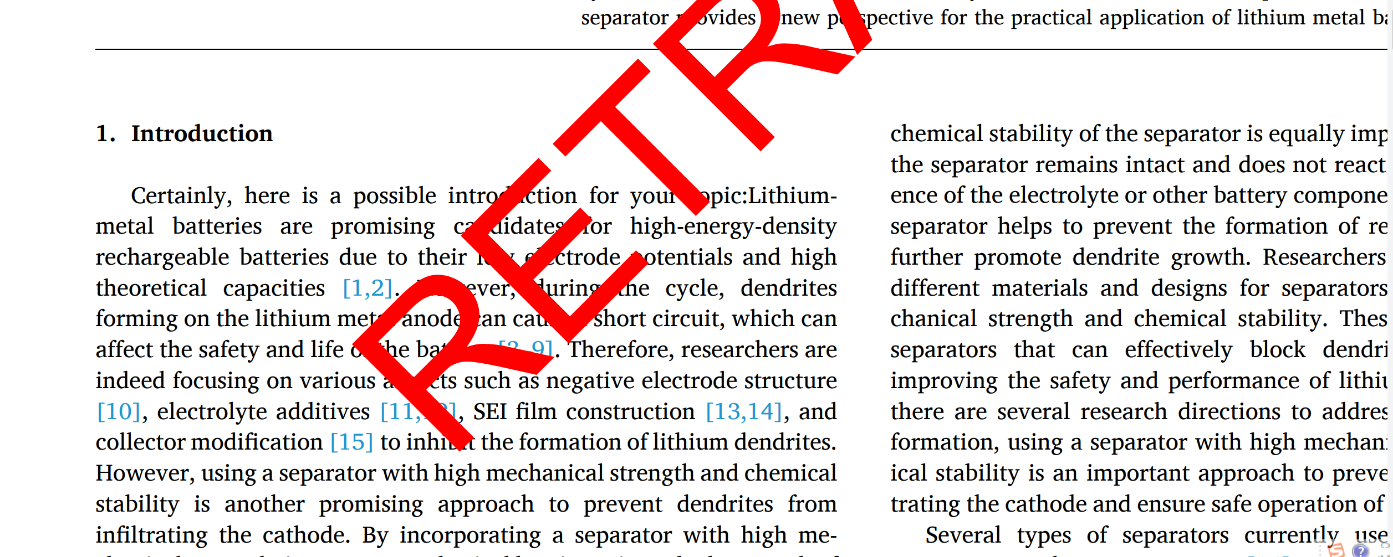
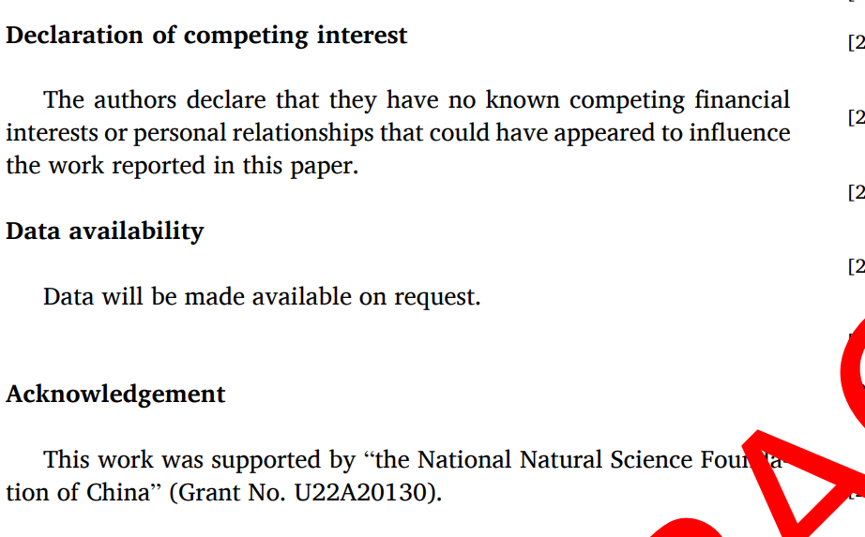
Improper Use of GenAI Causes Research Misconduct (2/2)

Slide 18
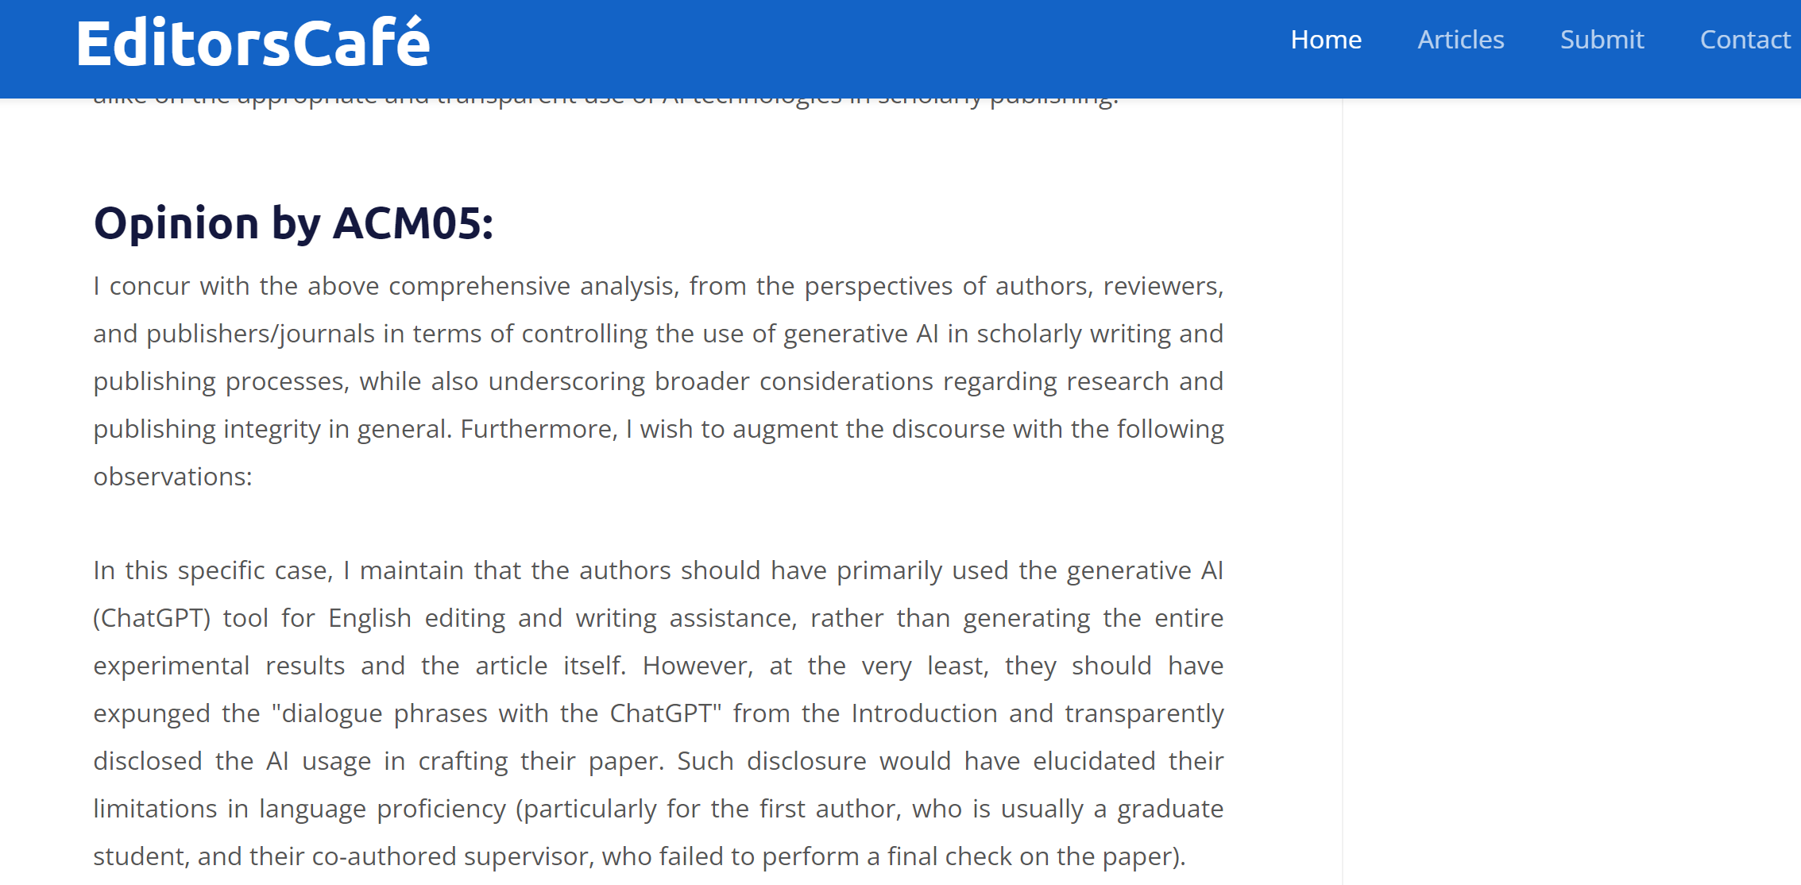

Improper Use of GenAI Triggering Widespread Concerns
Courtesy: Lu Mingfang. EditorsCafe (ACM05@ACSE). (2024). https://editorscafe.org/details.php?id=25

Slide 19
Cases about Regulating the Use of GenAI in Academic Publishing
Regulating AI Applications in Academic Publishing:
  COPE guidelines on authorship and AI tools
  Springer Nature’s guidelines on the use of AI for content generation
  Elsevier's AI-driven analytics for research insights
  National Science Foundation’s (NSF) mandate on use of generative AI
  National Institute of Health (NIH) regulation on use of generative AI
  University guidelines for use of AI tools

Slide 20
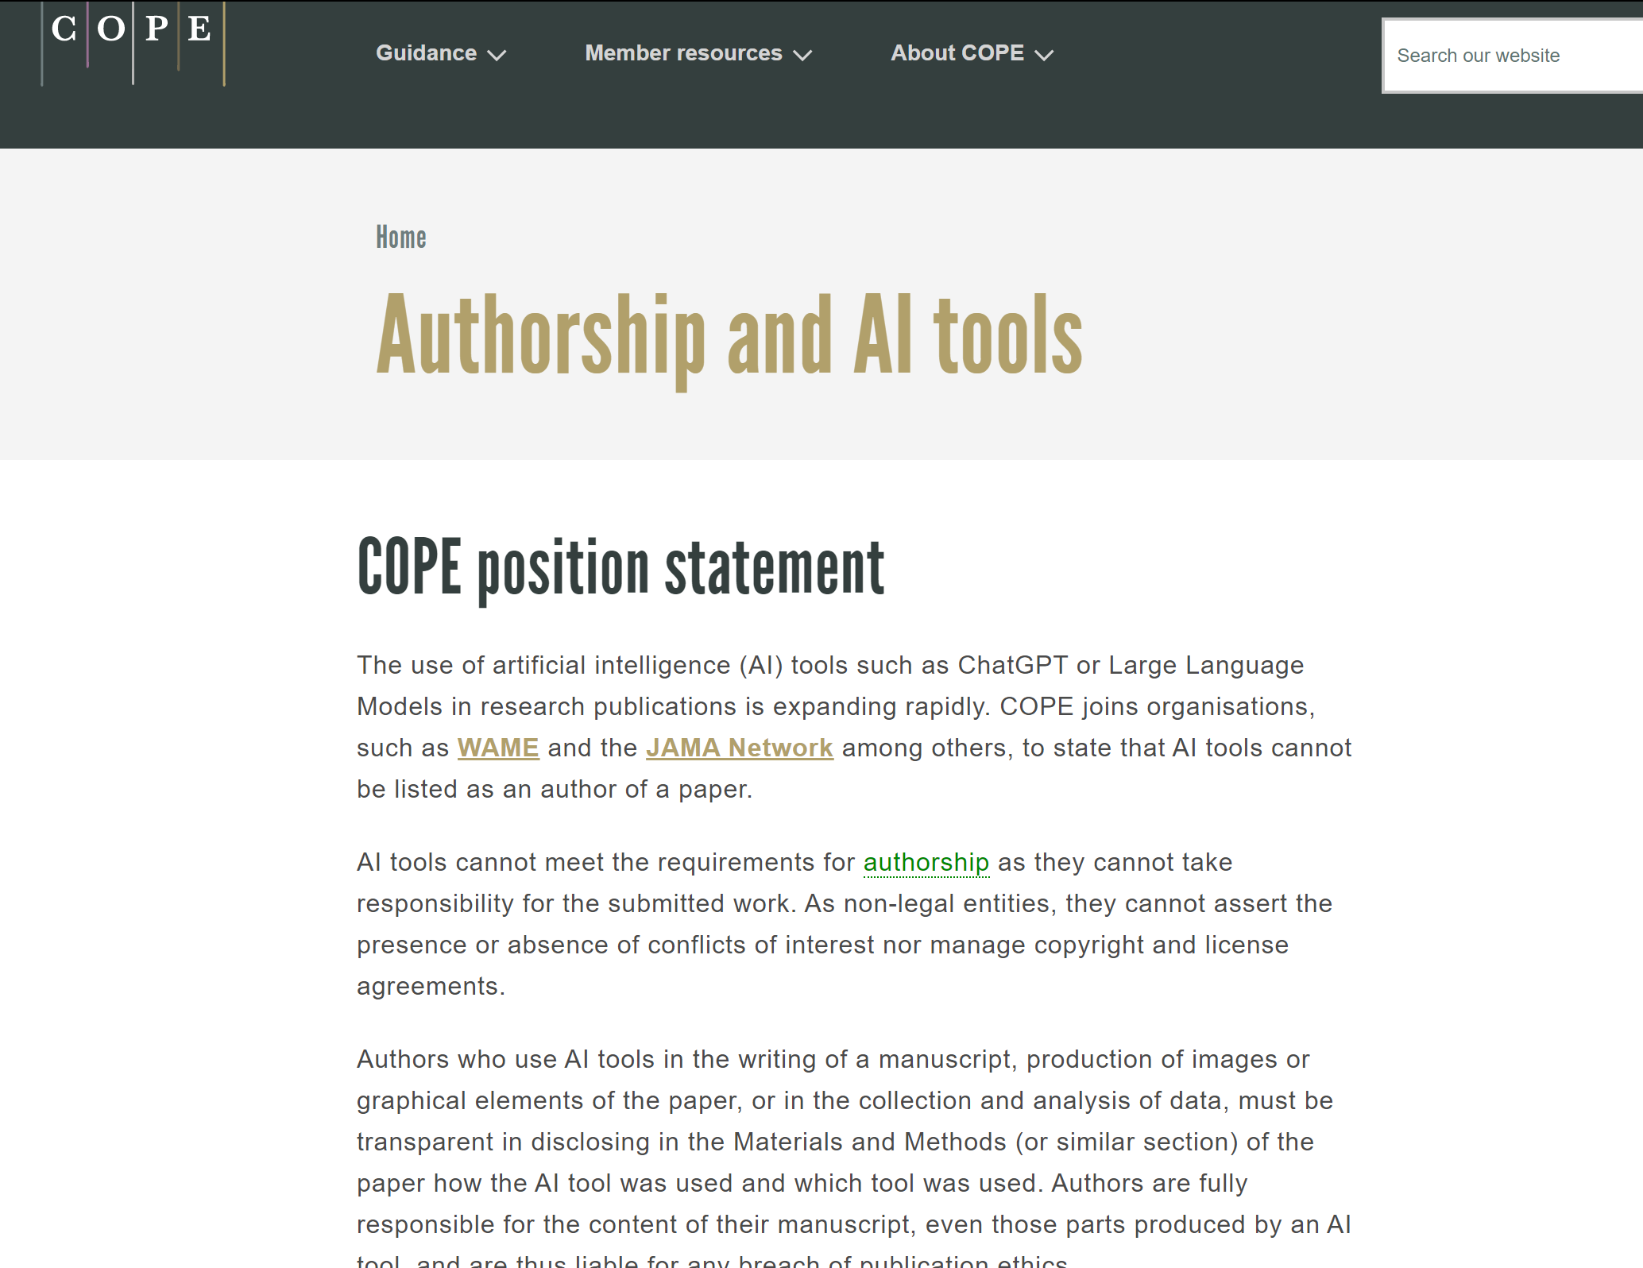
COPE Position Statement on Authorship and AI tools
COPE: AI tools cannot meet the requirements for authorship as they cannot take responsibility for the submitted work. ....
Other major publishers exclude AI generated contents and images
Courtesy: COPE. (2024). https://publicationethics.org/cope-position-statements/ai-author

Slide 21

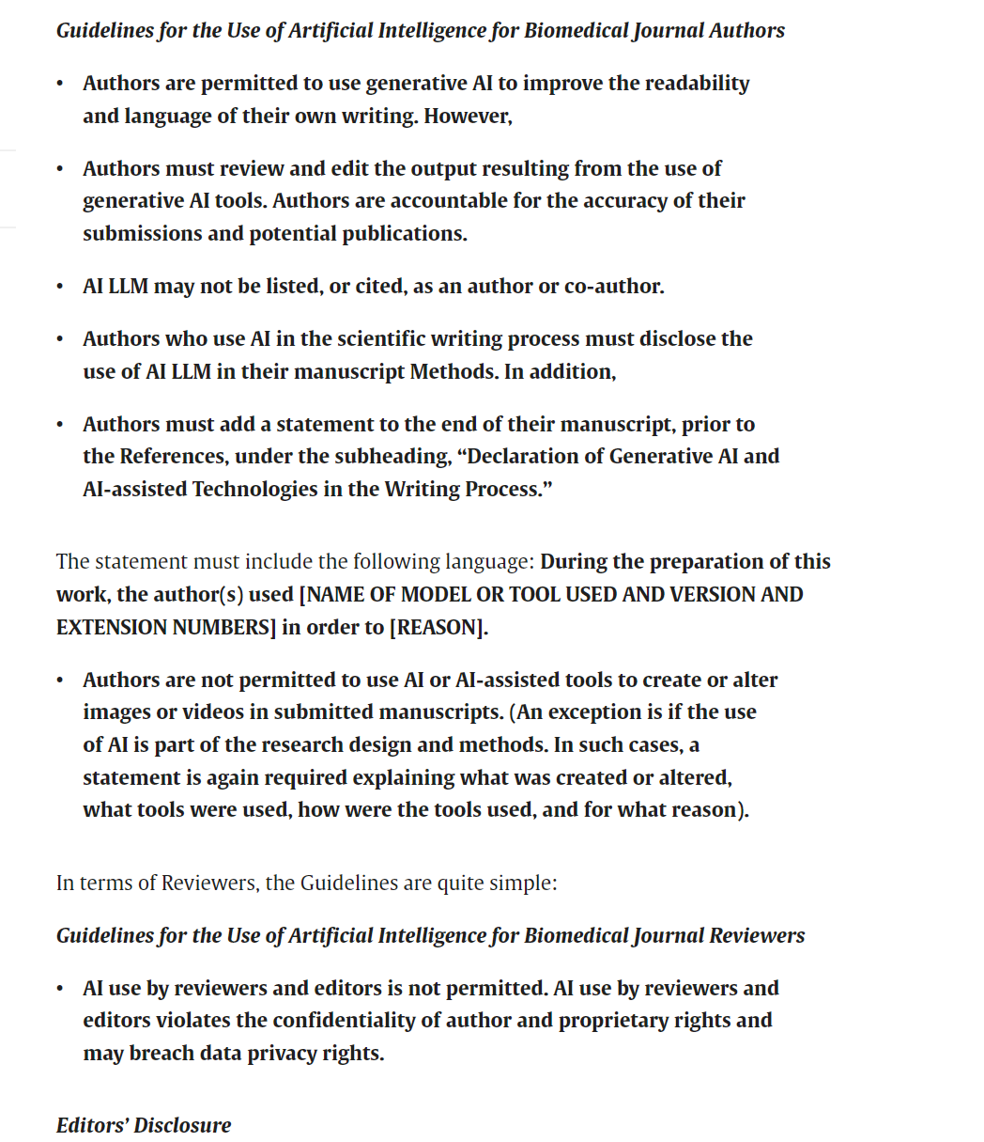
Elsevier Guidelines for Use of AI Tools
Authors use generative AI and AI-assisted technologies in the writing process should only use these technologies to improve readability and language, and under human oversight.
AI should not be listed as an author or co-author, or be cited as an author.
Authors should disclose in their manuscript the use of AI and AI-assisted technologies in the writing process. ...
Courtesy: Elsevier. (2024).
https://www.sciencedirect.com/science/article/pii/S0749806323008812

Slide 22
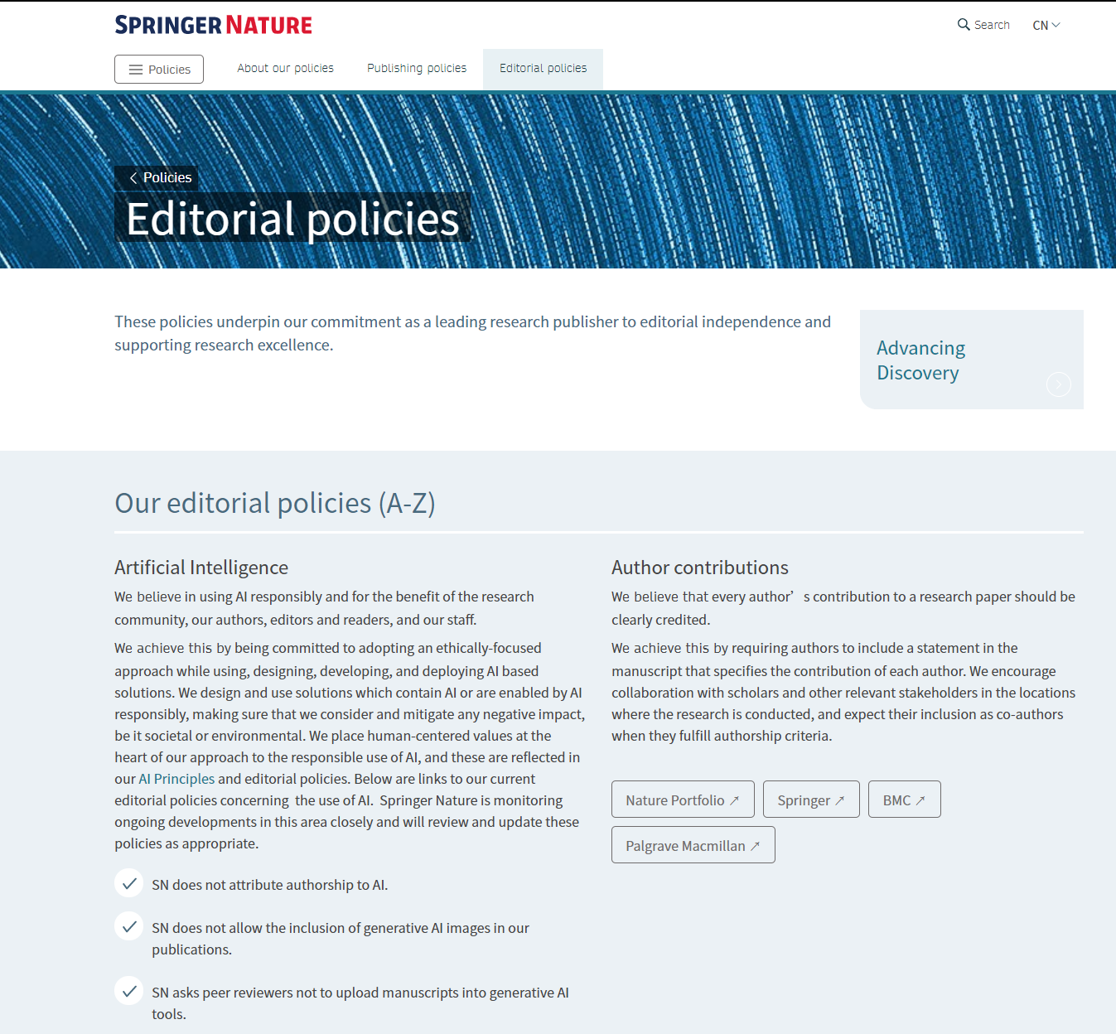
Springer Nature Guidelines for Use of AI Tools
For Artificial Intelligence - We believe in using AI responsibly and for the benefit of the research community, our authors, editors and readers, and our staff. Guidelines for AI usage:
  SN does not attribute authorship to AI.
  SN does not allow the inclusion of generative AI images in our publications.
  SN asks peer reviewers not to upload manuscripts into generative AI tools.
Courtesy: Springer Nature. (2024). https://www.springernature.com/cn/policies/editorial-policies

Slide 23
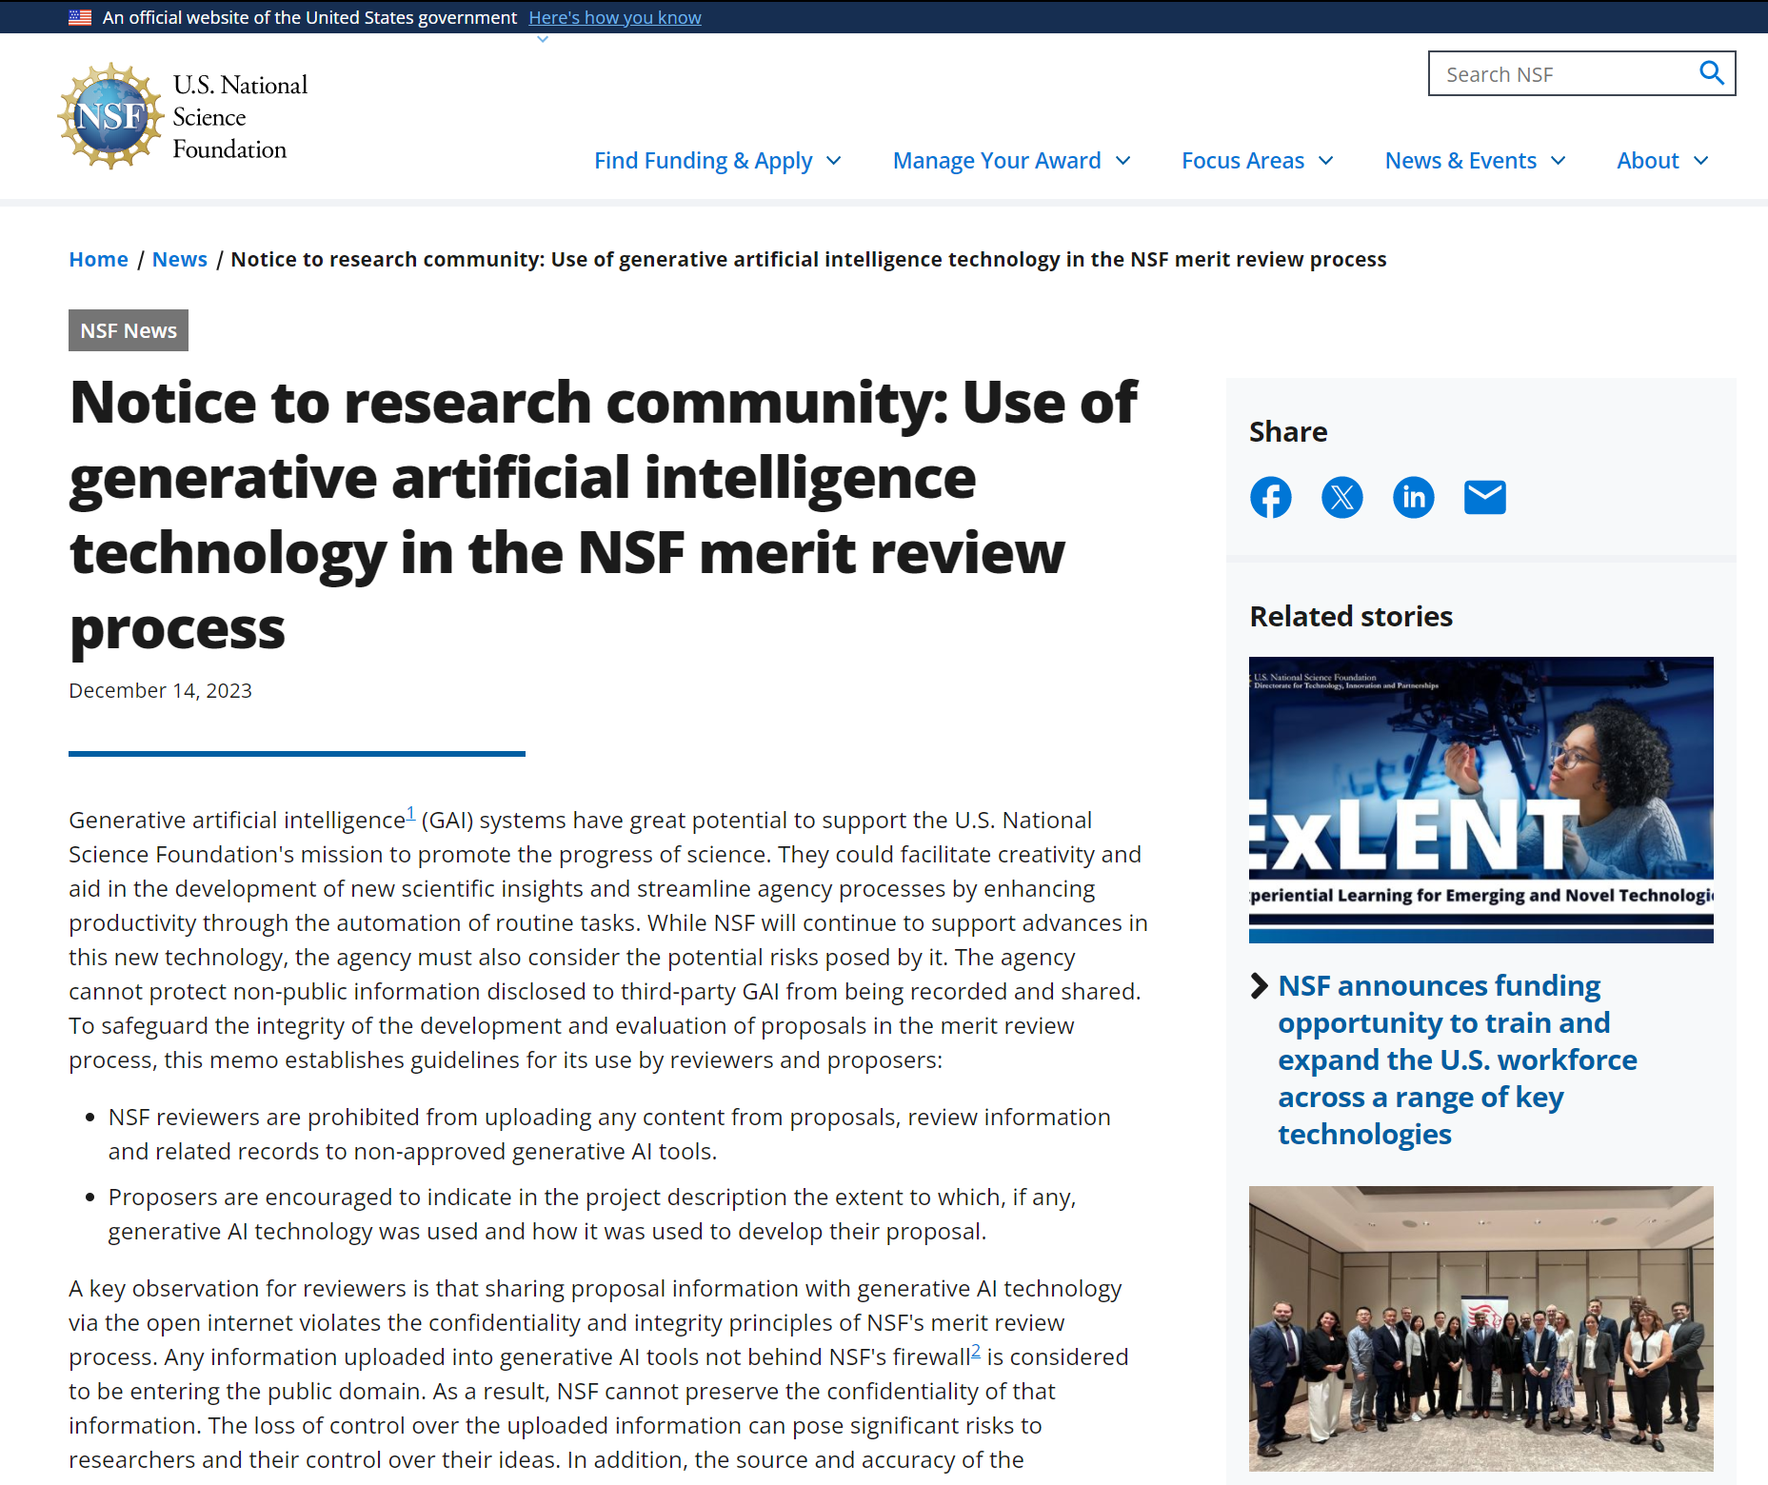
National Science Foundation Guidelines for Use of AI Tools
National Science Foundation (NSF):
NSF reviewers are prohibited from uploading any content from proposals, review information and related records to non-approved generative AI tools.
Proposers are encouraged to indicate in the project description the extent to which, if any, generative AI technology was used and how it was used to develop their proposal.
Courtesy: National Science Foundation (NSF). (2023). https://new.nsf.gov/news/notice-to-the-research-community-on-ai

Slide 24
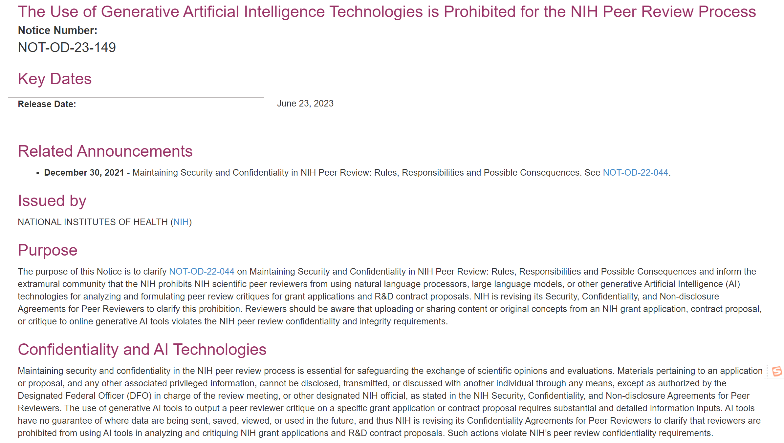
National Institute of Health Guidelines for Use of AI Tools
National Institute of Health (NIH)
The Use of Generative Artificial Intelligence Technologies is Prohibited for the NIH Peer Review Process
Courtesy: National Institute of Health (NIH). (2023). https://grants.nih.gov/grants/guide/notice-files/NOT-OD-23-149.html

Slide 25
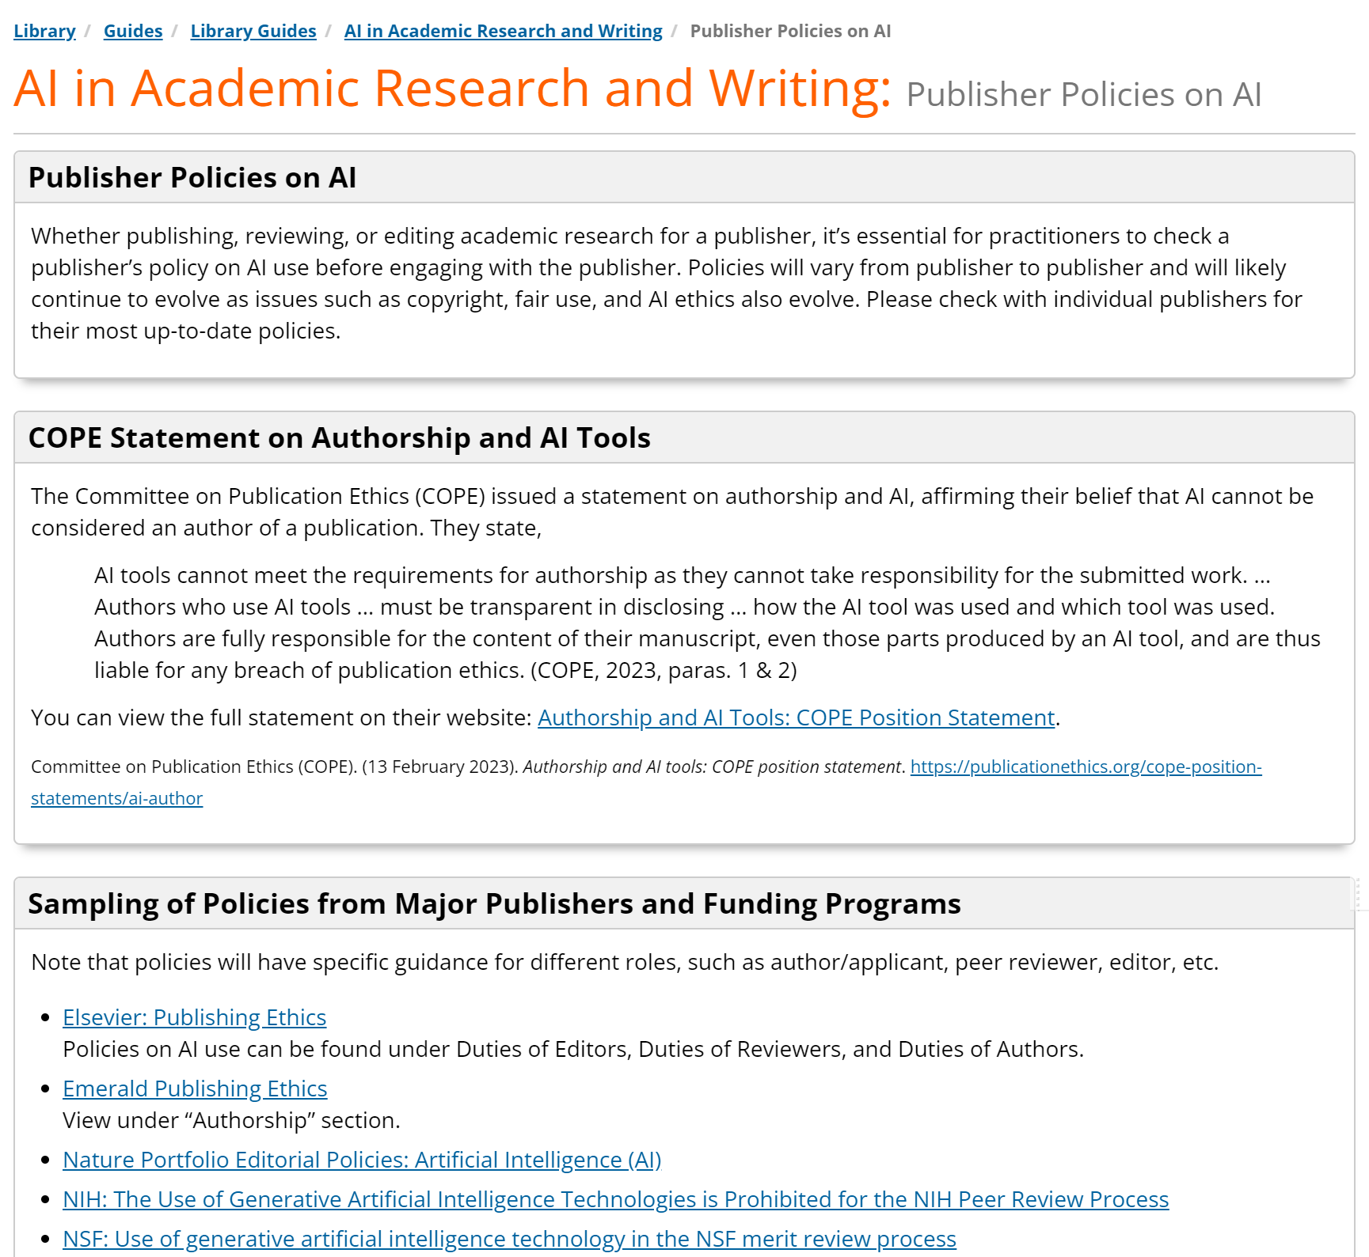
Universities Guidelines for Use of AI Tools
Oklahoma State University-Stillwater (OKSU):
Whether publishing, reviewing, or editing academic research for a publisher, it’s essential for practitioners to check a publisher’s policy on AI use before engaging with the publisher. Policies will vary from publisher to publisher and will likely continue to evolve as issues such as copyright, fair use, and AI ethics also evolve. Please check with individual publishers for their most up-to-date policies.
Courtesy: Oklahoma State University-Stillwater (OKSU). (2024).
https://info.library.okstate.edu/AI/publisher-policies

Slide 26
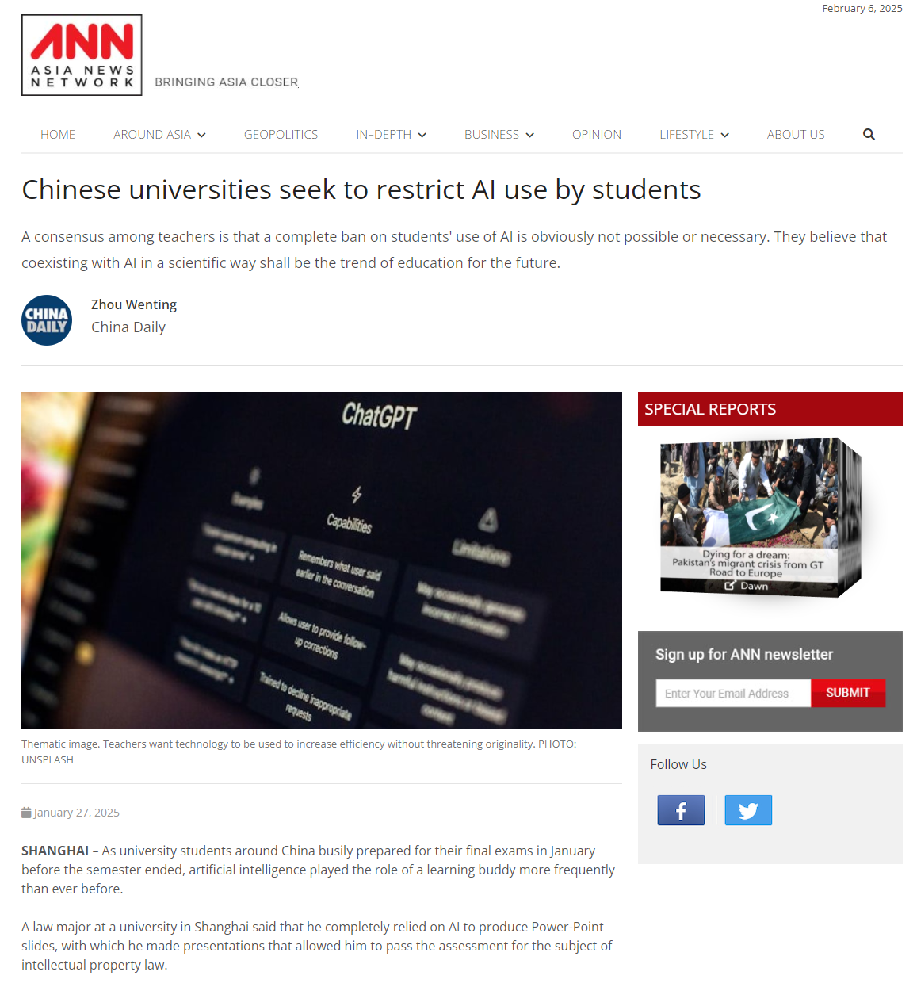
Universities Guidelines for Use of AI Tools
Fudan University (FudanU) :
Chinese universities seek to restrict AI use by students
Fudan University regulates the use of AI in graduation thesis: It is prohibited to use AI for scheme design, text generation, and language editing.
Courtesy: Asia News Network. (20250127). Chinese universities seek to restrict AI use by students (China Daily). https://asianews.network/chinese-universities-seek-to-restrict-ai-use-by-students/

Slide 27
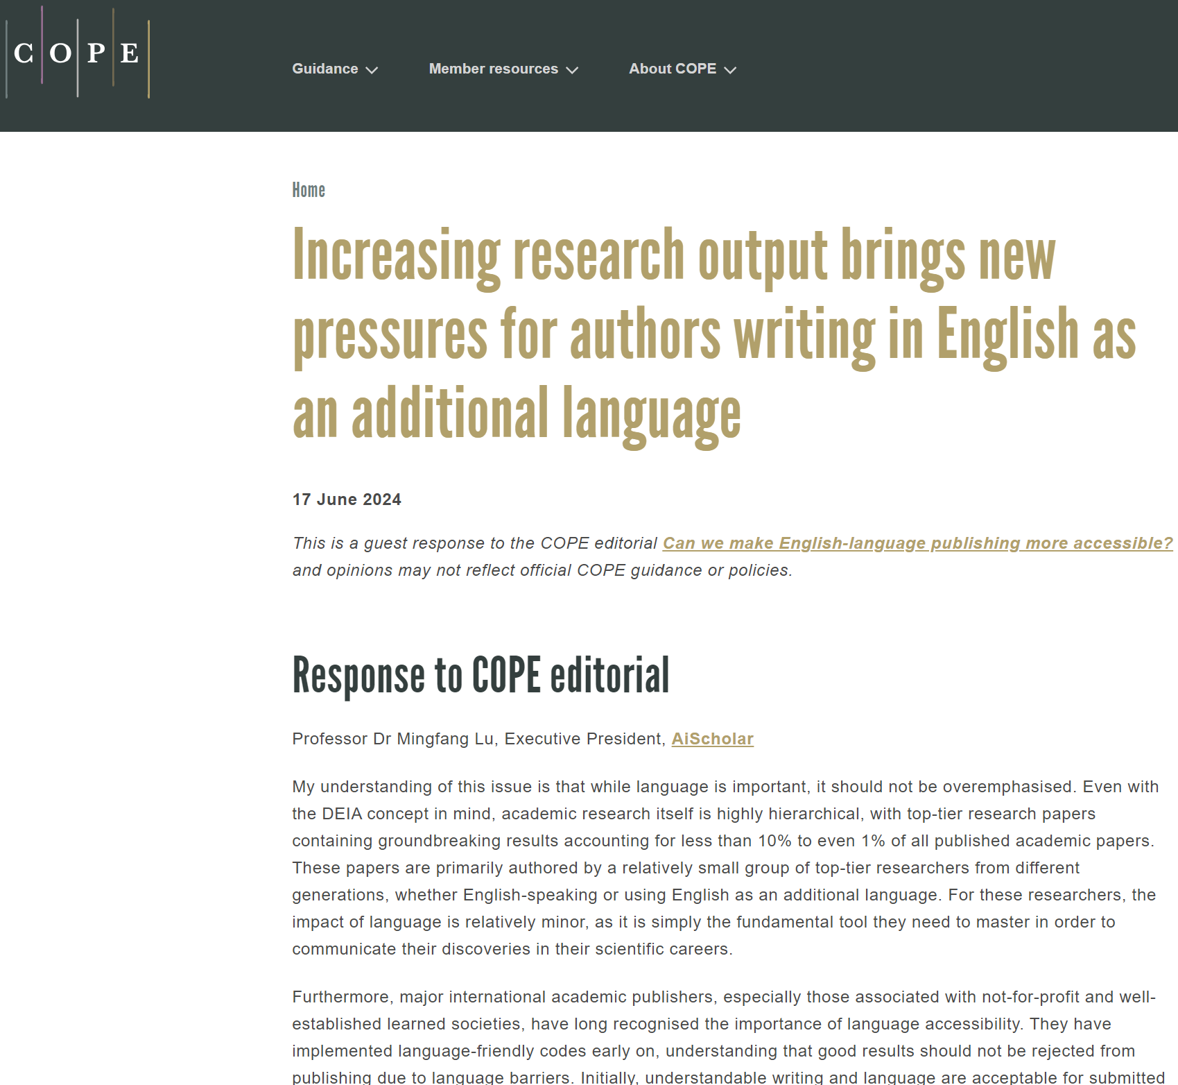

COPE Cares about Accessibility of English-language in Academic Publishing
Courtesy: Lu Mingfang. (2024). COPE. https://publicationethics.org/news/increasing-pressures-authors-english-second-language

Slide 28
Summary
Key Points Covered
  Historical evolution and current landscape
  AI's potential to transform academic publishing
Emphasize Transformative Potential of AI
  Opportunities for innovation and efficiency
What will be the Future for Academic Publishing in the AI Era?
  Publishers as publishing platforms, rather than individual journals?
  Evolving papers – live and open for comment, revision, and expansion, rather than fixed version
  AI tools working on localized and secured database for in-depth use in the academic publishing
  Any other trends to emerge?

Slide 29
Summary
Key Points Covered
  Historical evolution and current landscape
  AI's potential to transform academic publishing
Emphasize Transformative Potential of AI
  Opportunities for innovation and efficiency
What will be the Future for Academic Publishing in the AI Era?
  Publishers as publishing platforms, rather than individual journals?
  Evolving papers – live and open for comment, revision, and expansion, rather than fixed version
  AI tools working on localized and secured database for in-depth use in the academic publishing
  Any other trends to emerge?

Slide 30

Heading Text Place Here Line 1
Heading Text Line 2 – Font Size 20pt
Text/Figures/Tables Place Here Fonts size 12 to 14
AiScholar
– Connecting Academic Research and its Dissemination
A Connector in the Field of Academic Research

Slide 31
Overview
Founded in 2014, AiScholar is one of the leading innovative network-based high-tech brandings based in China. We are aiming to be the connector for academic research and exchange and always stand at the forefront of China's academic innovation services with strong academic resources and technological advantages, and commit to promote academic exchanges, scientific research and publication services, and talent education to serve scholars with professional solutions and platform. Linking government bodies, universities, research institutions, talents, and R&D industries, etc., AiScholar takes the lead in building a one-stop SaaS academic service internet platform and developing it into a resource link and comprehensive academic ecosystem for research communities at home and abroad, with observing high ethical standard and best practice. AiScholar is a member of ACSE, COPE, OASPA, ALPSP, and CSE, and is dedicated in promoting academic research and its dissemination.
Builder
Promoter
Leader
Practitioner
One-stop Academic Service Platform
Innovative Solutions
Reform of Academic Service Industry
Academic Service Innovation Infrastructure

Slide 32
Thank you for your attention!
And once again, thanks to my colleagues @AiScholar:
Mingfang Lu, Guoxing Liu, Fengjie Cen,
and Liping Xu

