Slide 1
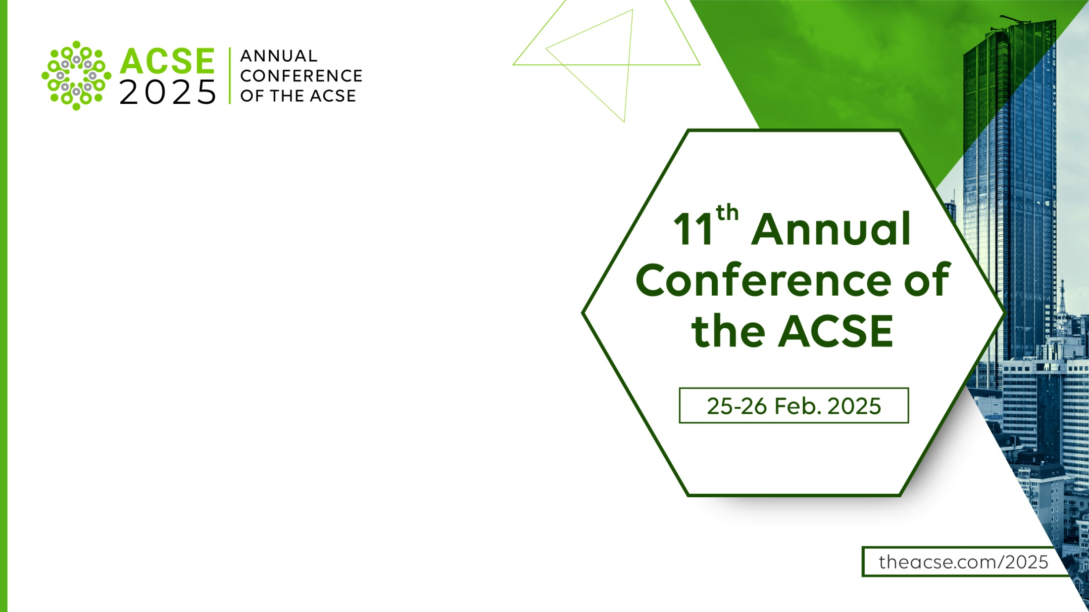
From Rejection to Mentorship:
Re-thinking Peer Review for Author Development
A seat at the table: Involving authors
in reforming peer review
Roohi Ghosh
Ambassador for Researcher Success
Cactus Communications (CACTUS) and Editage

Slide 2

Peer Review – A Rejection-Heavy Model
Did you know?
Rejection rates vary across journals, with high impact journals like Nature rejecting a significant majority of submitted manuscripts, with a rejection rate of approximately 92% (Nature, 2024).
Even less impactful journals often have high rejection rates, with studies showing rejection rates ranging from 20% to 50%, depending on the field and journal (Björk, 2019).
https://onlinelibrary.wiley.com/doi/full/10.1002/leap.1649

Slide 3
The Impact of a Rejection Heavy Model on Authors
Authors may go through different stages of the grief cycle: denial, anger, bargaining, and depression (Venketasubramanian & Hennerici, 2013), or a state of emotive misery (Han et al., 2019), which can slow or even undermine their productivity (Conn et al., 2016).
The psychological toll of rejections can also have consequences on a researcher’s professional journey and can delay career milestones like tenure, promotions, or research funding.
There is also the perceived stigma of repeated rejections harming the author’s research reputation.
https://onlinelibrary.wiley.com/doi/full/10.1002/leap.1649

Slide 4

What Are The Challenges Authors Face As They Navigate the Peer Review Process?
Rejection letters lack actionable insights leaving authors unsure about how to improve their manuscripts
Preparing and revising manuscripts for resubmission consumes significant resources, including time, money, and energy.
Delays in peer review and rejection extend the time authors must wait before resubmitting elsewhere, slowing down the dissemination of their research.
Many researchers lack access to experienced mentors who can provide guidance during the publishing process.
Reviewers often lack formal training, leading to uneven and sometimes contradictory feedback.
Peer reviewers may emphasize gatekeeping over mentorship, prioritizing flaws over potential improvements.
Non-native English speakers face additional challenges in language, cultural expectations, and formatting nuances, exacerbating rejection rates.

Slide 5


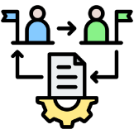


How Can These Challenges Be Overcome And How Can Peer Review Transform From a Rejection- heavy Model To A Mentorship Model?
Enhancing feedback quality
Leveraging technology
Involving authors in the peer review transformation process
Re-thinking the author-reviewer relationship
A culture of collaboration

Slide 6
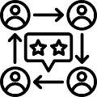
1. Quality of feedback in peer review
Studies focusing on peer reviewer feedback have revealed some negative findings in relation to the usefulness of peer reviewer feedback (Resnik and Elmore Citation2016).
Instead of focusing on the quality of the manuscript, these unprofessional comments target author attributes such as gender, nationality or affiliation, while some are based on reviewers’ personal bias or stance towards a research topic or method (Lee et al. Citation2013).
Unhelpful feedback from peer reviewers is caused by a number of reasons, including excessive workload of academics (Silbiger and Stubler Citation2019), the lack of training about peer-review and how to provide constructive feedback (Chong and Mason Citation2021; Chong Citation2021a; Mason and Chong Citation2022).
https://www.tandfonline.com/doi/full/10.1080/02602938.2022.2164757#d1e520

Slide 7




Enhancing feedback quality
Actionable Feedback: Ensure rejection letters and peer review comments include detailed explanations of both strengths and weaknesses, along with actionable suggestions for improvement.
Reviewer Guidelines: Provide peer reviewers with formal training to deliver constructive, unbiased, and actionable feedback.
Strength-Based Reviews: Encourage reviewers to identify and emphasize the merits of submissions to motivate authors and guide resubmissions.
Editorial Oversight: Can editors mediate and standardize reviewer feedback to eliminate contradictions and enhance clarity for authors?

Slide 8

2. Leveraging technology
The review process contains paradoxical elements. On the one hand, as “gatekeepers,” editors and their teams must critically evaluate the publishability of potential manuscripts, which requires surfacing weaknesses and challenges in a paper submission’s design and arguments. On the other hand, as “diamond cutters” and “champions,” editors and their teams must help develop and sharpen ideas (e.g., Saunders, 2005; Sarker et al., 2015), which requires creatively identifying solutions and opportunities for strengthening a submission’s analysis and narrative.
https://aisel.aisnet.org/cgi/viewcontent.cgi?article=2165&context=jais
Can a major aspect of the gatekeeping be taken over by AI in the future? And the final decision and mentorship/ diamond cutting be the responsibility of the peer reviewer? How would this work for more senior authors having their manuscript edited?

Slide 9



Potential workflow
AI as a gatekeeper
Peer reviewers as mentors
Final decision
Identifying gaps in methodology
Adherence to journal guidelines
Detecting plagiarism
Enhancing the core arguments and mentorship
Close collaboration with authors
Jointly by editors and reviewers integrating AI insights

Slide 10

3. Involving authors in the peer review transformation process
Feedback loops: Introduce post-review surveys for authors to evaluate the clarity, usefulness, and fairness of peer reviews
Co-Designing Solutions: Invite authors to participate in advisory boards or task forces focused on improving peer review practices.
Diversity in Peer Review: Actively include diverse author voices, including non-native English speakers and early-career researchers, in discussions about peer review standards.
Author-Driven Peer Review Innovations: Empower authors to co-create and suggest new collaborative peer review workflows, ensuring their voices shape the process.

Slide 11

4. Re-thinking the author-reviewer relationship
Mentorship Models: Pair early-career authors with experienced reviewers or editors for guidance beyond the review process.
Collaborative Platforms: Create platforms where authors and reviewers can engage in structured, anonymous dialogues to clarify feedback.
Open Peer Review: Explore transparent peer review models where authors can respond to reviewer comments, fostering a constructive exchange.
Reviewer-Author Collaboration: Pilot collaborative review models where authors work directly with reviewers to address major revisions.
Living Review Documents: Transition to living peer review documents where authors and reviewers continuously update manuscripts together, ensuring an iterative improvement.

Slide 12

5. A culture of collaboration
Cross-Disciplinary Peer Review Panels
Assemble diverse peer review panels with experts from different fields to encourage interdisciplinary dialogue and holistic feedback.
Global Collaboration Hubs
Develop regional or global online hubs where authors, reviewers, and editors can share resources, best practices, and success stories.
Collaborative Open-Access Reviews
Publish peer review reports openly to showcase constructive criticism and celebrate collaboration among authors and reviewers.
Author-Reviewer Partnership Programs
Create long-term programs where reviewers and authors build mentoring relationships across multiple projects.

Slide 13

Re-imaging peer review: A mentorship driven future
Let’s reimagine peer review together:
Where mentorship takes precedence over rejection.
Where every author leaves the process with not just a decision but a path forward for their research.

