Slide 1
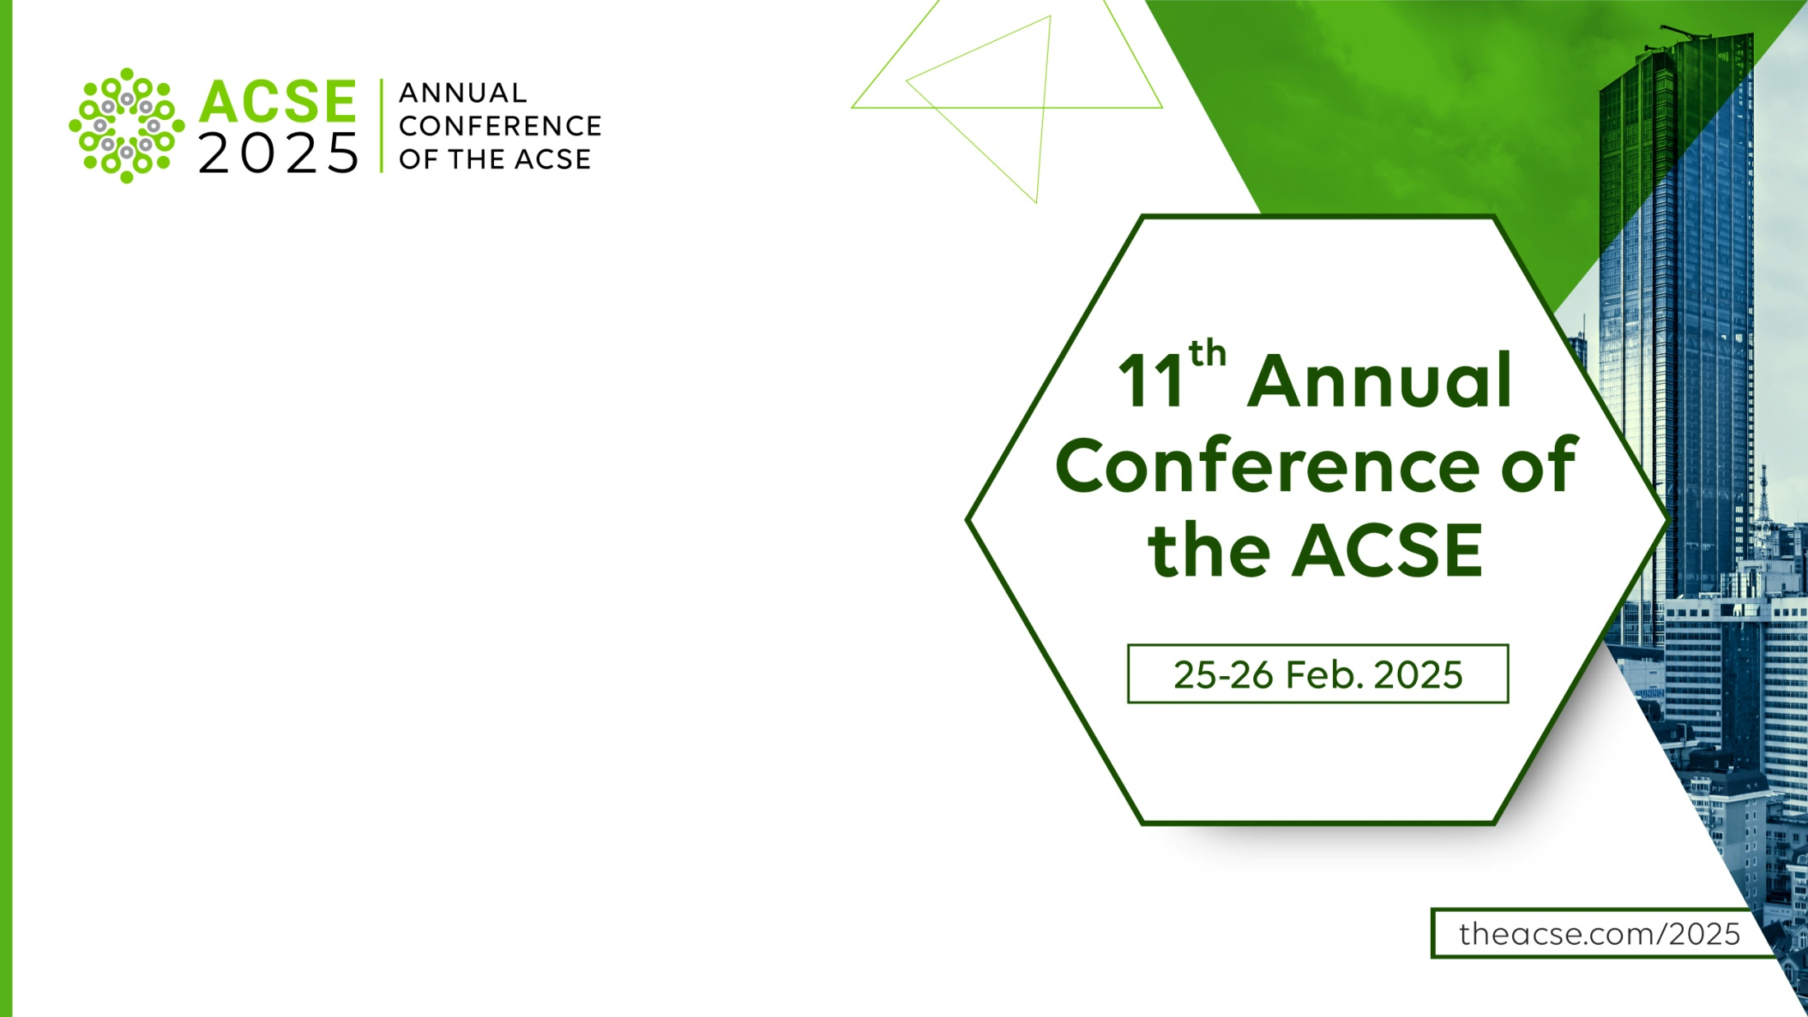
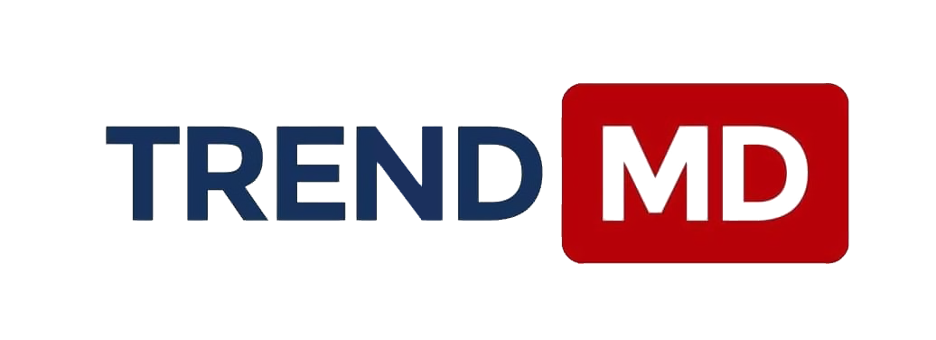
Driving Research Discoverability in an AI-Enhanced World
Engaging Readers and Expanding Impact Through AI
Roxanne Muller
Sales Manager
Notes:
Thank you for joining me today.
My name is [Your Name], and I’m excited to discuss a challenge that affects every researcher, publisher, and institution: getting research discovered in an AI-driven world.
Every year, millions of papers are published, but only a fraction get the attention they deserve.
How do we ensure that valuable, high-quality research finds the right audience?
Today, we’ll explore how AI-powered tools, like TrendMD, are transforming research discoverability—not just increasing citations but also reinforcing research integrity.

Slide 2



The Discoverability Crisis in Research
The Growth of Research Publishing
The Decline in Citation Impact
The Struggle for Visibility
Over 2.5 million research papers are published annually (Dimensions.ai, 2023)
Average citations per paper have declined by 20% in the past decade (Scopus, 2024).
Researchers struggle with visibility due to information overload.
Notes:
The sheer volume of research being published is overwhelming. While research output is increasing, citation impact is actually declining.
This means groundbreaking research is getting lost in the flood of new publications. So, how do we ensure that high-quality research finds its intended audience?
Let’s put things in perspective—over 2.5 million research articles are published every year. That’s a staggering number, and it’s growing! But there’s a problem. The average number of citations per paper has declined by 20% in the past decade (Scopus, 2024). Even groundbreaking research can get lost in the noise. Researchers spend years developing their work, but many struggle to get noticed due to information overload and outdated dissemination models. So, how do we fix this? AI offers a solution by intelligently matching research with the right audience, ensuring visibility for quality content.

Slide 3




AI as the New Discovery Tool
AI-Powered Personalized Research Recommendations
AI matches content to relevant readers via personalized recommendations (like Netflix for research).
Reader behavior
NLP for Context-Aware Discoverability
Natural Language Processing (NLP) helps AI understand content context, improving recommendations.
AI processing
Boosting Engagement Through AI
AI-driven discoverability tools increase engagement by 50% (Publishing Insights, 2024).
Personalized
recommendations
Notes:
We all know how Netflix recommends shows based on what we watch. Imagine if research worked the same way—where relevant papers found you instead of you searching for them. AI-powered tools like TrendMD analyze reading behavior and content context, dynamically recommending research to the right audience. With Natural Language Processing (NLP), AI goes beyond simple keyword matching. It understands the context of research, ensuring recommendations are relevant and high quality. Impact: AI-driven discoverability tools increase reader engagement by 50% (Publishing Insights, 2024). This means more citations, more collaborations, and more impactful research.

Slide 4
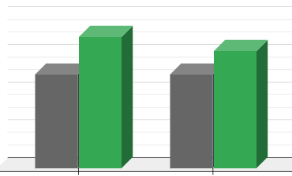
Real-world impact of AI Discoverability and Citations
+40%
Boosting Research Visibility with AI
+25%
AI-powered recommendations lead to a 40% increase in article downloads within 6 months.
AI’s Role in Citation Growth
Studies show a 25% increase in citations after 1 year of AI-enhanced discoverability (TrendMD, 2024).
Article downloads in 6 months
Citations growth in 1 year
Notes:
Let’s look at a real-world impact. One of our publishing partners implemented AI-driven recommendations, and within 6 months, article downloads increased by 40%. Not only that—citations grew by 25% in the first year, proving that AI recommendations drive real engagement. This isn’t about random visibility. It’s targeted discovery, ensuring that research reaches those who need it the most.

Slide 5



Beyond Gatekeeping – Fostering Research Integrity
AI Enhances Research Quality
Transparency Through Peer Review
Community-Driven Responsible Publishing
AI prioritizes well-cited, high-impact studies to ensure credibility.
AI supports post-publication peer review, increasing engagement and research scrutiny.
Feedback from the research community helps maintain integrity and reliability.
Notes:
"A"Traditionally, publishing worked as a gatekeeping system—determining what gets published and who sees it. But today, we’re shifting towards mentorship and guidance. AI not only promotes high-quality research but also detects research misconduct by identifying anomalies in data and citations. Post-publication peer review is emerging as a new trend, allowing AI-driven feedback loops that help improve research over time. Community-driven feedback is also playing a larger role, ensuring collaborative validation of findings.

Slide 6
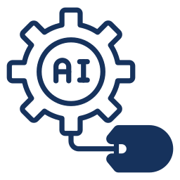


AI-Powered Discoverability with Research Integrity
vs.
Traditional Model: Limited Reach
AI Model: Continuous & Adaptive
Research is static and dependent on journal indexing.
Visibility relies on citations and manual discovery.
Research dynamically reaches relevant audiences.
AI-driven recommendations enhance discoverability over time.
Notes:
Let’s compare how research has traditionally been discovered versus how AI is transforming it. Old Model: Static, passive discovery—researchers had to manually search for papers or rely on citations to find relevant work. New AI Model: Active, dynamic dissemination—research is continuously matched with the right readers, increasing its reach and impact. AI ensures research visibility without compromising quality, focusing on well-cited, reproducible studies.

Slide 7




Join the AI Revolution for Research Discoverability
Boost Your Research Impact
AI-assisted tools like TrendMD increase citations and visibility.
Ensure Your Work Gets Recognized
AI enhances discoverability, ensures quality research is seen and recognized
Collaborate for a Smarter Future
Researchers, publishers, and AI together drive research accessibility and innovation.
Notes:
We’ve seen how AI transforms research discoverability. Now, it’s time to embrace these tools. AI-driven discoverability isn’t the future—it’s happening now. More publishers, institutions, and researchers are using AI to maximize impact. If you want to ensure your research gets seen, cited, and engaged with, AI-powered platforms like TrendMD can help. Let’s work together to make research more accessible and impactful.

Slide 8


Thank you for your attention!
trendmd.com
Roxanne Muller
Sales Manager
roxanne.muller@trendmd.com
Stone Zhong
Manager, TrendMD China
stone.zhong@trendmd.com
Notes:
"Thank you for your time! I’d love to hear your thoughts and answer any questions you have. Let’s discuss how AI can best support research discoverability and integrity."

